Slide 1

Longitudinal Primary Care
(MED 5096-1):
Orientation

Slide 2
Objectives of the presentation:
1) Structure of LPC
2) Our expectations of the students
3) Roles and responsibilities of our preceptors
4) Benefits for preceptors

Slide 3
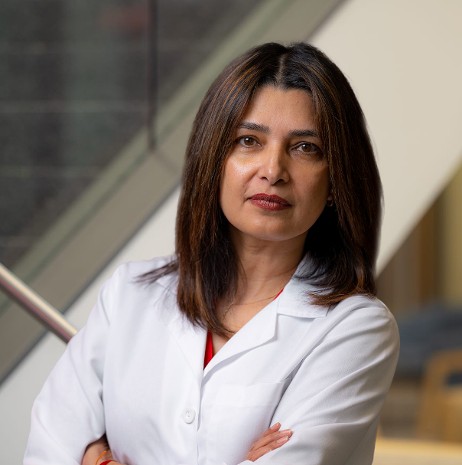
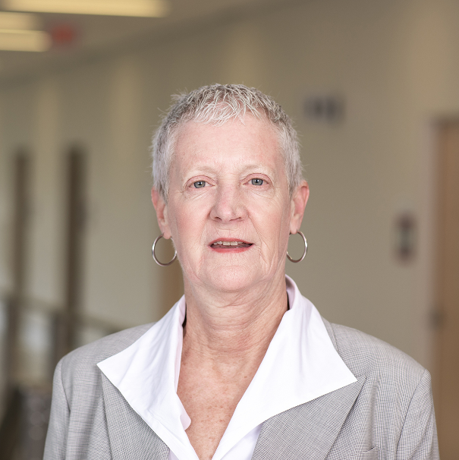
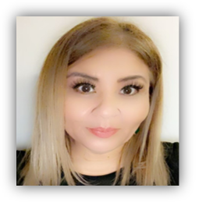
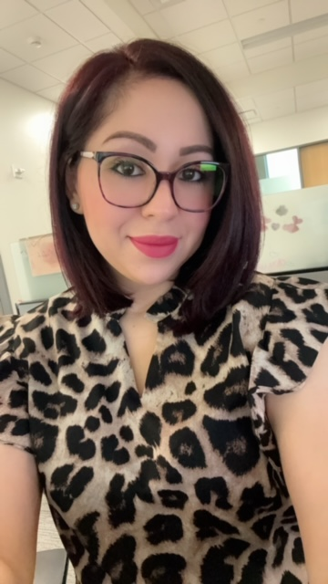
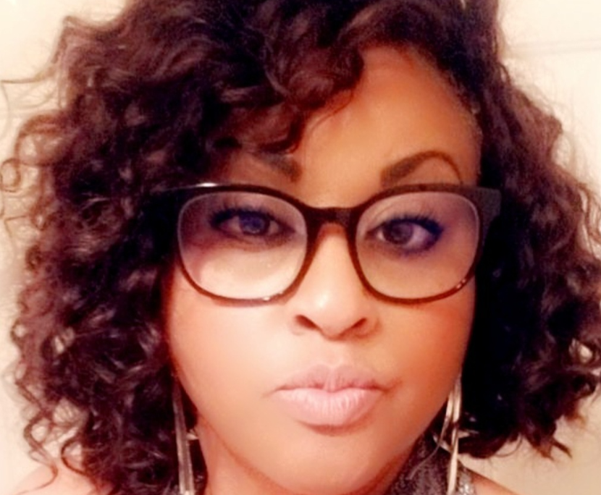
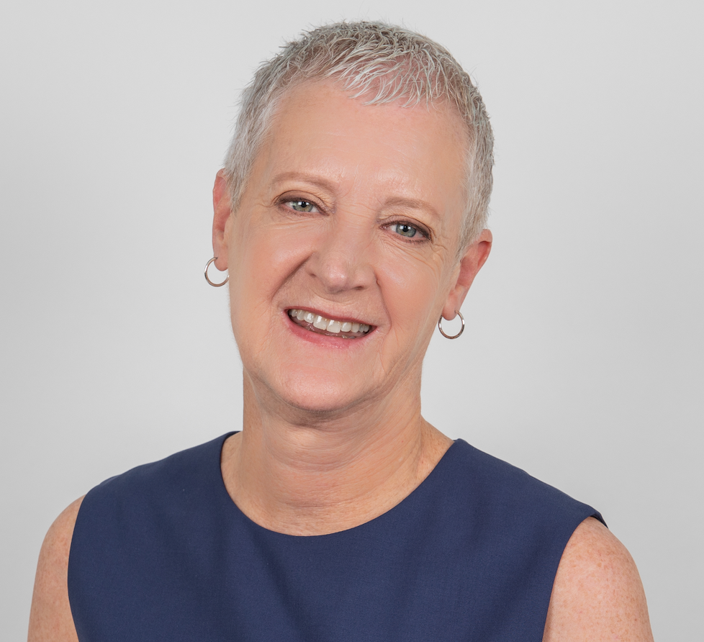
Longitudinal Primary Care Course Team
Dr. Amber Zulfiqar, M.D
LPC Course Director
Dr. Camille Leugers, M.D
LPC Course Co-Director
Lupita Rangel Curiel
LPC Program Manager
Esmeralda Machado
LPC Program Coordinator
Marie Stevens
LPC Program Coordinator

Slide 4
Office Hours/Contact Information
Amber Zulfiqar, MD Non-Emergency: amzulfiq@central.uh.edu
- Emergency: 832-573-4485
Camille Leugers, MD cleugers@central.UH.edu
-Emergency : 281-744-1851
Lupita R.Curielgrcuriel@uh.edu
956.543.4147
Office: 832.842.8331

Slide 5
Tilman J. Fertitta Family COM Mission :
Tilman J. Fertitta Family COM mission is educating a diverse group of physicians who will provide compassionate, high value care to patients, families and communities, with a focus on primary care and “engaging, collaborating with, and empowering patient populations & community partners to improve their health and healthcare.”

Slide 6
Course Description/Structure :
The Longitudinal Primary Care Course is 18 -month community-based ambulatory clinical experience in which students progressively develop their clinical skills under the guidance of a faculty preceptor during the pre-clerkship phase. The course is designed to provide students with the opportunity to practice the skills learned in the Physicians, Patients and Populations course and biomedical sciences, in an ambulatory settings.

Slide 7
LPC 1: Breakdown Per Semester
LPC 1 is broken down into LPC 1A and LPC 1B
LPC 1A (Fall Semester) July 22, 2024 - Dec 6, 2024
LPC 1B (Spring Semester) Jan 2, 2025 – Jun 6, 2025
MS1 are off for Summer (Mid June to August 1)

Slide 8
Expectations of students:
During the course :
Students are required to attend weekly sessions at their assigned clinical site
In general students are required to spend 4 hours in the clinic
You will be assigned one or more MS1 or MS2
Students assigned as MS1 will continue to work with the preceptor for 18 months

Slide 9
Expectations of students:
If they miss a session for any reason, OK to make up the activity during the semester. They must notify you
ONLY allowed LPC excused absences are; HCC visits, HCC Seminars, and CFS week ( s) . They WILL NOT need to make these hours
Notes:
Our team will Notify you in advance

Slide 10

LPC 1A Objectives:
By the end of LPC 1A Student will be able to:
Obtain histories in outpatient settings with all the pertinent elements* in acute conditions that are complete, accurate and organized
Demonstrate the ability to routinely perform a system-focused physical, using proper technique (Vitals, General survey, HEENT, Neck, CV/RESP, Abdominal Exam)
Establishes rapport with patients by demonstrating care and compassion in all patient encounters
Document a history and system-focused physical exam
Routinely performs an organized oral presentation for a clinical encounter.
Notes:
Course objectives have been send to you. We will appreciate you signing the attestation form and sending them back to us.

Slide 11
LPC 1B Objectives:
By the end of LPC 1B Student will be able to:
Obtain histories in outpatient settings with all the pertinent elements* in chronic conditions that are complete, accurate and organized
Demonstrate the ability to routinely perform a system-focused physical, using proper technique (integument, heme-lymph, nervous system, musculoskeletal and GI)
Establishes rapport with patients by demonstrating care and compassion in all patient encounters
Document a history and system-focused physical exam
Routinely performs an organized oral presentation for a clinical encounter.

Slide 12
LPC 2A Objectives:
By the end of LPC 2A Student will be able to:
Obtain histories that are complete*, accurate, organized, and focused for health maintenance
2. Demonstrate the ability to routinely perform a complete, system-
focused physical, using proper technique (integument, heme-lymph,
nervous system, musculoskeletal ,GI, CV respiratory, renal, GU and
psychiatric )
3. Effectively establishes rapport with patients, by demonstrating care and
compassion and using patient-centered language
4. Document a thorough history and system-focused physical exam
5. Routinely performs a well-organized, focused oral presentation for a
clinical encounter.
6. Generates a problem-focused differential diagnosis based on positive
and negative findings

Slide 13
LPC 2B Objectives:
By the end of LPC 2B Student will be able to:
Obtain histories that are complete*, accurate, organized, and focused for health maintenance
2. Demonstrate the ability to routinely perform a complete, system-
focused physical, using proper technique (integument, heme-lymph,
nervous system, musculoskeletal ,GI, CV respiratory, renal, GU and
psychiatric )
3. Effectively establishes rapport with patients, by demonstrating care and
compassion and using patient-centered language
4. Document a thorough history and system-focused physical exam
5. Routinely performs a well-organized, focused oral presentation for a
clinical encounter.
6. Generates a problem-focused differential diagnosis based on positive
and negative findings

Slide 14
Role and responsibility of preceptors:
Preceptor of Student Assessments are REQUIRED.
2 times per semester
General Comments are REQUIRED.

Slide 15
Preceptor of Student Assessments:
Preceptor of Student Assessment Dates:
Fall 2024 (LPC 1A)
Formative
Mid-term - Opens - Oct 14, 2024
Due By - Oct 18, 2024
Summative
Final - Opens - Dec 2, 2024
Due By - Dec 9, 2024
Spring 2025 (LPC 1B)
Mid-term - Opens - Feb 24, 2025
Due By - Mar 3, 2025
Final- Opens - May 26, 2025
Due By - Jun 2, 2025

Slide 16
Preceptor Assessment of Student
For Midterm Formative we require you to meet in person with your student to identify their strengths and weaknesses and develop an improvement plan in a timely manner.
For summative Assessment , we require you to meet in person with your student
* We appreciate completion of the assessments in timely manner as required by LCME

Slide 17
LPC 2 Preceptor of Student Assessments:
Preceptor of Student Assessment Dates:
Fall 2024
Mid-term - Opens - Sept 23, 2024 -
  Due By- Sept 27, 2024
Final - Opens Dec 02, 2024 -
Due By- Dec 06, 2024
Spring 2025
Final - Opens Feb 10, 2025 -
Due By -Feb 17, 2025

Slide 18
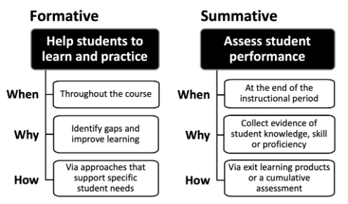
Difference between Formative and Summative
https://www.celt.iastate.edu/instructional-strategies/evaluating-teaching/assessment-overview/

Slide 19

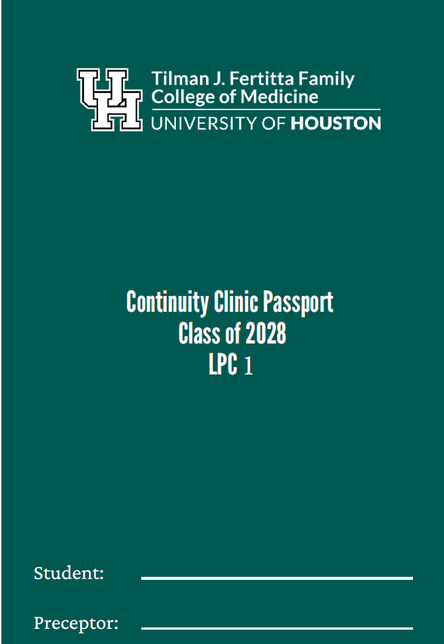

Slide 20
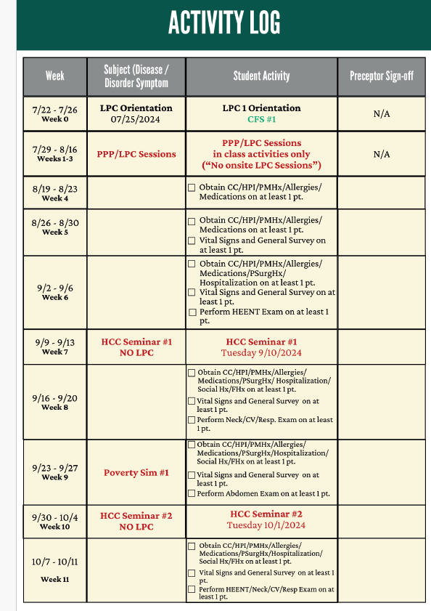
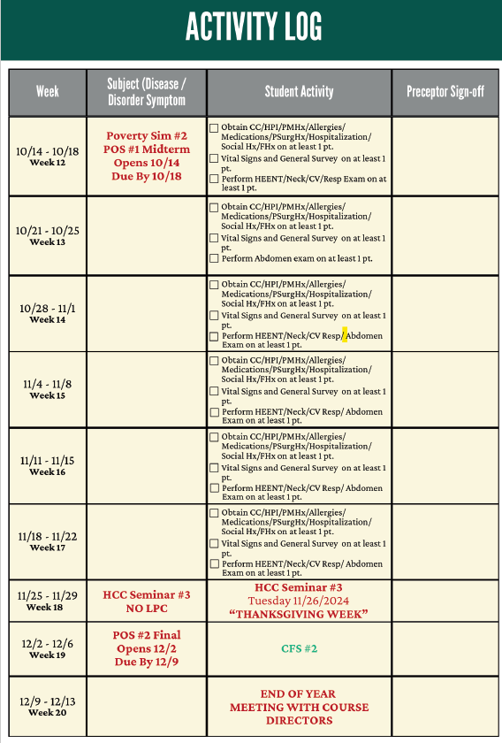
LPC 1A PASSPORT

Slide 21
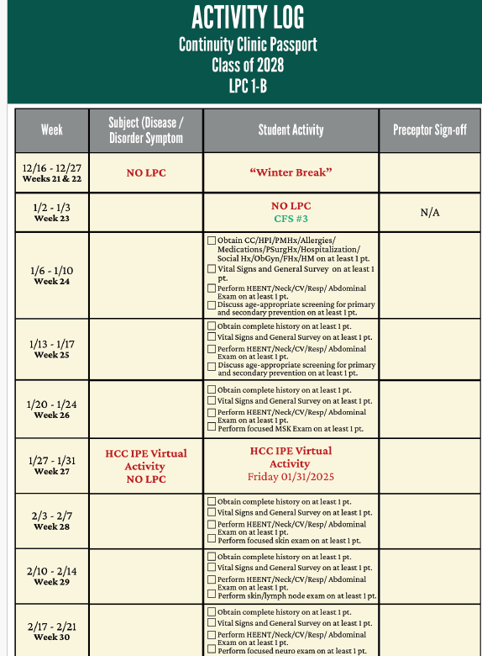
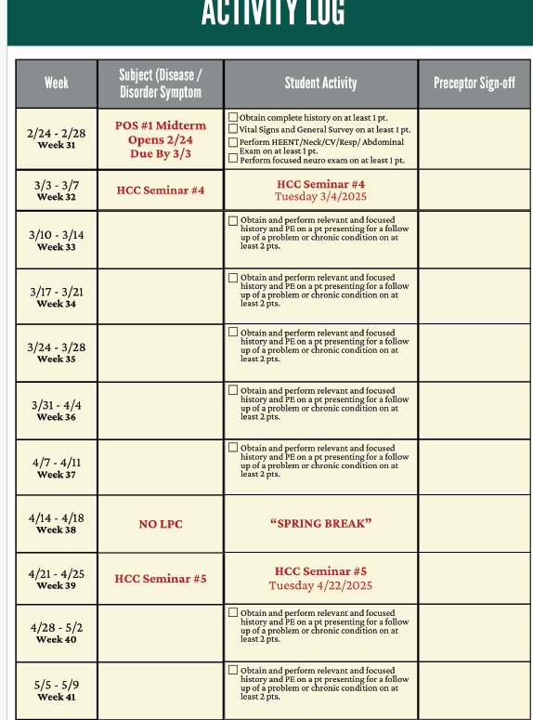
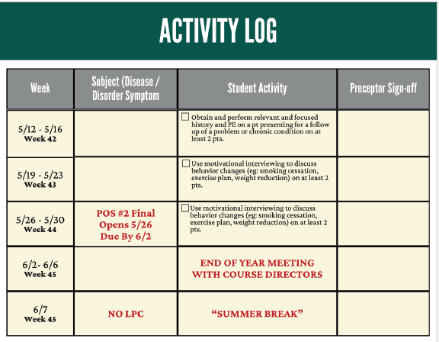
LPC 1B PASSPORT

Slide 22
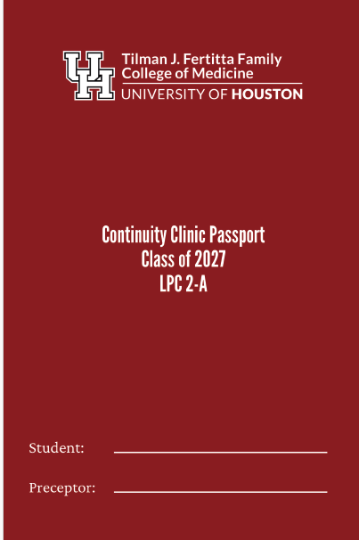


Slide 23
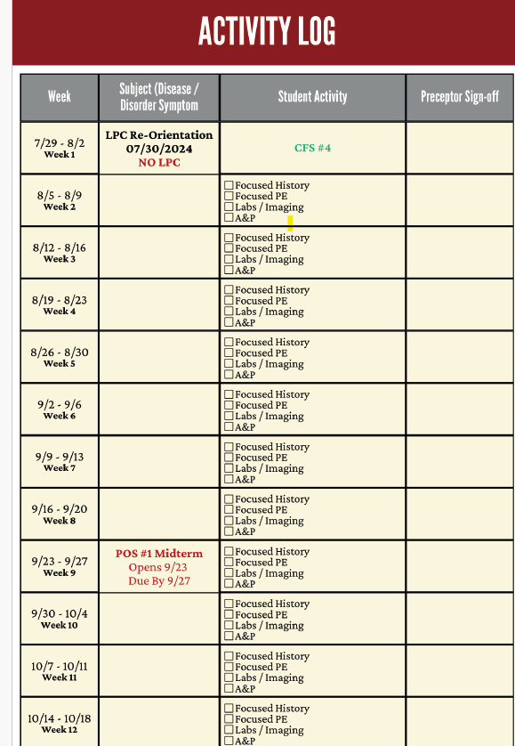
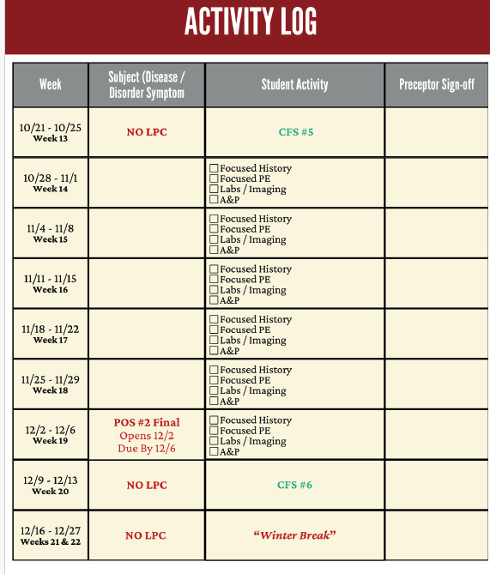
LPC 2A Passport

Slide 24
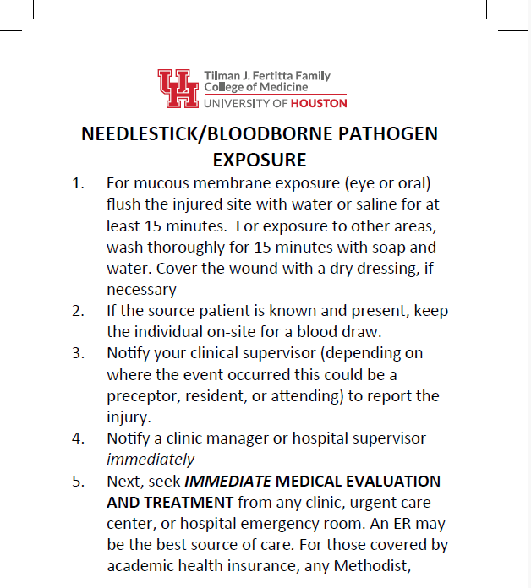
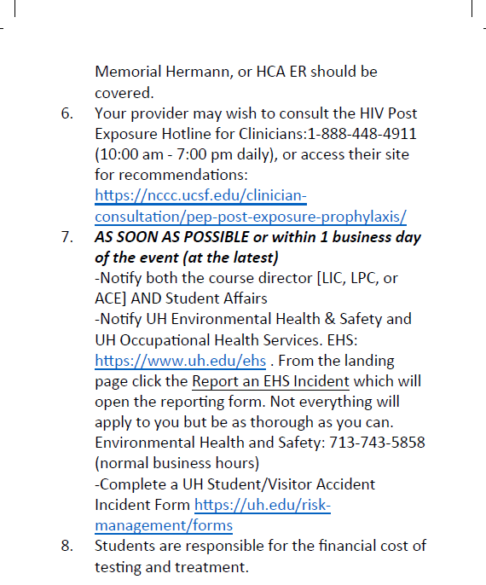
Needlestick/Bloodborne Pathogen Exposure

Slide 25
Student Professionalism
We expect students to behave professionally and need to hear from you if you have any concerns

Slide 26
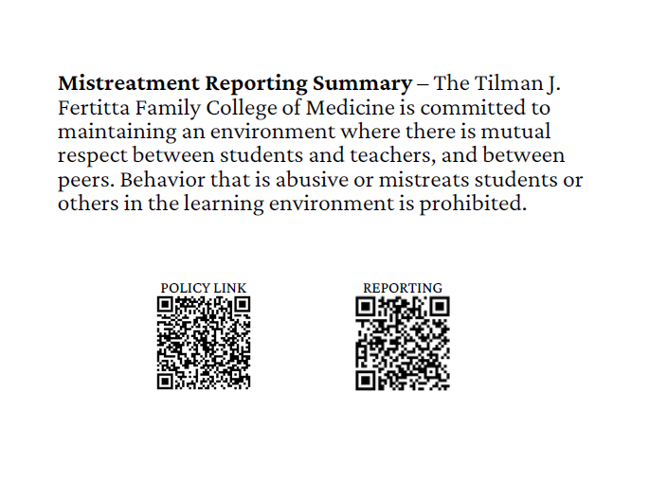
Mistreatment Policy

Slide 27

Professionalism
Embarrassment:
Based on something we do to ourselves
Humiliation:
Based on something others do to us or we do to others
It’s ok to be embarrassed. It is not ok to humiliate or to be humiliated.

Slide 28
Continuing Professional Development Reimbursement (CPD) Policy
The CPD policy is based on and subject to the rules and requirements published by the IRS.
A preceptor is eligible for CPD reimbursement if the preceptor: Is scheduled for a minimum of 20 full days of direct teaching and supervision of their assigned student(s)within the current academic year; AND,
Provides regular real-time oral and written feedback for their assigned student (e.g. by completing requested session and course assessments of their student); AND,
Maintains all requirements for a faculty appointment at the TJFFCOM, including completing all faculty appointment credentialing and onboarding requirements.
At any time, if a preceptor drops out or does not have a student assigned to them, they are no longer eligible for CPD reimbursement.
More information on this policy will be provided as well as contact information to submit your request.

Slide 29
Documents to sign :
Faculty Affairs - University of Houston (uh.edu)
Syllabus Attestation

Slide 30

Questions & Answers

