Slide 1

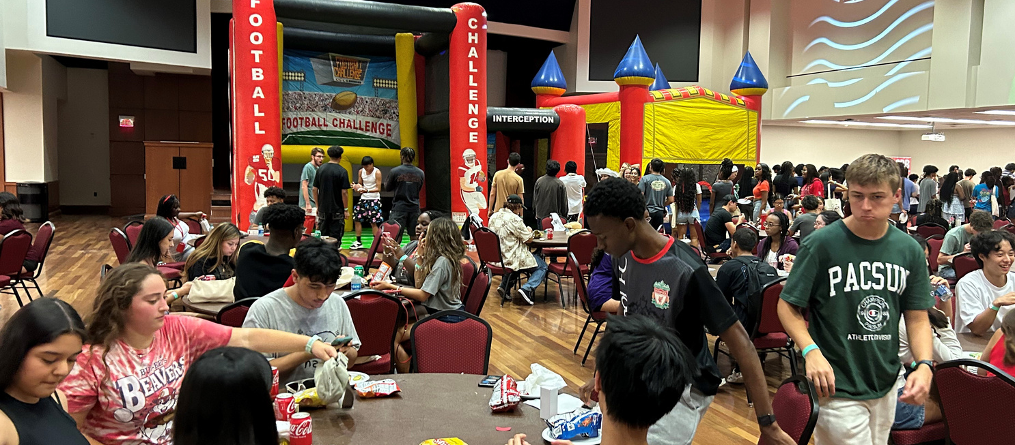
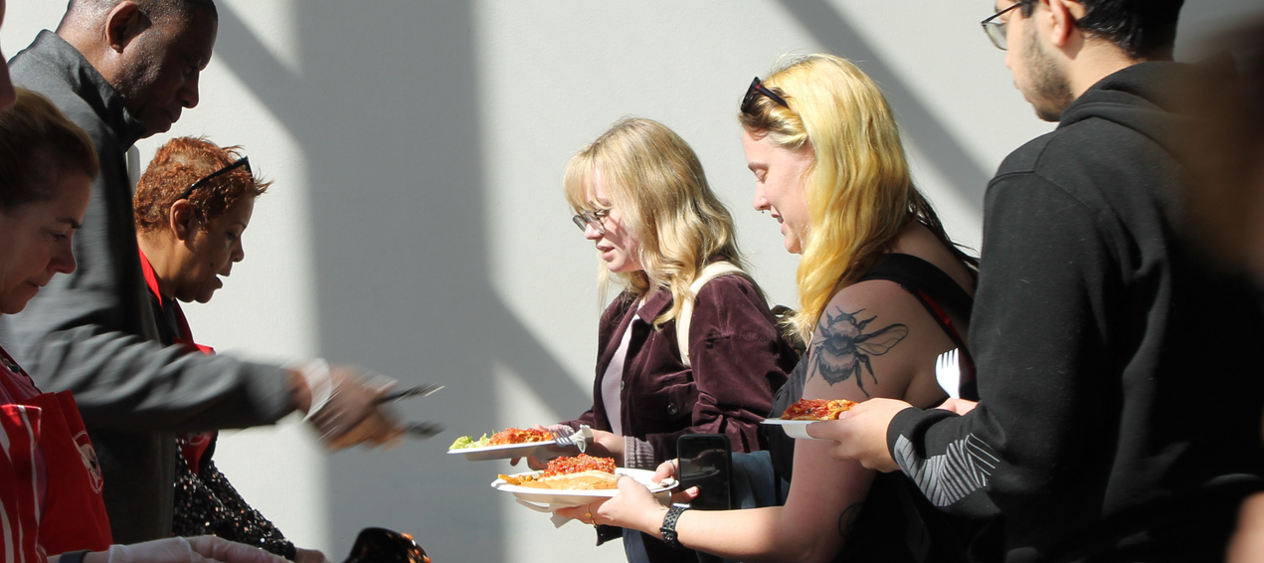
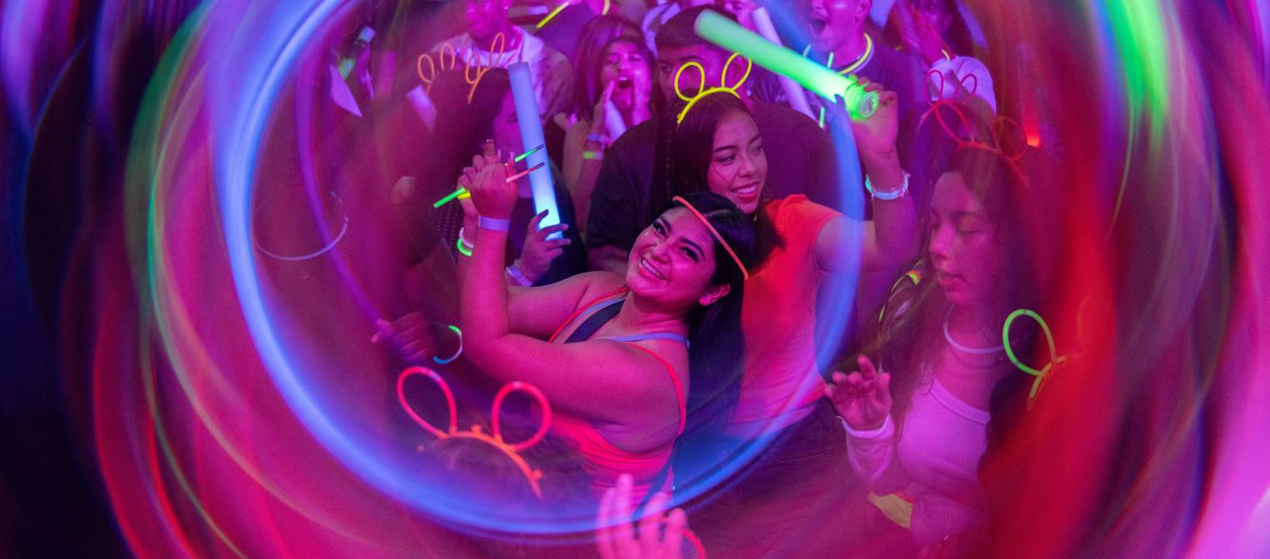
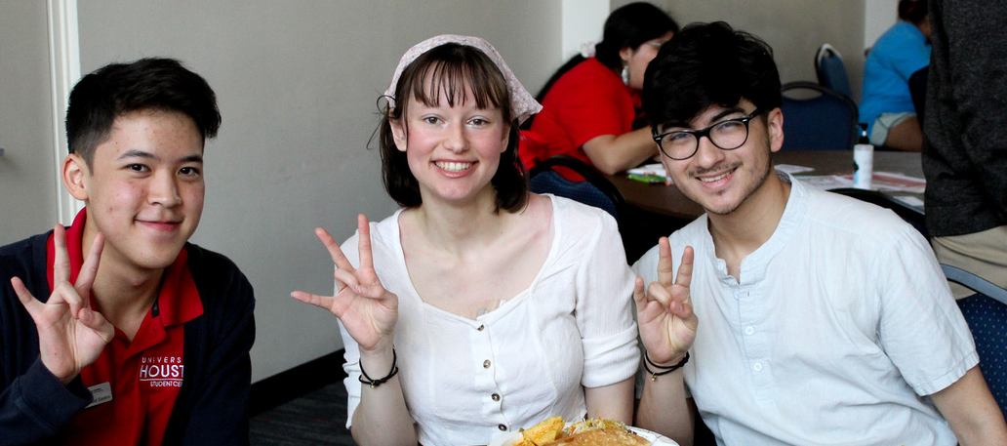
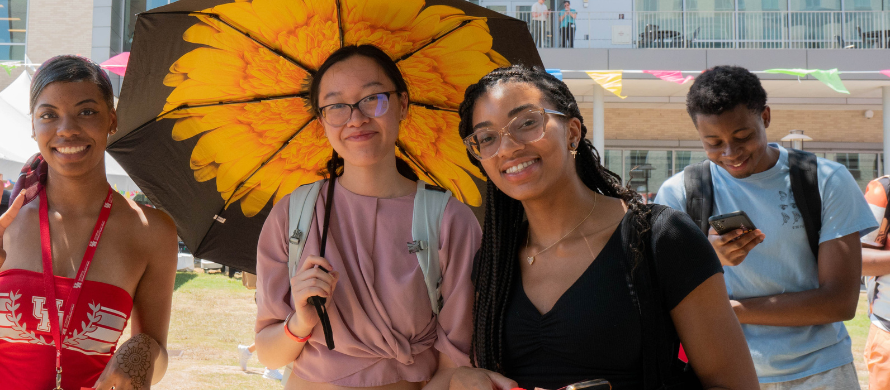
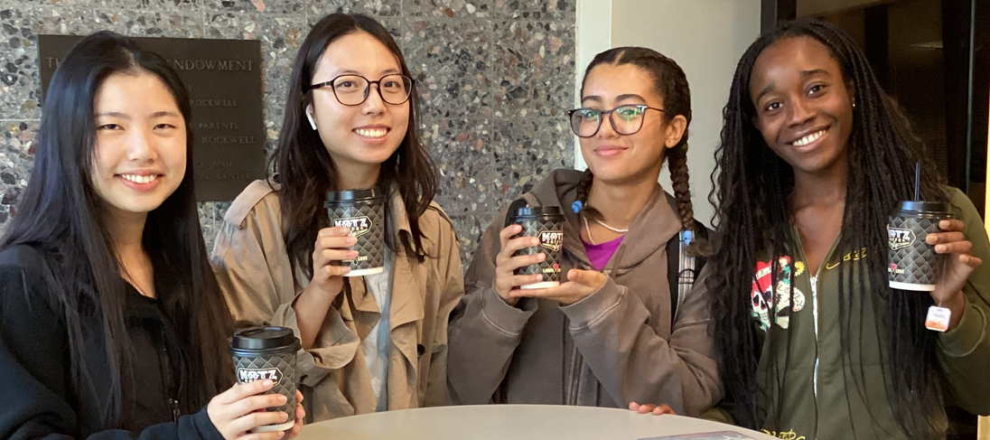


A.D. BRUCE RELIGION CENTER
SFAC FY 25-26

Slide 2
MISSION – VISION – CORE VALUES
The A.D. Bruce Religion Center embraces, celebrates and fosters spiritual and religious experiences of the diverse University of Houston community.
MISSION – VISION – CORE VALUES
The A.D. Bruce Religion Center envisions a campus in which spirituality and religion integrate with the university experience.
MISSION – VISION – CORE VALUES
Community
Collaboration
Customer Service
Discovery

Slide 3
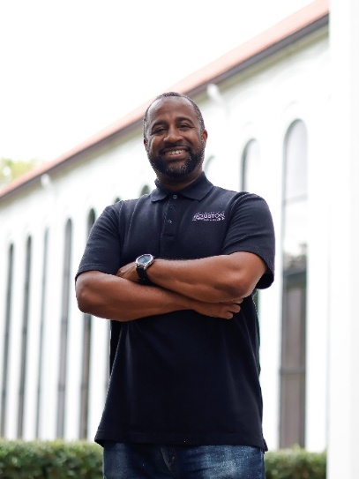
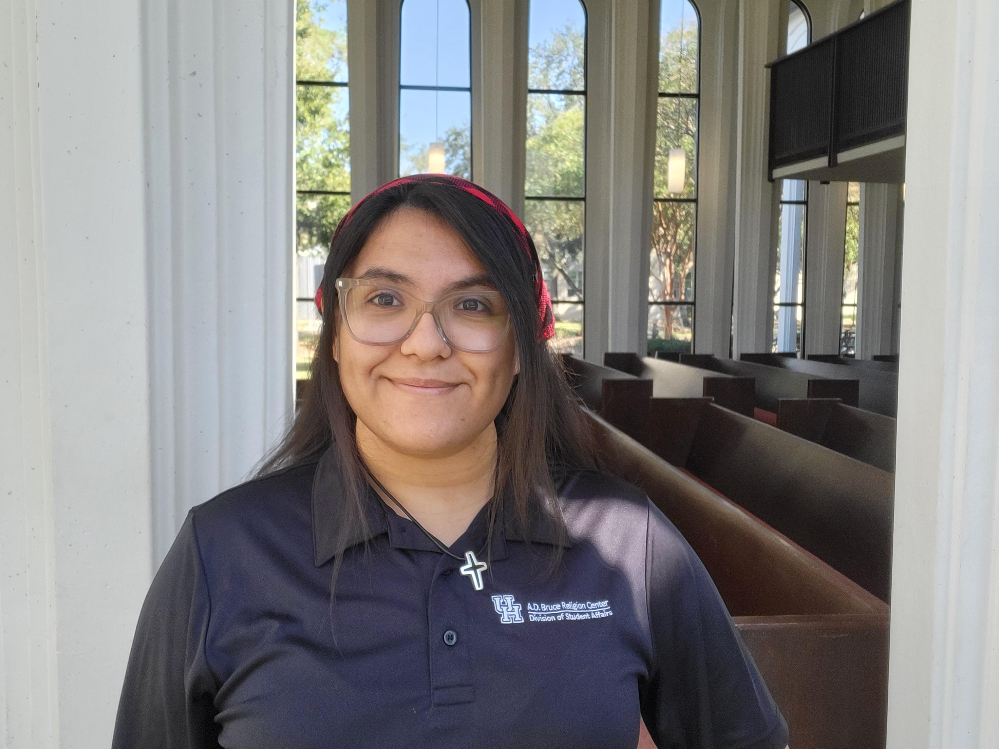
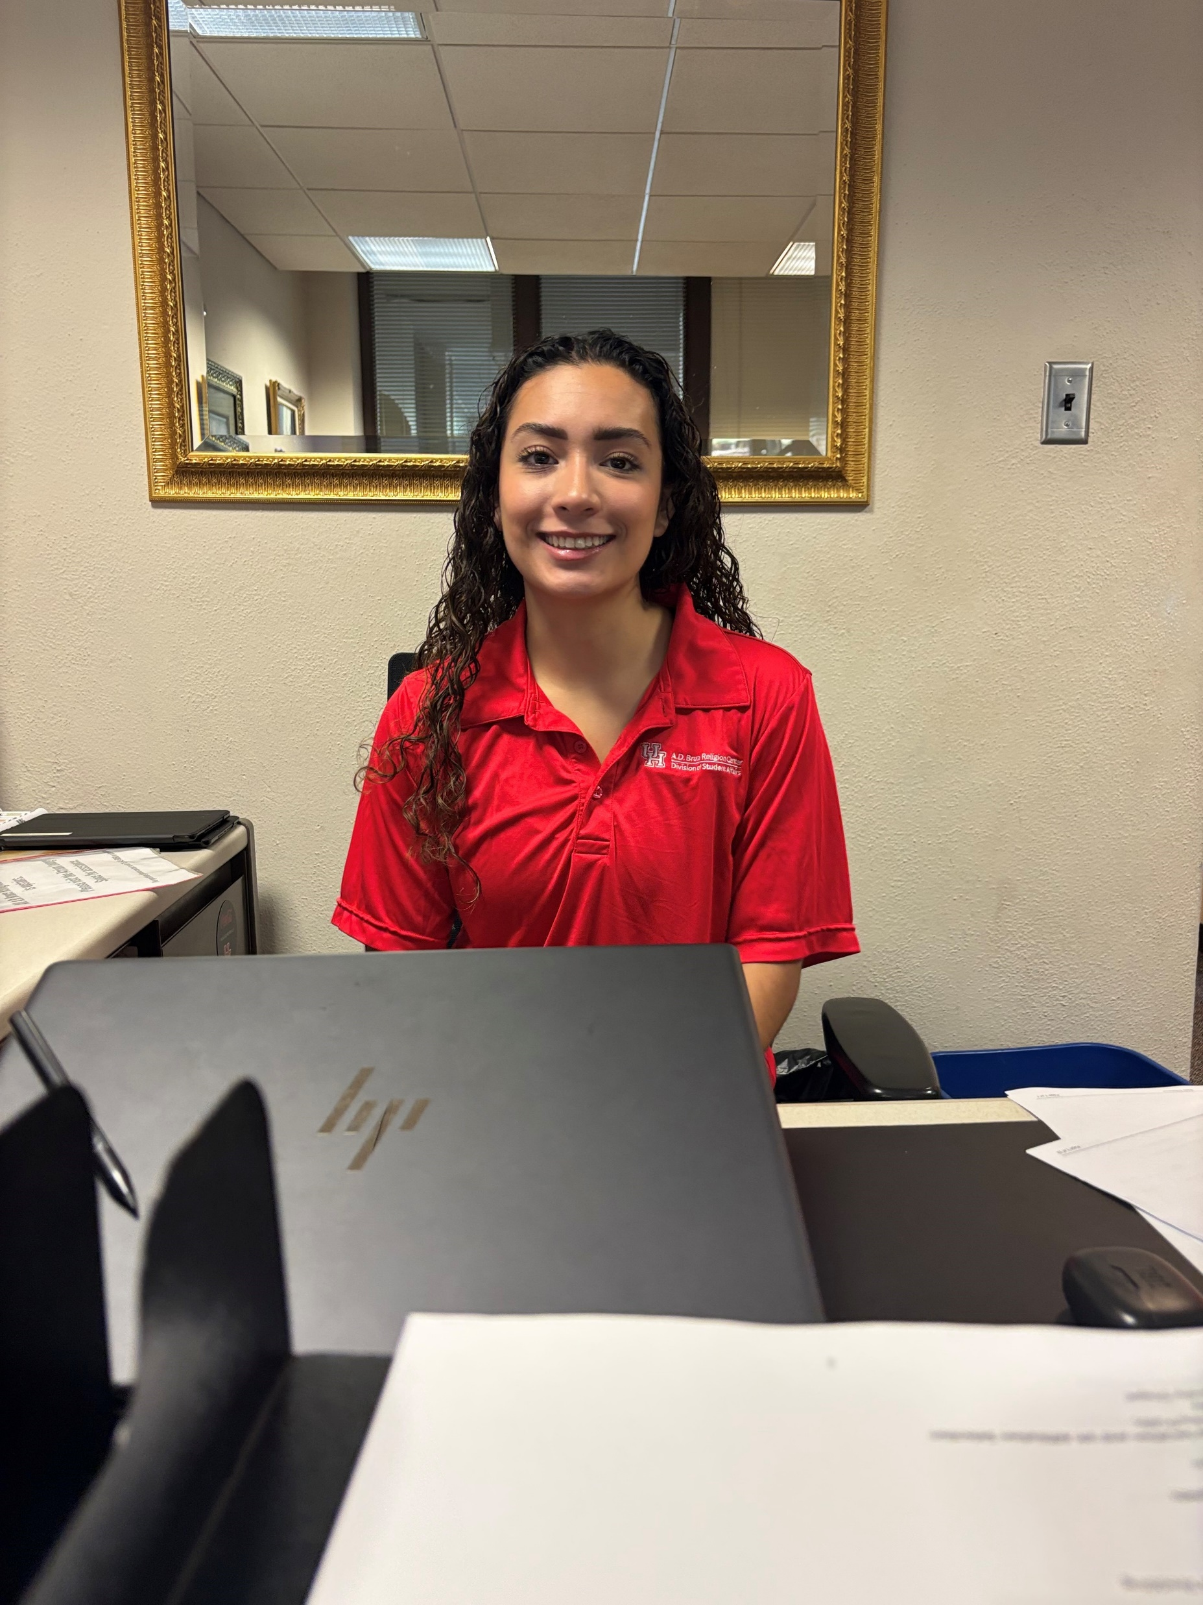
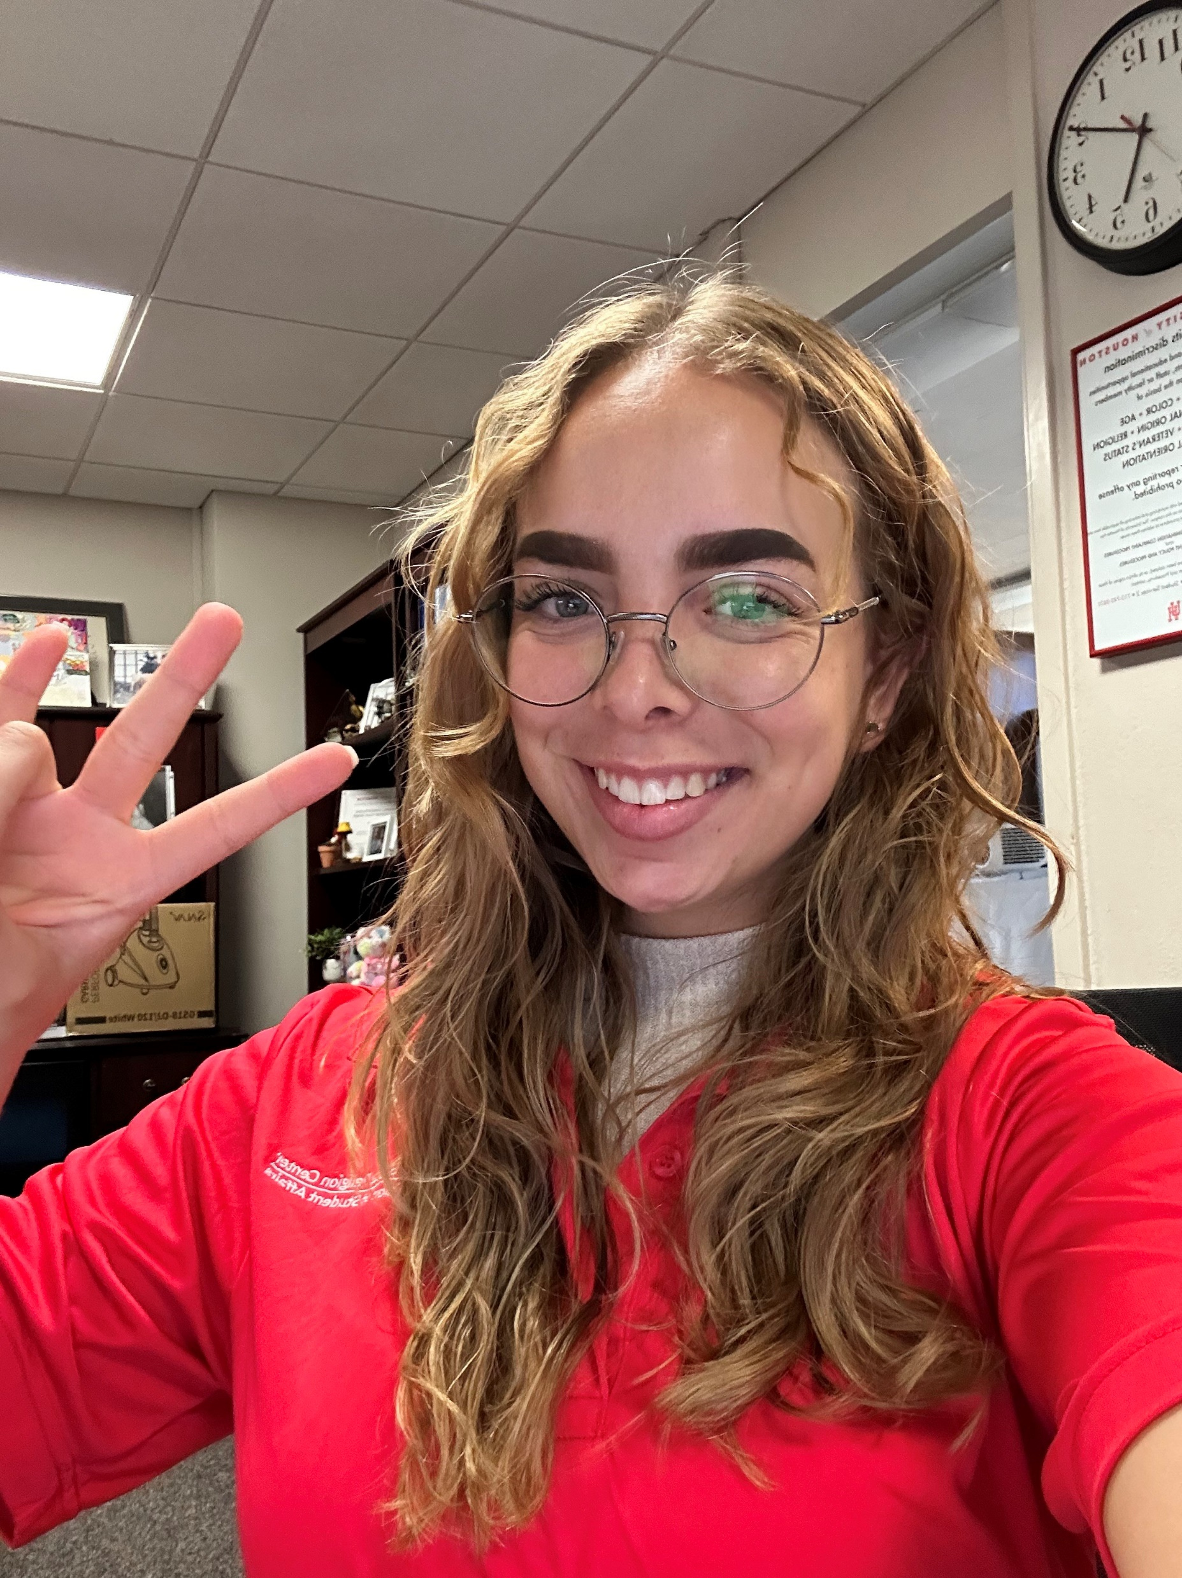
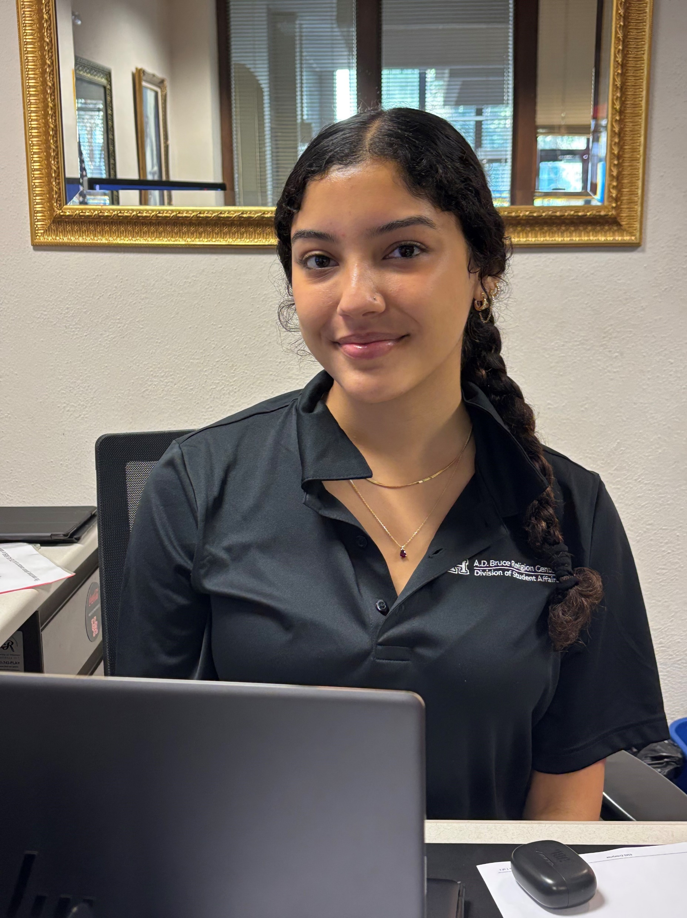
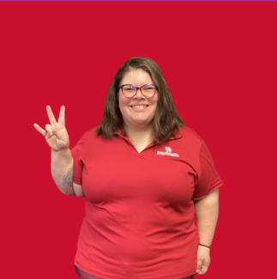
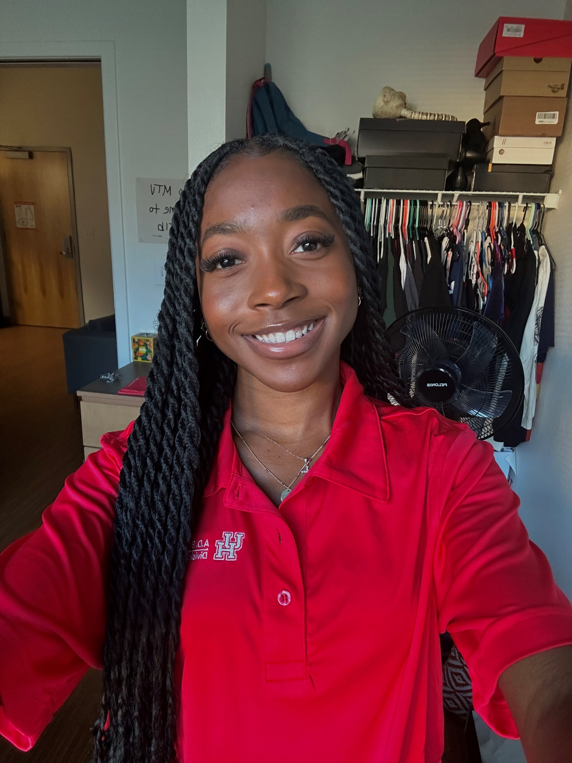
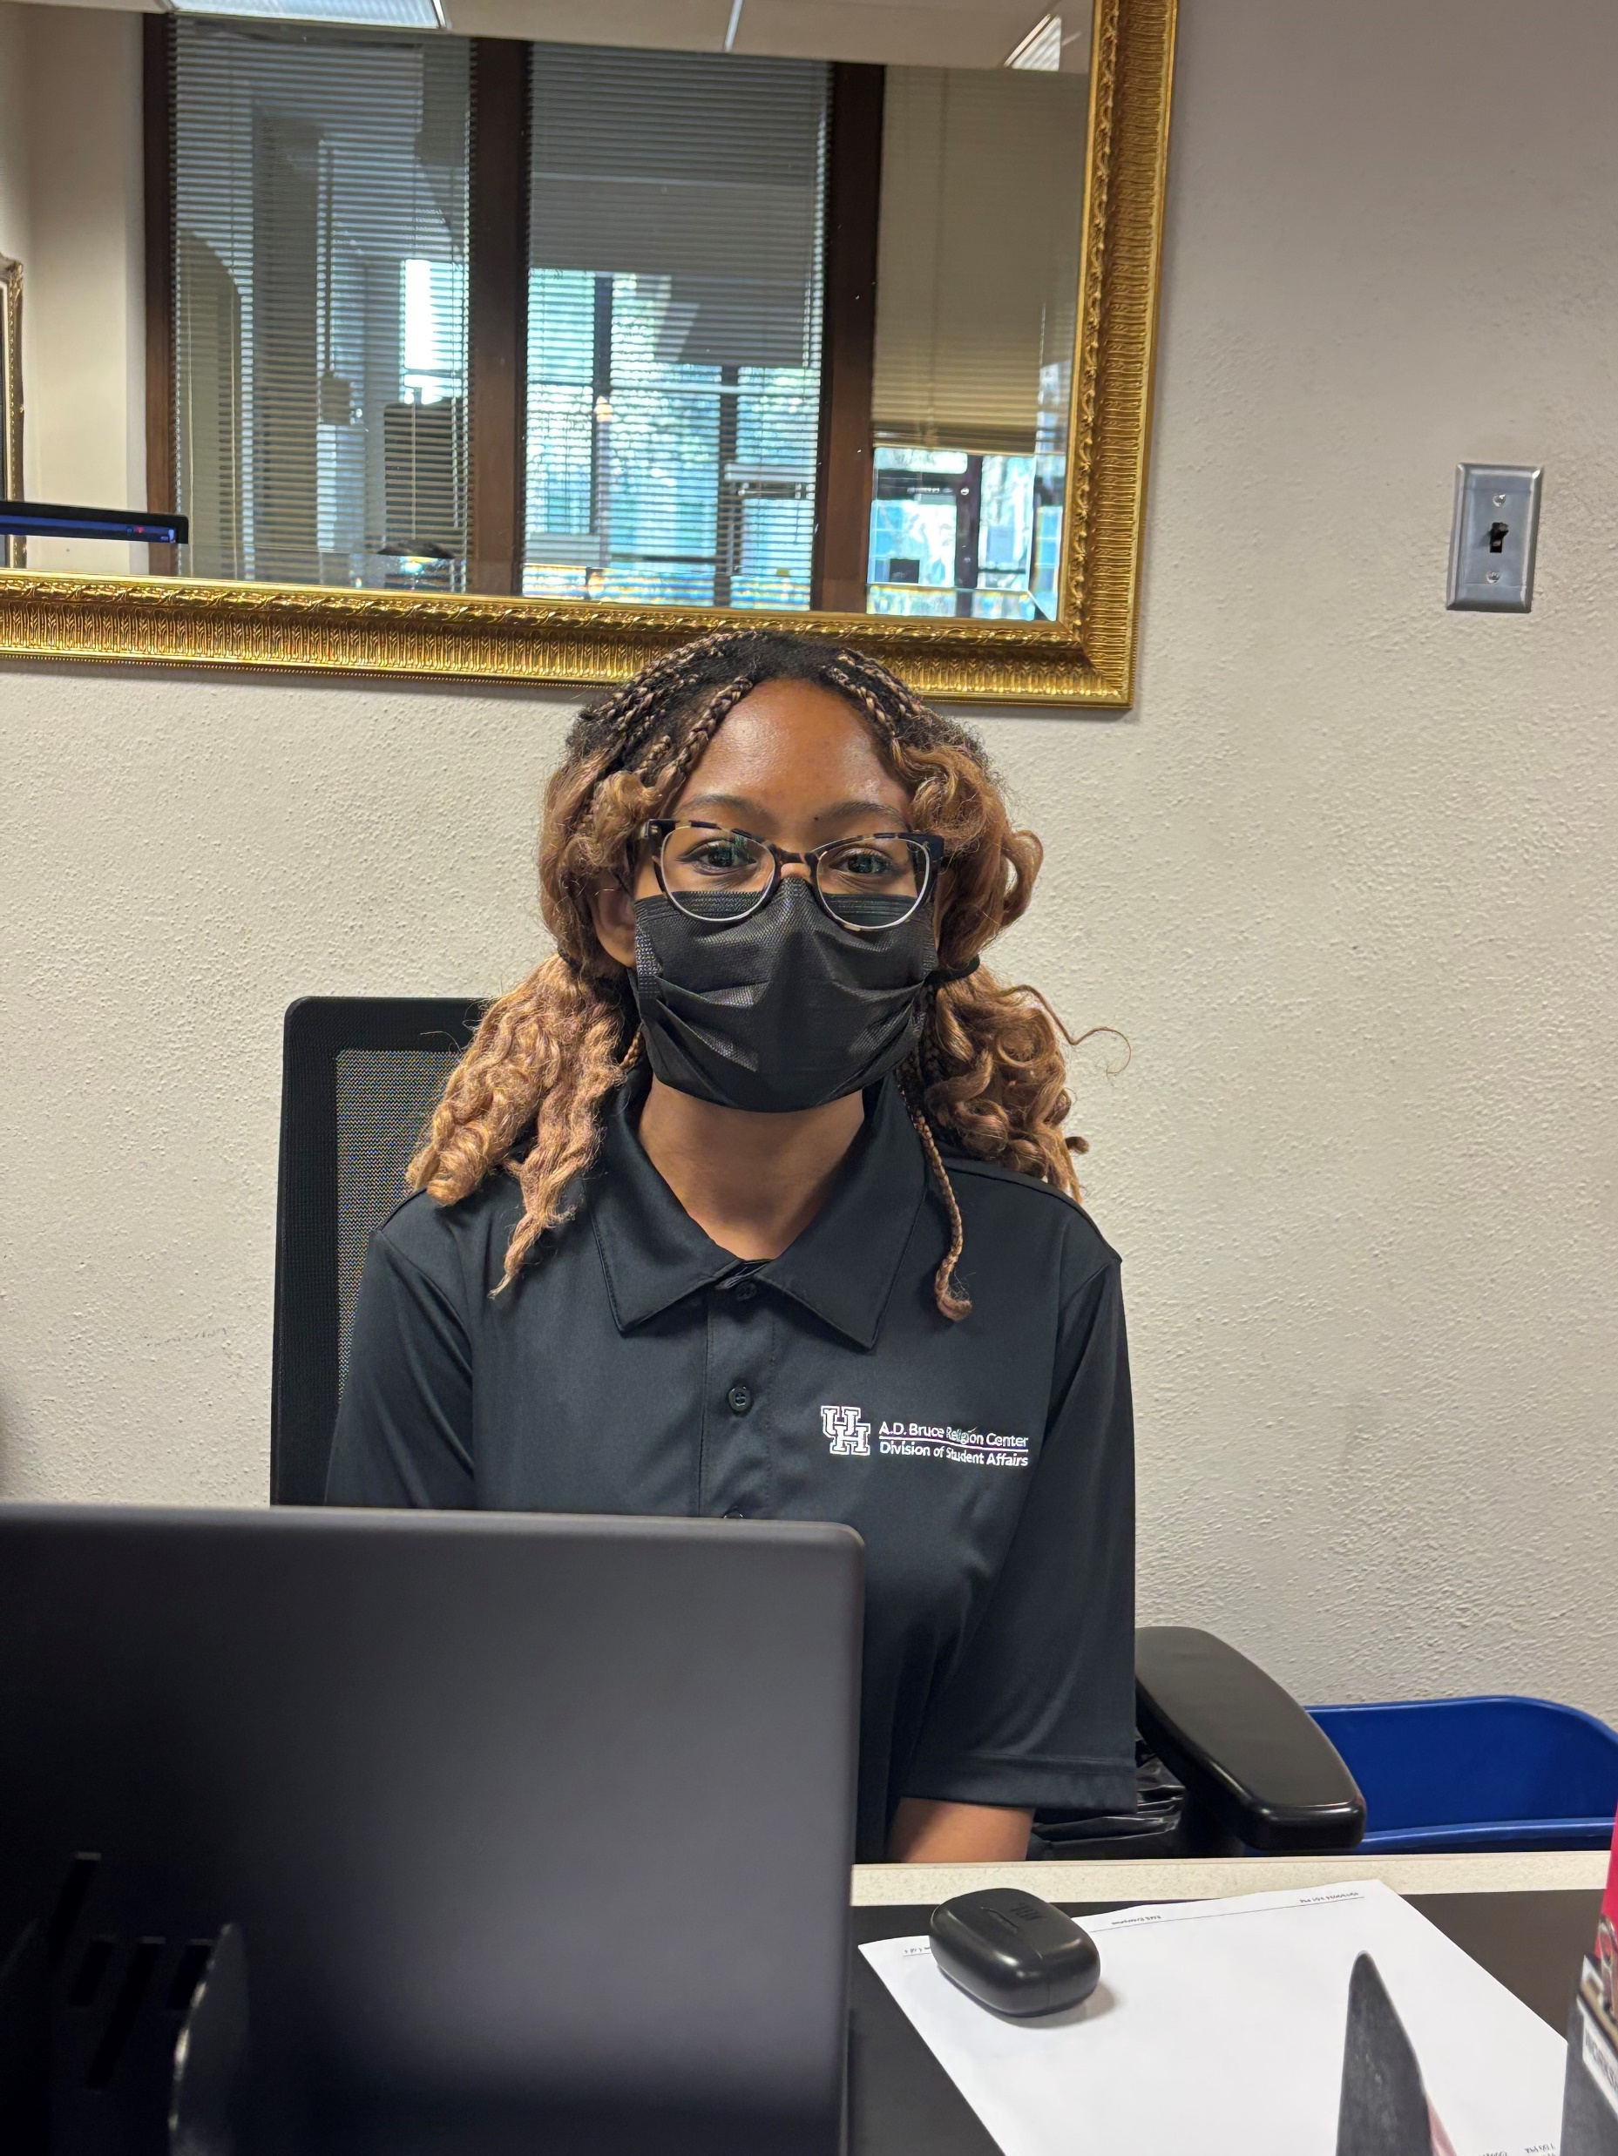
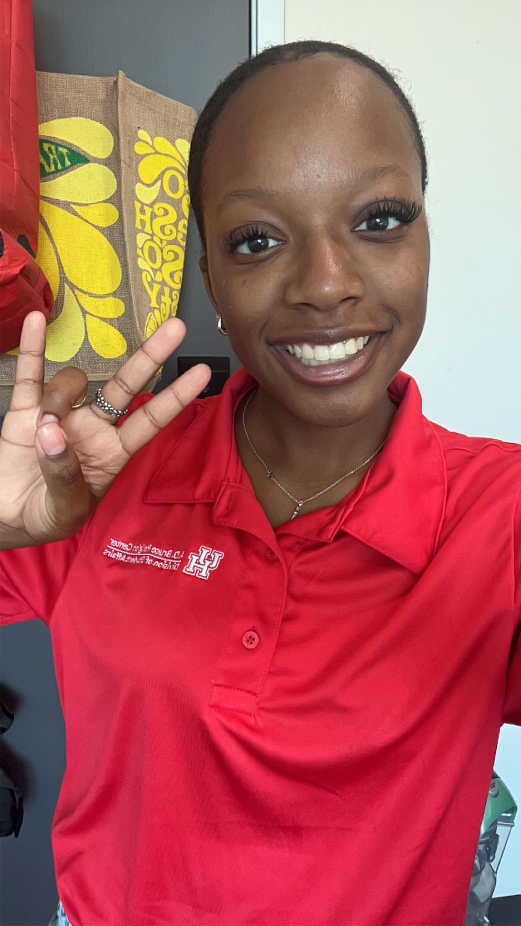
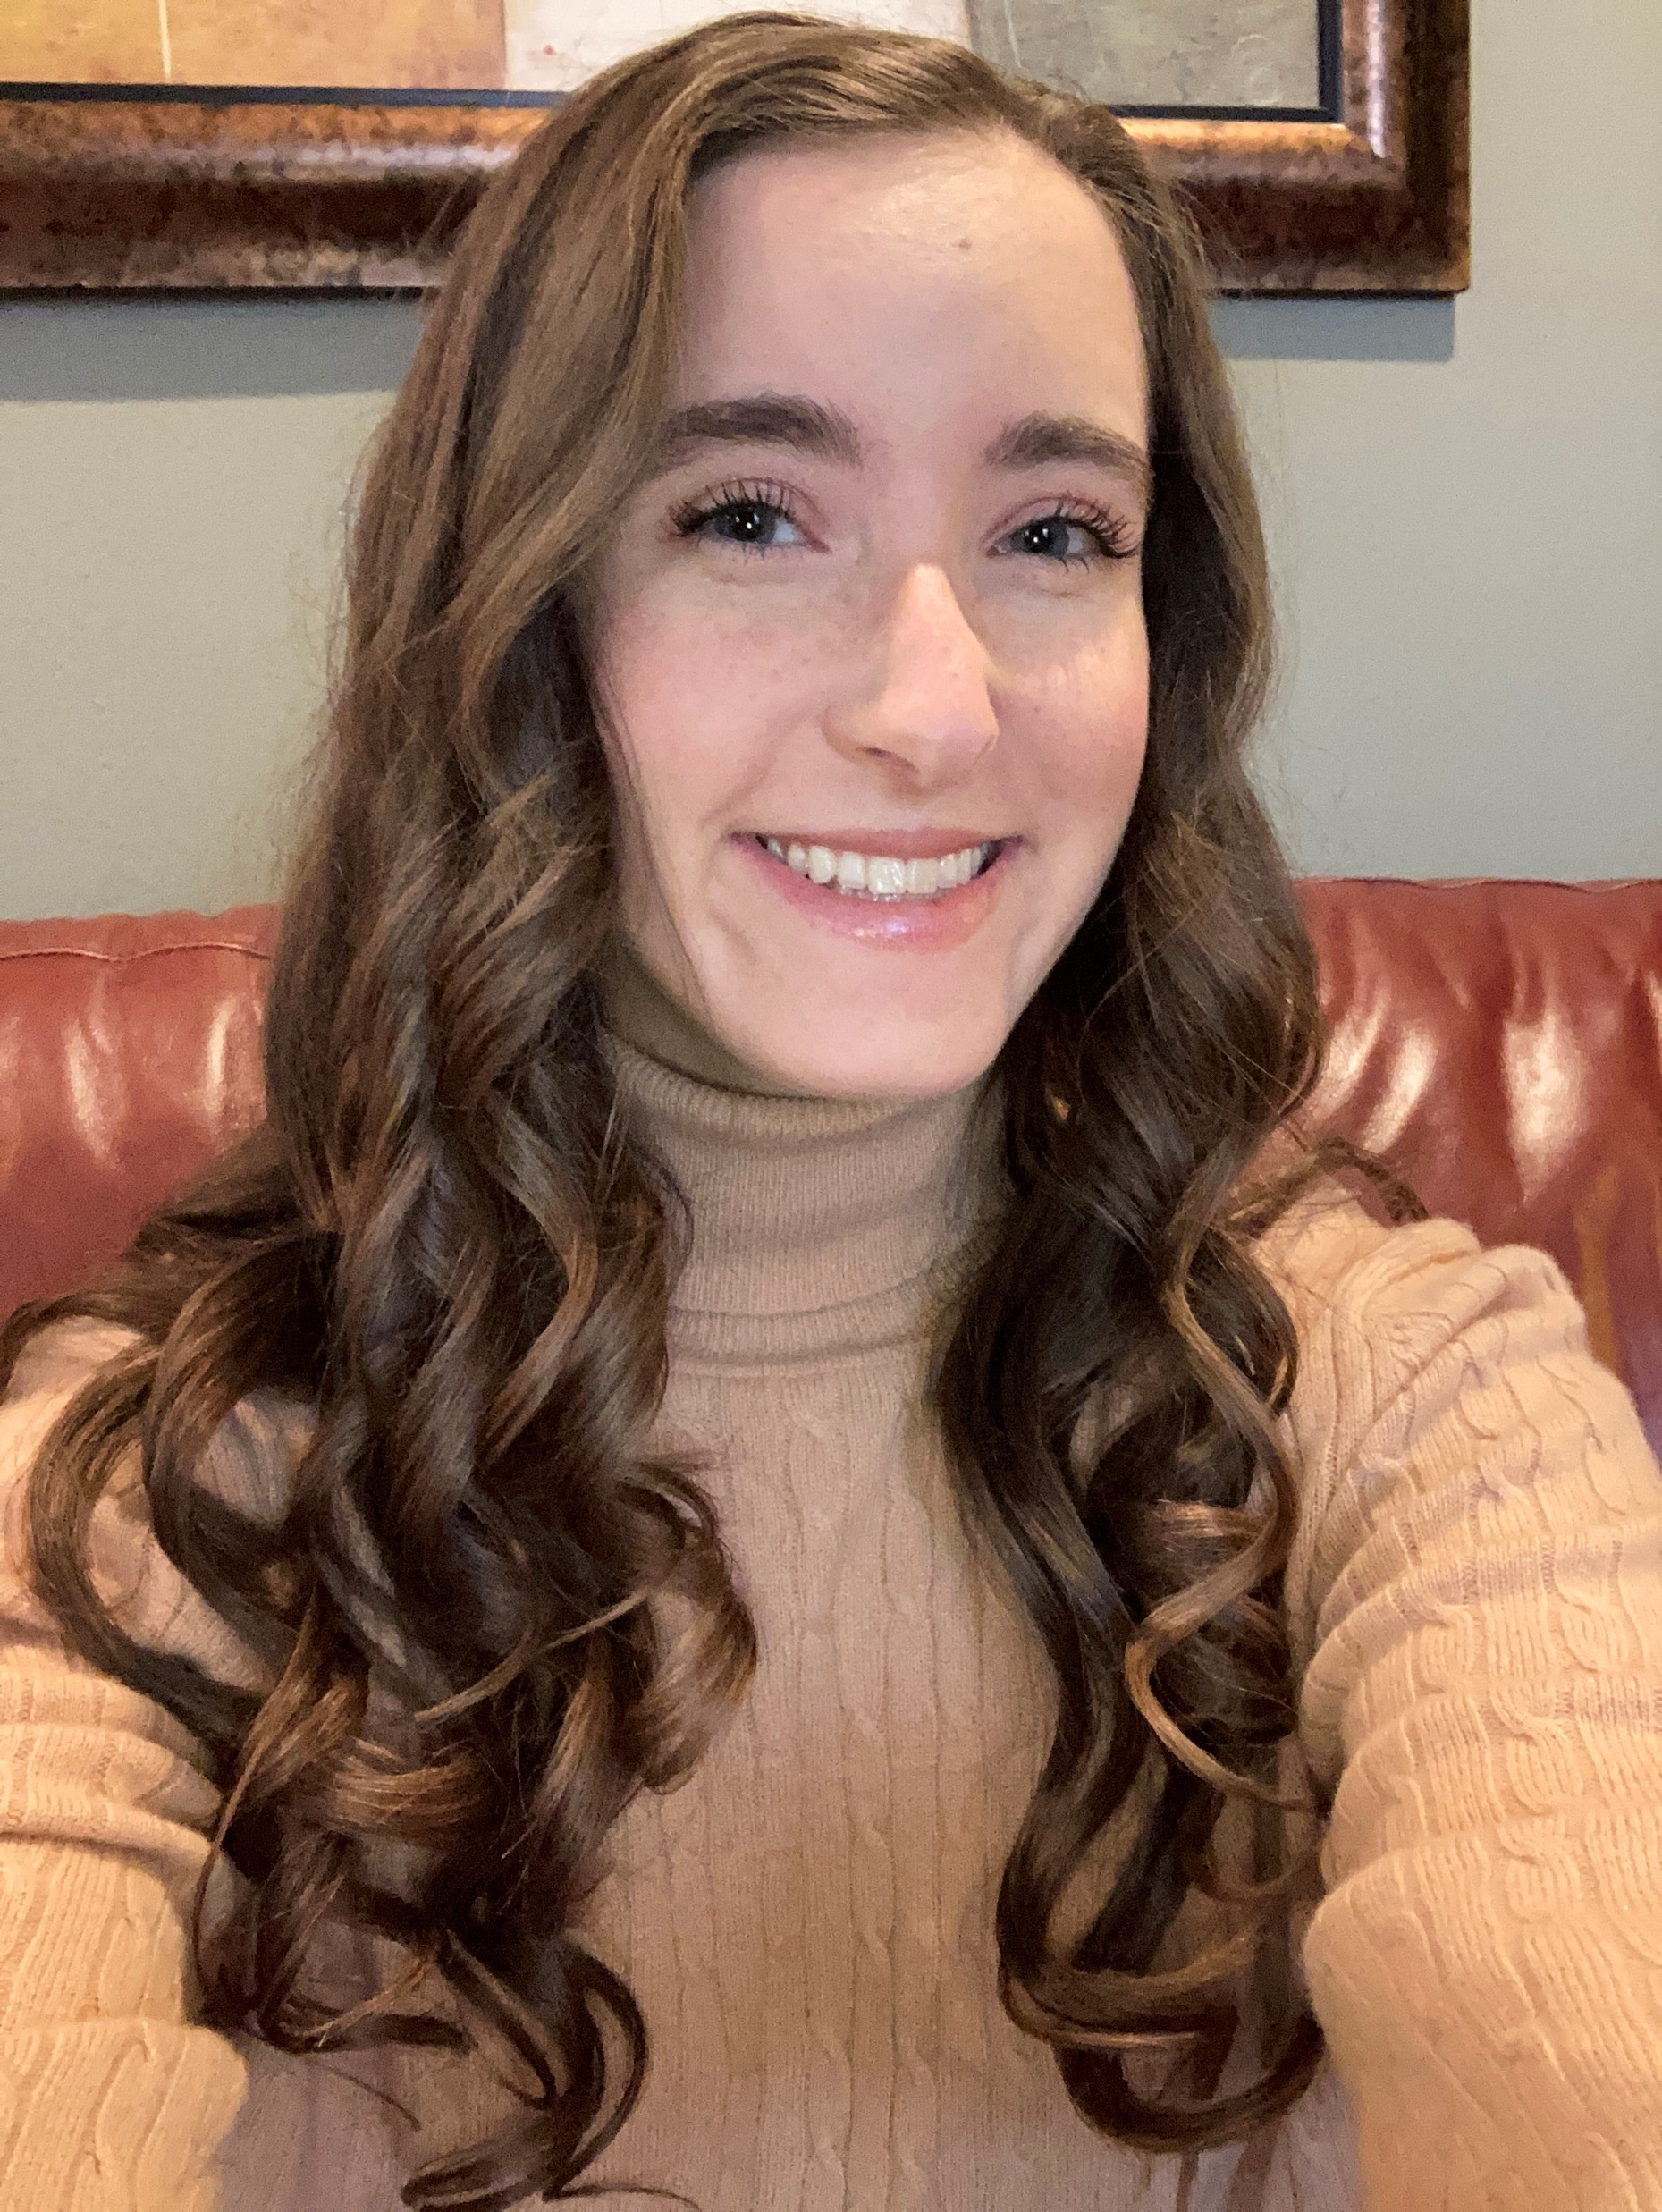
OUR STAFF!
André J. Adams
Director
Mystique
Ximena
Paola
Thakurani
Cheyenne Peer
Events & Administrative
Coordinator
LaResa
Trenise
Katie
Morgan

Slide 4
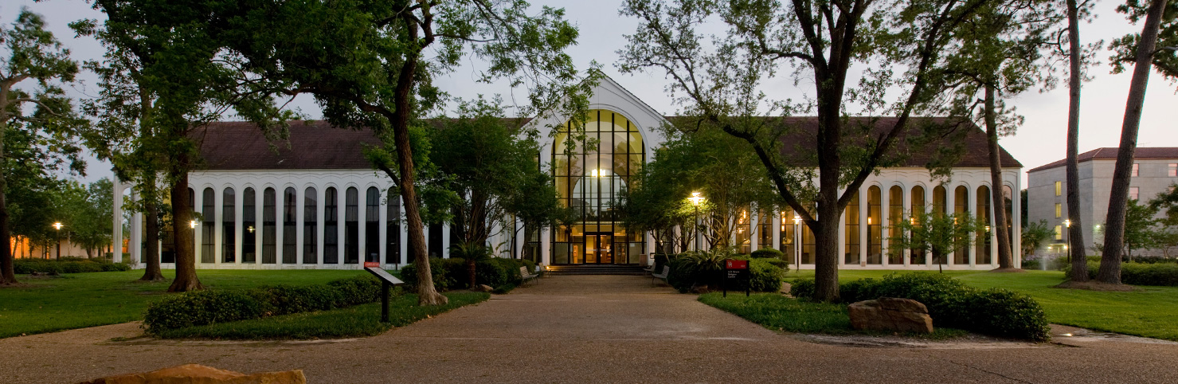
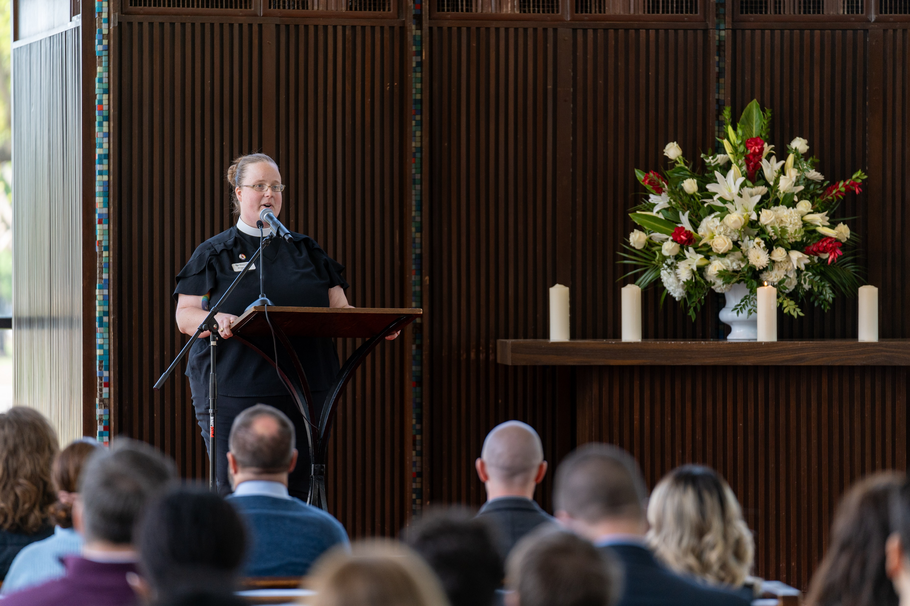
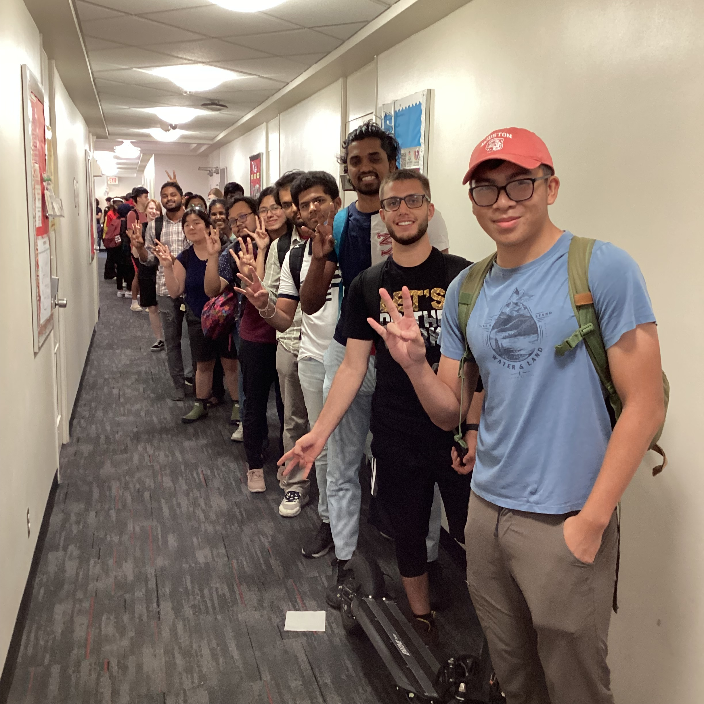
Who We Are!
Almost 60 years old…
13 Campus Ministries
1,000 Students Weekly
One of the Smallest
Staffed Depts in DSA

Slide 5
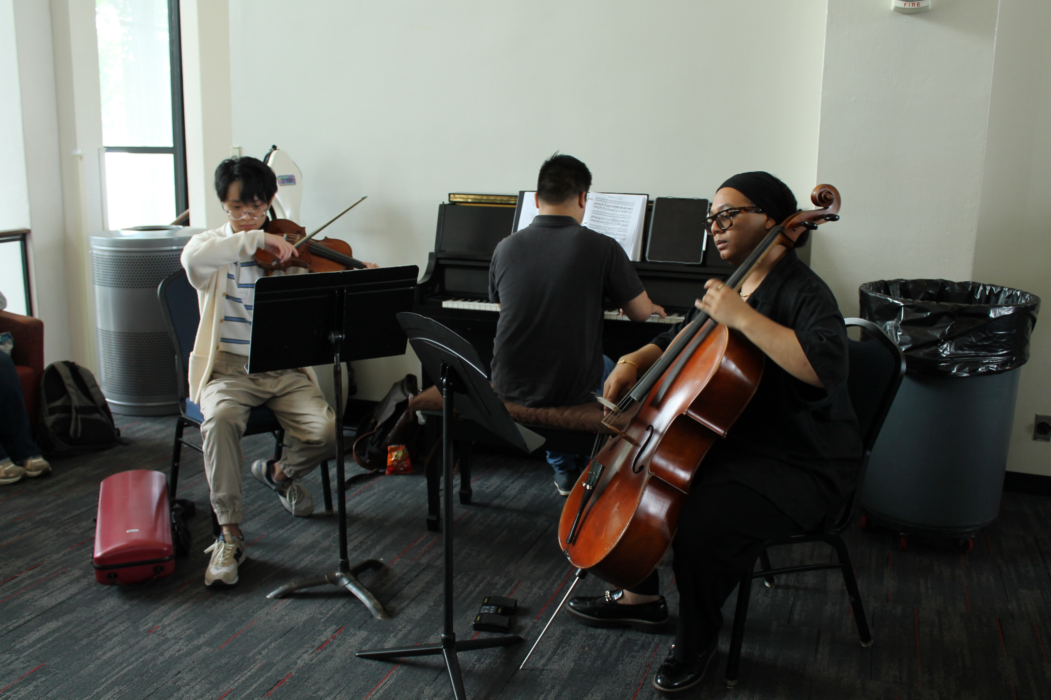
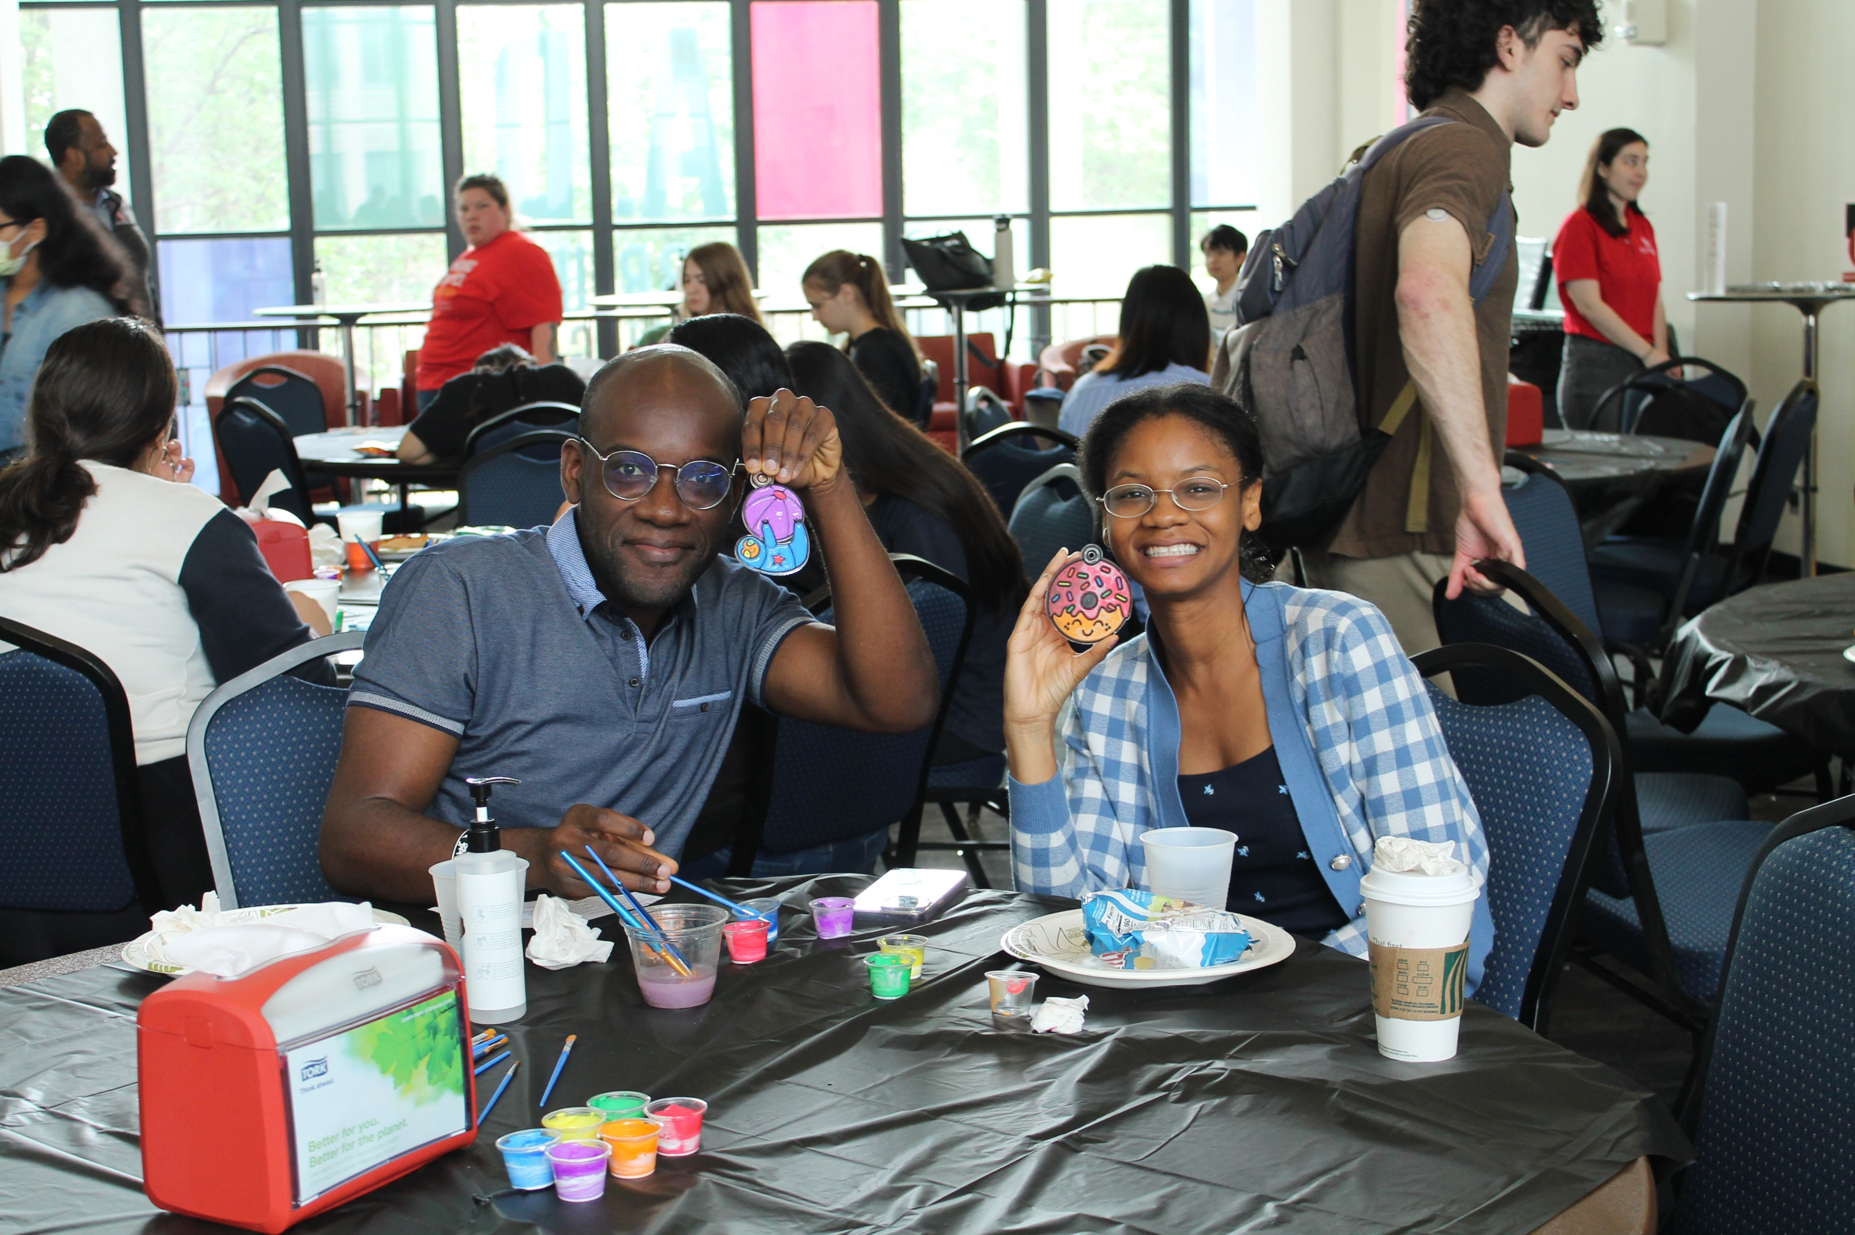
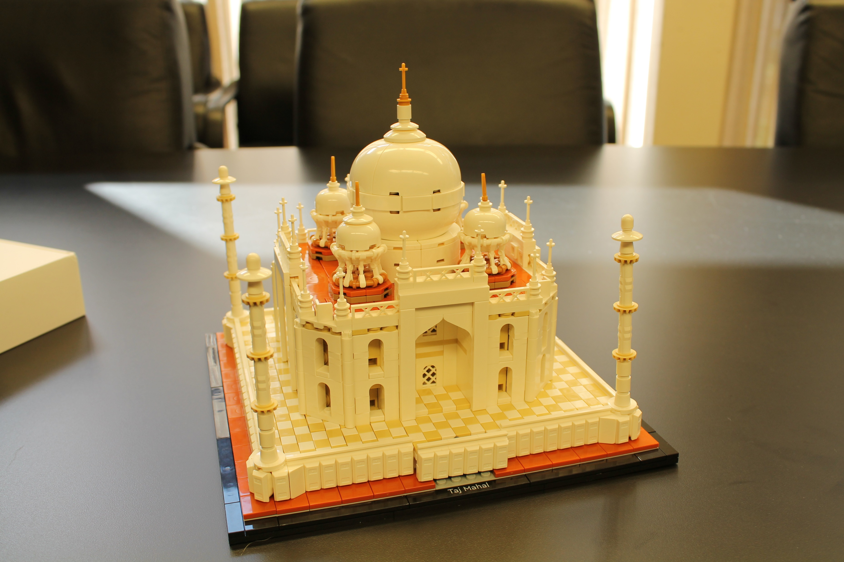
CORE VALUES CONTINUED!
Building Community Collaborate
“I made some new friends during Lego Your Stress, now we are Lego Friends”
“Thank you for doing this. I feel more connected to the UH community after coming to the events weekly.”

Slide 6
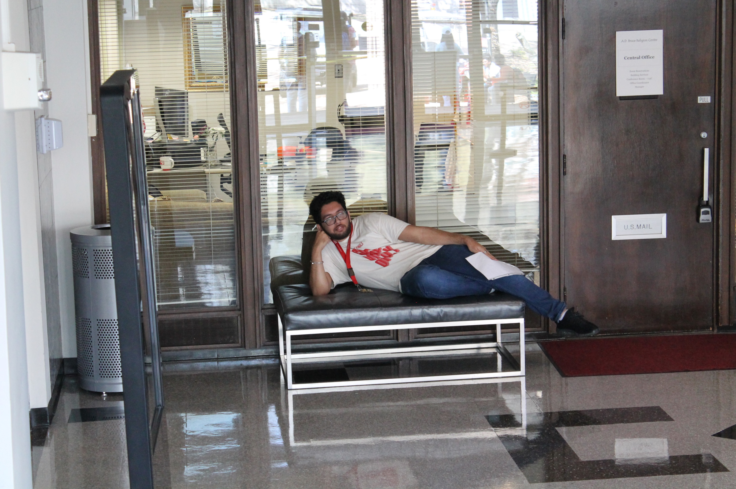
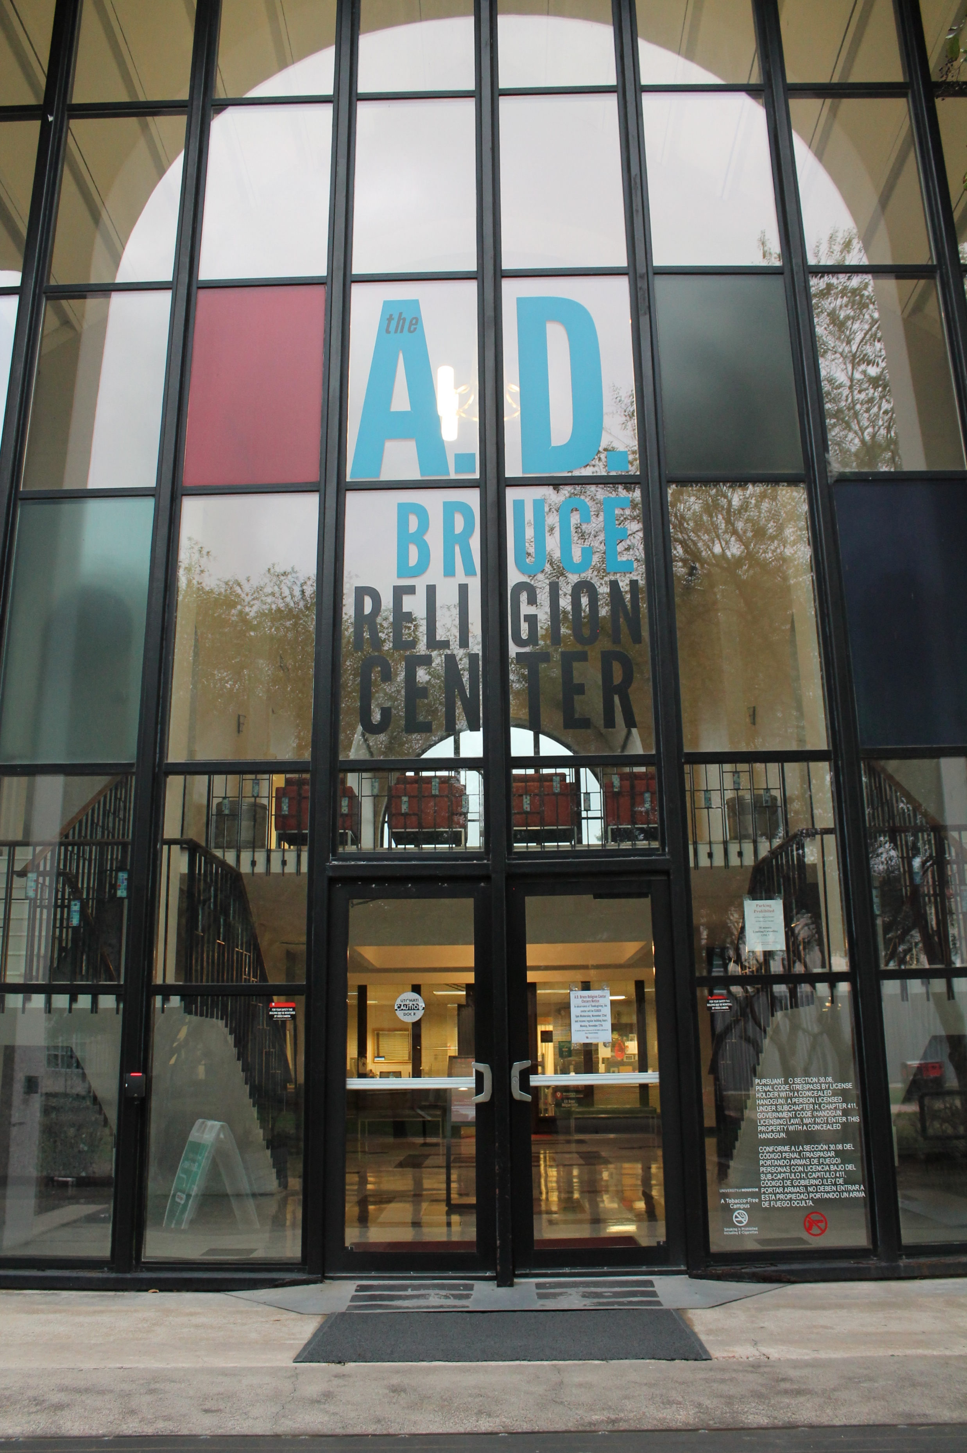
CORE VALUES CONTINUED!
Customer Service Discover Opportunities
95% of students agree or strongly agree that Free Wednesday Lunch fulfills an important need for the campus community.
89% of students agree or strongly agree to having a sense of belonging when at Free Wednesday Lunch

Slide 7
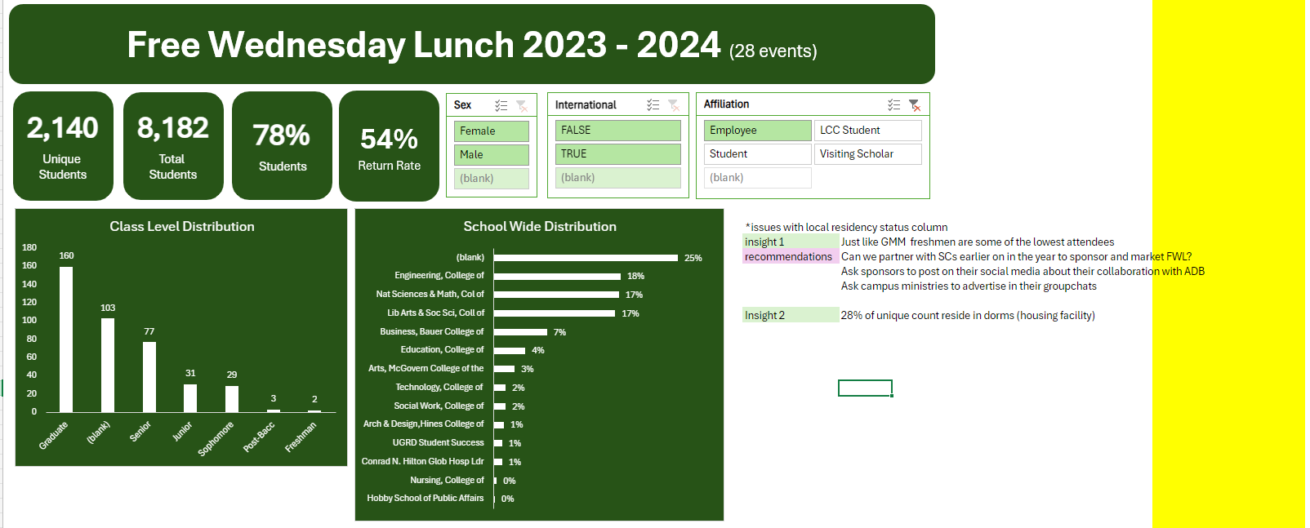
WHAT WE LEARNED!
“Thank you for doing this! I did not have the time and capacity to bring food every day. It was hard to plan and prepare the food. I was new in Houston; at first, everything felt overwhelming as an international student. you definitely made my life so much easier. thank you! You fed me my first year of school, and then second, it was rare because I did not have class on Wednesday, but I knew that if I were on campus, I could go to your building. thank you again :)”

Slide 8
OUR REQUESTS!– ONE TIME REQUESTS
Wudu & Fire Egress Design Plan
$121,900.33 (includes admin charges)
SLA Support
$151,243.33 (includes potential FY25 increase)
Administrative Coordinator
$20,792.77 (including benefits)
Estimated Hire Date: May 1, 2025

Slide 9












OUR REQUESTS!– BASE AUGMENTATION REQUESTS
Service Level Agreement Support $151,243.33
(includes potential FY25 increase)
Administrative Coordinator
$62,378.35 (including benefits)
Graduate Assistant
$17,172
Marketing
$10,600
CELEBRATE
SPIRITUAL
DIVERSITY
Programming
$15,900

Slide 10
THANK YOU!

