Slide 2
OUR MISSION
ONLINE & IN-PERSON
APA Accredited
Training
CAPS promotes the well-being of the diverse campus community by balancing high quality mental health services and clinical training with accessibility to foster student success through self-discovery, learning, and interpersonal engagement
Outreach Services
IACS Accredited
Clinical Services
Tabling
Presentations
Workshops
Interviews
Debriefings
Support Groups
24/7 Services
TRAININGS
Focused Care Hour
You Can Help a Coog

Slide 3
COOGS CARE
WEB OF SUPPORT
Non-profit
Organizations
Online Resources
Professors
Veteran Services
Financial Aid
CSAC
CSE
Librarians
AD Bruce
Mentors
Dart
Center
CSI
ISSSO
Health
Center
UHPD
Healthy
Coogs
LAUNCH
UH Marketing
CIR
Rec
Wellness
WGRC
Career Services
SHRL
Dean of Students
Teaching Assistants
Residential Assistants
Community
Agencies
CFSL
Public
Policies
Student Groups
Academic Advisors

Slide 4
CAPS External Review
Increase staffing to 35 clinical FTE to expand clinical capacity by targeting masters-level clinicians from the Houston community, adding embedded counselors and expanding the training program.
2) Launch a 24/7/365 service option for all students (not just athletes) using a contracted service provider.
3) Reconceptualize and update faculty, staff, and student training in mental health awareness and impact.
UNIT CHALLENGES

Slide 5
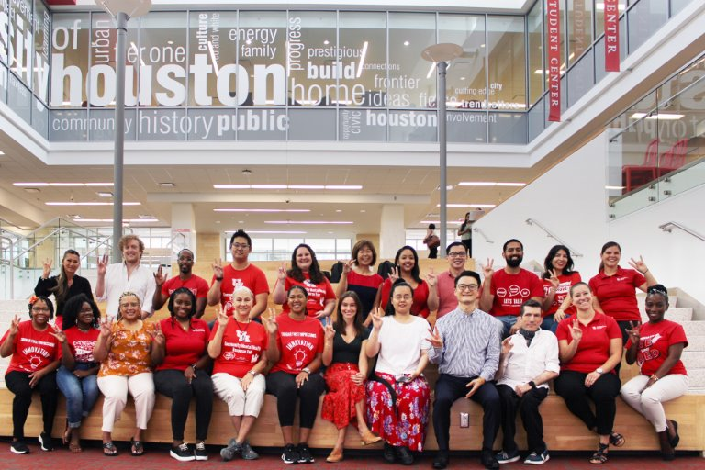
CAPS Staffing
Clinical Load Index (CLI) =
The annual caseload of a typical full-time clinician working 40-hour a week with 24 clinical hours
Counseling Center Utilization
(Students attending sessions)
+
Counseling Center Clinical Capacity
(Expected clinical hours when fully staffed)
+
University Enrollment
UNIT CHALLENGES

Slide 6
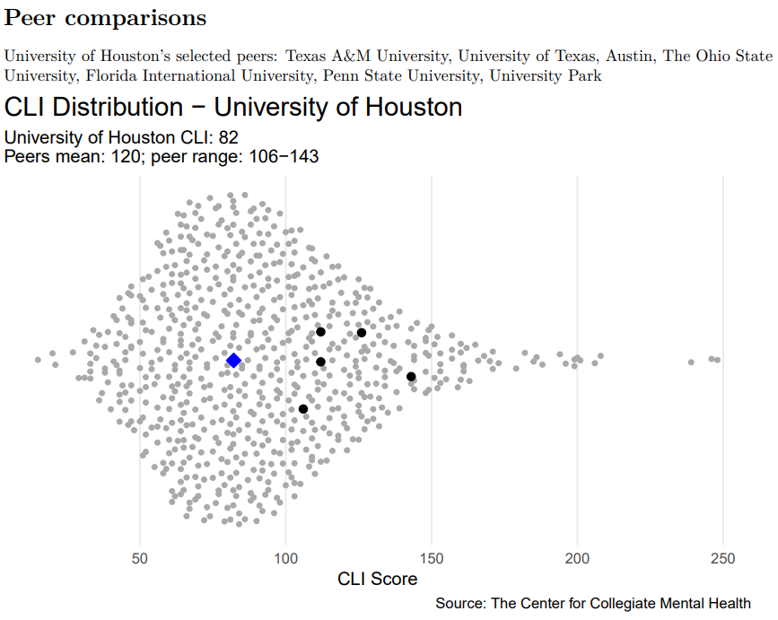
CAPS Staffing
Low CLI: < 57
Weekly counseling, no waitlist, no restrictions
Medium: 57-127
Increasing need for managing demand,
e.g., Stepped Care Model, not everyone can
be served through individual counseling,
possibility of waitlist during peak periods
High: >147
Higher focus on case mgt and referrals, greater restrictions on length/frequency of individual counseling, focus on serving many by offering less
UH CAPS CLI: 82​
Peers Mean: 120; Peer Range: 106 – 143​
Texas A&M ​
UT Austin​
Ohio State ​
Florida International ​
Penn State ​
UNIT CHALLENGES

Slide 8
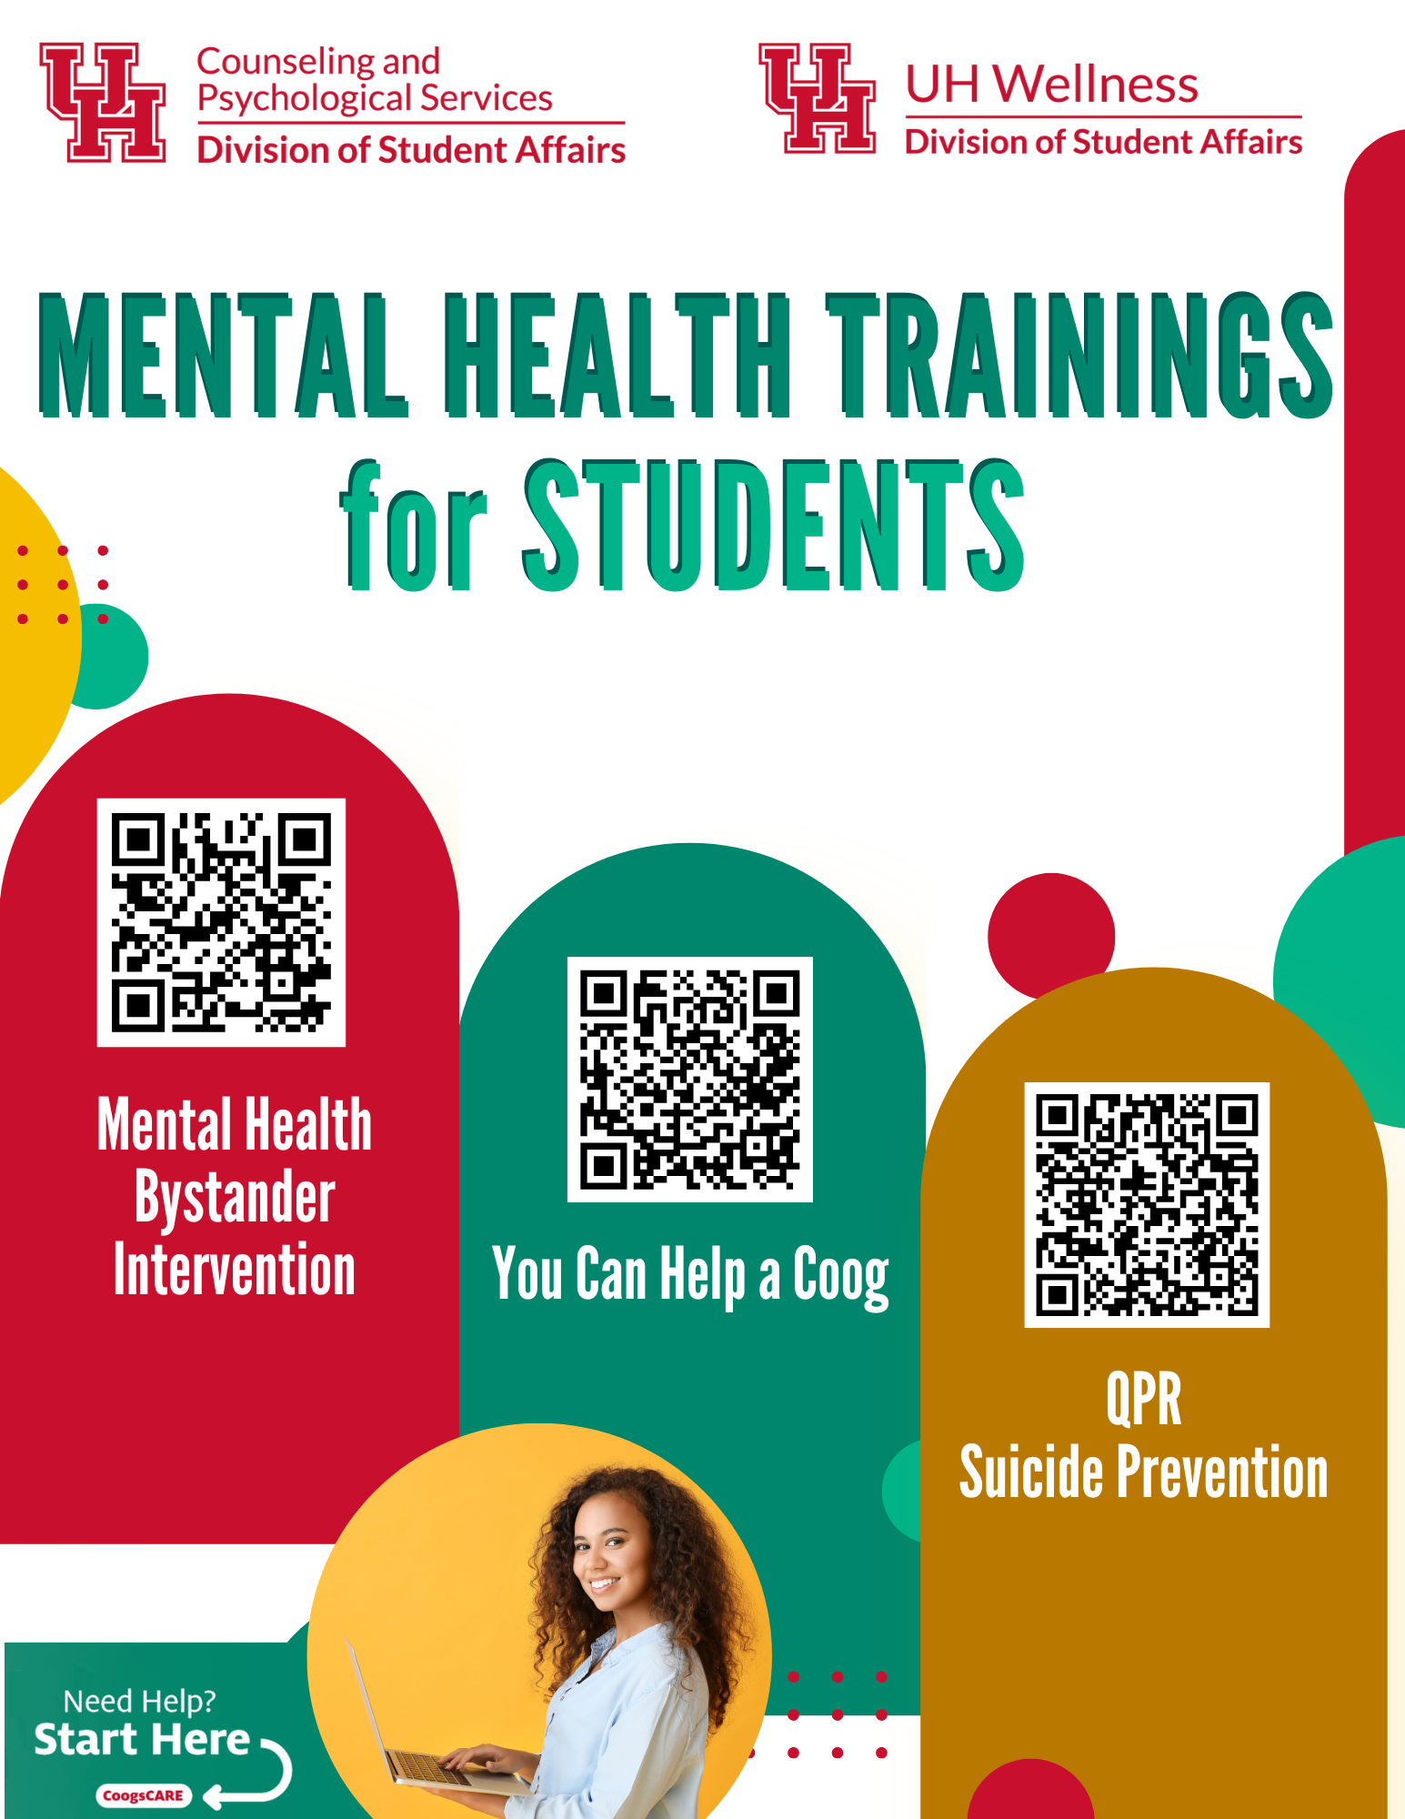
Mental Health Trainings
Notes:
1-time funding asks

Slide 9
SFAC Requests
Bottom Line
Increase staffing to 35 clinical FTE
To offer more treatment, we must decrease our CLI by increasing our staffing.
Move from serving 4% to 8% of the student population.
More access points and coverage across the university.
Clinicians available after business hours and provide mobile response at the scene.
2) Launch a 24/7/365 service option for all students
Continue to offer Togetherall and WellTrack Boost.
Covered/Bridge to Care psychotherapy sessions . These are paid (covered) sessions to community providers for those students who economically disadvantaged.
3) Reconceptualize and update faculty, staff, and student training in mental health awareness and impact.
Resources needed for the Mental Health Training Series, JED 3yr Kick-Off, Annual Community Mental Health Resource Fair.

Slide 10
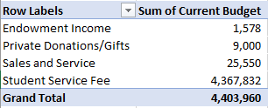
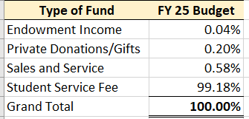
FY 25 Budget
Notes:
.

Slide 11
Budget

