Slide 1
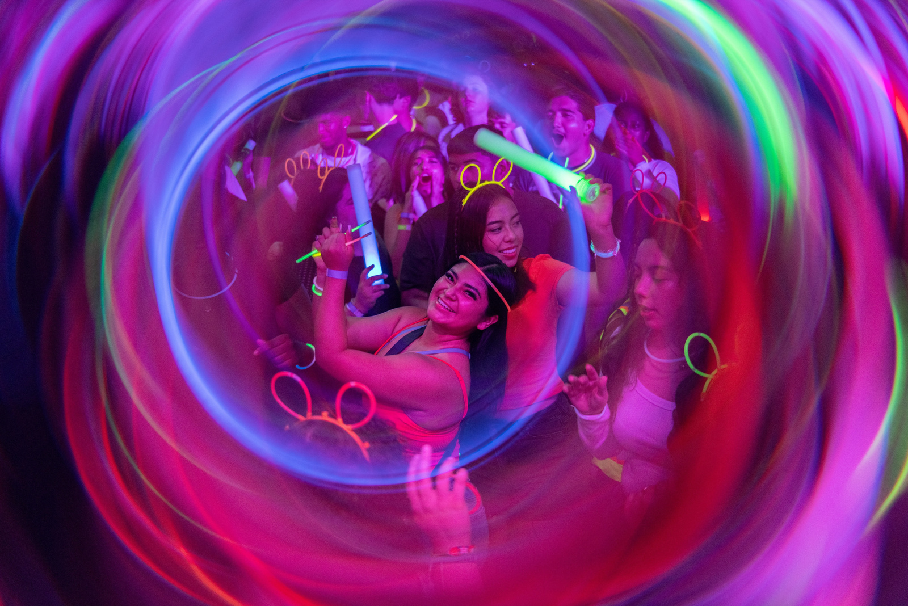
CENTER FOR STUDENT
INVOLVEMENT
SFAC FY 25-26

Slide 2
MISSION
The Center for Student Involvement creates a dynamic and accessible environment that provides meaningful and diverse learning and involvement opportunities to impact student success. Students will gain a sense of self and strong leadership skills, while becoming responsible and engaged citizens in their community.
VISION
We will create a culture of involvement by engaging all students in meaningful experiences.
Notes:
Involvement Data
-

Slide 3
Community
Collaboration
Empowerment
Innovation
DSA STRATEGIC VALUES

Slide 4
CENTER FOR STUDENT INVOLVEMENT PROGRAMS
Registered Student Organizations
Campus Events and Traditions
Leadership Development Programs
Civic and
Community Engagement
Notes:
This is how we bring our mission to life!

Slide 5
CENTER FOR STUDENT INVOLVEMENT PROGRAMS
UHSL
SUGAR LAND
SHASTA’S
Night
OUT
Notes:
Shasta's Night Out
Voting things
UHSL

Slide 6
UNIVERSITY SPONSORED ORGANIZATIONS

Slide 7
FY24 HIGHLIGHTS
Ignite Graduates
52
InfraRED Attendance
2,552
Instagram Followers
+24%
Notes:
The Ignite Program has grown to levels not seen in a number of years graduating 52 participants in FY 24, up from 25 in FY 23. 108% increase

Slide 8
STUDENT EXPERIENCE
I absolutely love working for the Center of Student Involvement. My time as a Cougar Involvement Ambassador has shown me how much work it takes to have a thriving student organization! I find so much pride and joy from ensuring all student organizations have the knowledge and tools they need to get students on campus engaged. I have learned and grown so much from this job and I am so thankful to interact with some of the hardest working people on campus.
Madison Rainwater
Cougar Involvement Ambassador
Political Science, Sophomore
Notes:
LeadUH Awards
27 in FY21
33 in FY22
# Ignite grads is ___

Slide 9
FY24 HIGHLIGHTS
CSI Event
Attendance
39,906
Event
Registrations
8,675
Registered
Student
Organizations
537
Notes:
Total attendance FY24: 39,906
Unique attendance: 19,485
Event registrations processed by CSI staff jumped from 6,406 event registrations in FY 23 to 8,675 in FY 24, yielding more than a 35% increase. Furthermore, this growth has been consistent over a two-year period, having experienced an 184.6% increase in event registration submissions from the Spring 2022 semester.

Slide 10
STUDENT EXPERIENCE
"Ignite Leadership has captivated my heart. As a first-year student at the University of Houston the program allowed me to connect with other students and encouraged me to utilize my leadership skills to help grow in my collegiate journey. Additionally, it taught me the power of resilience through difficulties and encouraged me to believe that I can truly make a difference."
Roberto Carrizales Gaytan
Ignite Mentor, Fall 2023-Spring 2024
Account and Professional Sales, Sophomore
Notes:
Attendance (Bingo to Beat Hunger, End It, Days of Service)
FY19: 563
FY21: 143
FY22: 277
PVSA
FY21 - (15)
Gold- 7
Silver - 3
Bronze - 5
FY22 - (27)
Gold- 8
Silver - 5
Bronze - 14
Independent Sector: $29.95
FY21 4,672 hours
FY22 7,314

Slide 11
UH SUGAR LAND ENGAGEMENT
 | FY23 | FY24 | Projected FY25
# Events | 4 | 6 | 8
Total Attendance | 250 | 634 | 1,075
UH SUGAR LAND ENHANCEMENT
Notes:
Our first event of FY25 had 119 attendees and we expect to see continued increases in engagement as our partnerships with departments at UHSL expand.

Slide 12
STUDENT EXPERIENCE
“I have been at UH Sugar Land since my freshman year. I enjoyed the grab and go event we had this semester but I also LOVED the events that we had last semester with your customized hat, paint splashing, catered food, and more. I really appreciate those types of events and the “relaxation” events because it feels like UH Sugar Land isn’t just a separate entity from UH Main. During my first 2 years of uni, I’d feel really bad that I couldn’t attend similar UH Main events because the commute/class time would overlap with the event duration. I'm excited to see what the UH Sugar Land team brings next!!”
Abion Stevens
Digital Media, Junior
Notes:
Attendance (Bingo to Beat Hunger, End It, Days of Service)
FY19: 563
FY21: 143
FY22: 277
PVSA
FY21 - (15)
Gold- 7
Silver - 3
Bronze - 5
FY22 - (27)
Gold- 8
Silver - 5
Bronze - 14
Independent Sector: $29.95
FY21 4,672 hours
FY22 7,314

Slide 13
FY26 ONE TIME REQUEST
Fall Welcome Back | $4,000.00
Grab & Go (6 events @ $1,500/event) | $9,000.00
Spring Fling Event | $7,000.00
UHSL Branded Items | $5,000.00
6% Administrative Fee | $1,500.00
Total Request | $26,500.00
UH SUGAR LAND ENHANCEMENT

Slide 14
THANK YOU!

