Slide 1
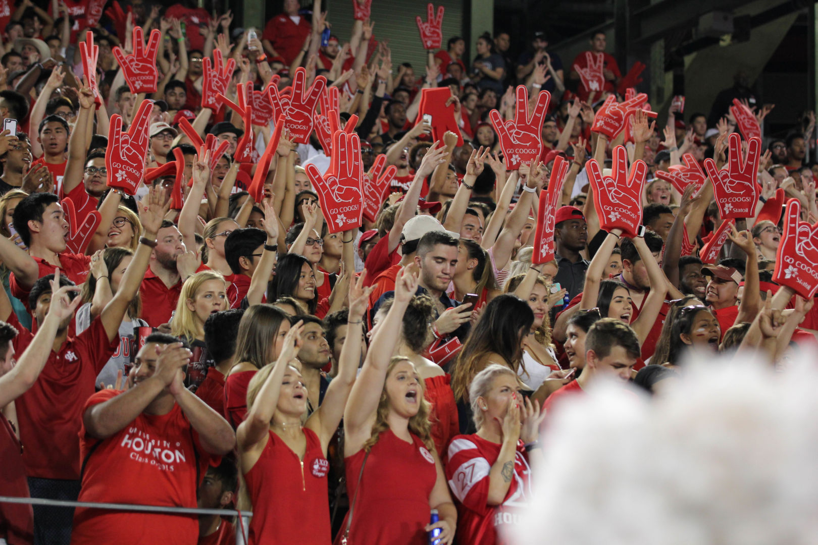


HOMECOMING BOARD
SFAC FY26 PRESENTATION

Slide 2
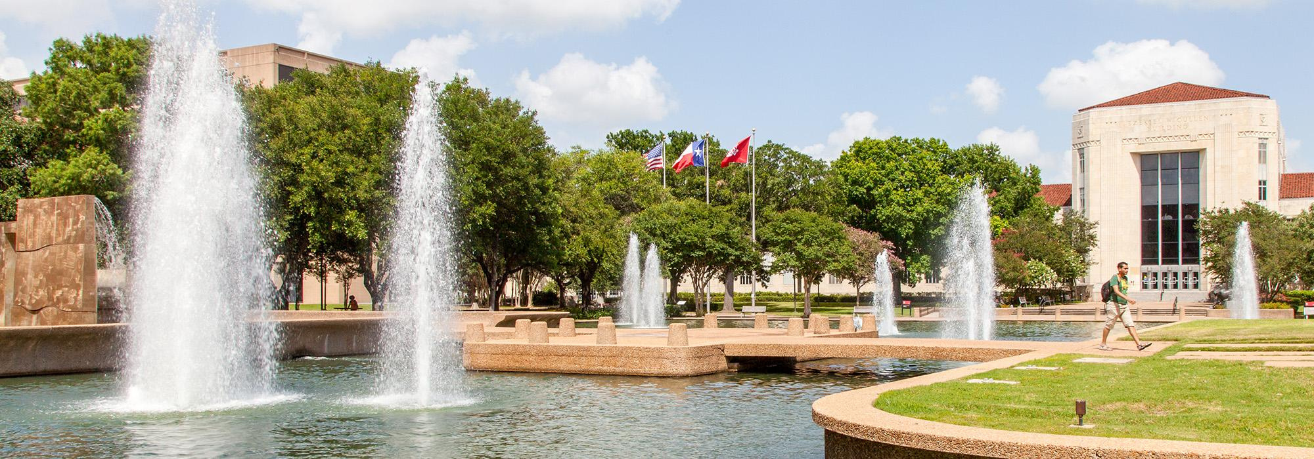


OCTOBER 21ST 2024 - OCTOBER 26TH 2024
TABLE OF CONTENTS
01
02
03
MISSION OF HC
STRATEGIC VALUES
ORG STRUCTURE
04
05
06
UNIT SUCCESSESS
REQUEST OVERVIEW
Q&A

Slide 3
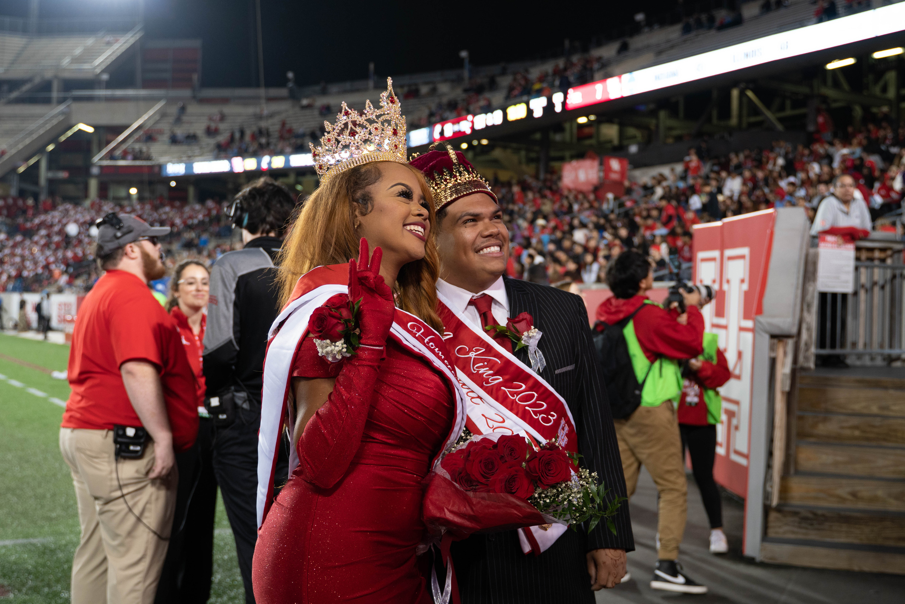
OCTOBER 21ST 2024 - OCTOBER 26TH 2024
MISSION OF HC
The Homecoming Board organizes and leads one of the University of Houston's longest traditions. Our mission is to bring together students, faculty, staff, alumni, and the Houston community for a week of spirited events and celebrations. We aim to create a welcoming environment where everyone feels a sense of belonging, with events that are accessible to all.

Slide 4



OCTOBER 21ST 2024 - OCTOBER 26TH 2024
DSA VALUES &
ORG STRUCTURE

Slide 5



OCTOBER 21ST 2024 - OCTOBER 26TH 2024
VALUES
Community
Collaboration
Empowerment
We embrace our diversity and work to ensure the University of Houston is a place where everyone feels a sense of belonging and responsibility for the well-being of their fellow community members.
Our best work is realized through diverse perspectives, knowledge, and resources within the division, across the university, and with community partners.
We empower individuals to grow and advocate for themselves and others while building leadership and communication skills. Our focus is on fostering belonging and measuring success through our programs.

Slide 6




ORGANIZATION STRUCTURE
CHAIR
CSI ADVISOR,
ASSISTANT DIRECTOR
KENNEDY LOTT
VICE CHAIR
INSTRUCTIONAL
ASSISTANT
MARIANA SALINAS
DIRECTOR OF COURT ACTIVITIES
DIRECTOR OF MARKETING
DIRECTOR OF PRODUCTIONS
DIRECTOR OF SPIRIT
KIANA MC DONALD
ENIOLA ELUFIOYE
CYNTHIA BLANCHARD
ANISIA CANNON
ASSISTANT DIRECTOR
ASSISTANT DIRECTOR
ASSISTANT DIRECTOR
ASSISTANT DIRECTOR
PAID POSITION
UNPAID POSITION

Slide 7


OCTOBER 21ST 2024 - OCTOBER 26TH 2024
UNIT SUCCESSES/
AND CHALLENGES

Slide 8
OCTOBER 21ST 2024 - OCTOBER 26TH 2024
SUCCESSES
ATTENDEE ENGAGEMENT
  Activities were available to anyone who attended, not just those who participated in our spirit teams
  Attendance has increased throughout the years with events such as bed races, kick-off, and our early Tuesday events
COLLABORATIONS
  New and strengthened collaborations with other University Sponsored Organizations.
  Spirit Team interests and engagement increased within our Registered Student Organizations and Greek Life.

Slide 9
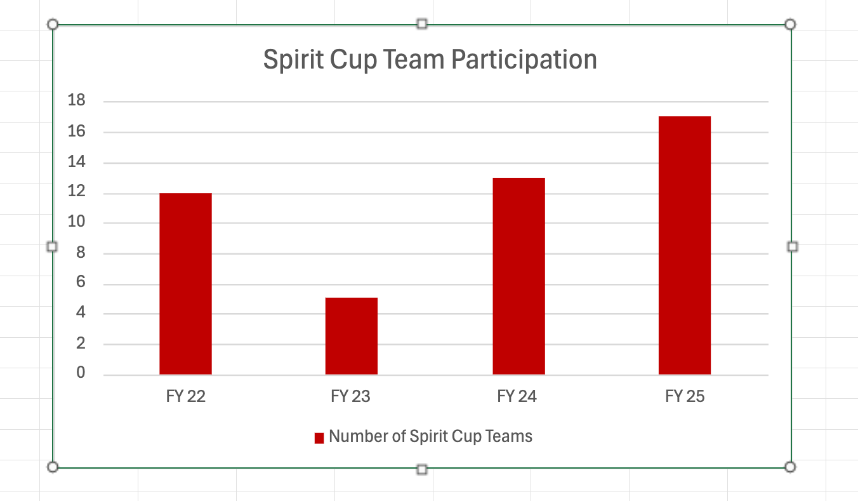
OCTOBER 21ST 2024 - OCTOBER 26TH 2024
SUCCESSES

Slide 10
OCTOBER 21ST 2024 - OCTOBER 26TH 2024
CHALLENGES
Board Development
  Training an entirely new board served as a setback in ensuring a smooth process into the new year.
  The delay in the formation of the board resulted in the backup of tasks delegated to an earlier time expectancy.
Campus Engagement
  We encountered Challenges with recruitment and engagement with Spirit Cups teams and court applicants.
  The unexpected weather led to poor attendance at Cougar Quest and Concert.

Slide 11


PAST ATTENDANCE OF FY 24
5,675
Attendees
Inclement weather Friday led to a lower than anticipated attendance at Cougar Quest that was moved indoors.
4,770
Attendees
4,021
Attendees
1,071 Attendees
OCTOBER 21ST 2024 - OCTOBER 26TH 2024

Slide 12

OCTOBER 21ST 2024 - OCTOBER 26TH 2024
BASE AUGMENTATION
REQUESTS

Slide 13
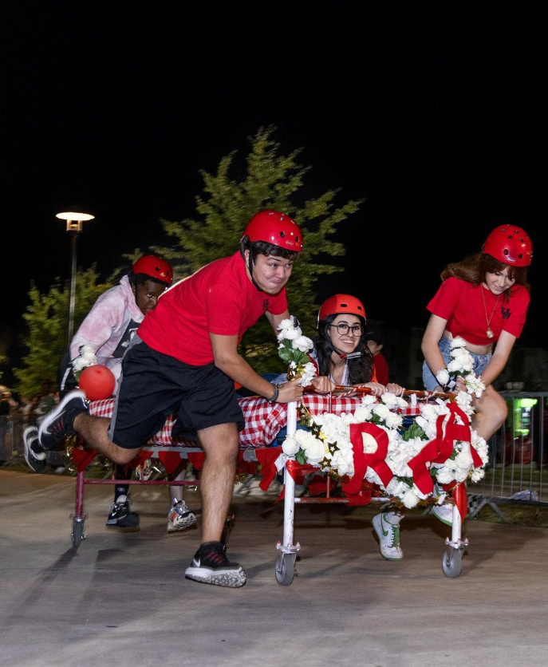
WHAT IS BED RACES?
BED RACES
One of Homecoming’s favorite traditions, Bed Races is an event like no other! Teams decorate a bed and race for the fastest time to win. With free food trucks, giveaways, and plenty of activities, this event will be a great time for everyone, participating or spectating!
OCTOBER 21ST 2024 - OCTOBER 26TH 2024

Slide 14

ONE-TIME REQUEST FOR BED RACES
ITEM
COST
VENDORS
$6,300
LIGHTS AND INSTALLMENTS
$840
SECURITY/EMS
$800
FACILITIES
$300
MARKETING AND PROMOTIONS
$1,200
FOOD AND BEVERAGE
$6,000
Subtotal
$15,440
UH Administrative Charge (6.0%)
$926.40
Total
$16,366.40
OCTOBER 21ST 2024 - OCTOBER 26TH 2024

Slide 15
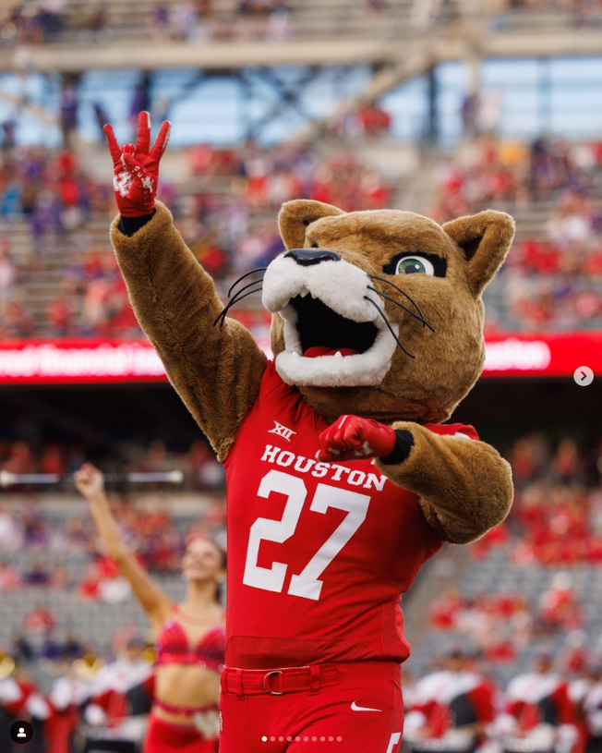
ONE-TIME REQUEST FOR SUMMER MARKETING
ITEM
COST
MARKETING & PROMOTIONAL ITEMS
$9,850
MARKETING & CREATION STATION
$1,312
Subtotal
$11,162.50
UH Administrative Charge (6.0%)
$669.75
Total
$11,832.25
OCTOBER 21ST 2024 - OCTOBER 26TH 2024

Slide 16

OCTOBER 21ST 2024 - OCTOBER 26TH 2024
HOMECOMING
THEME

Slide 17

THE HOMECOMING BOARD PROUDLY PRESENTS:
COOG CITY
The University of Houston proudly presents Homecoming 2024! Homecoming is more than a football game—it is a week celebrating the University of Houston, uniting students and organizations, and showcasing Cougar Pride and Cougar Spirit during one of the oldest traditions on campus! For each day of Homecoming, there are different events for students, alumni, and the UH community. Mark your calendars this year for Homecoming 2024, and celebrate Homecoming with us October 21st - October 26th!
OCTOBER 21ST 2024 - OCTOBER 26TH 2024

Slide 18

OCTOBER 21ST 2024 - OCTOBER 26TH 2024
WEEK
OF EVENTS

Slide 19
OCTOBER 21ST 2024 - OCTOBER 26TH 2024
PAINTING WITH
A COUGAR
HOMECOMING KICK-OFF
PEP RALLY W/RHA
STUFF-A-COOG
Saturday, October 19th, 2024
9:00 am - 12:00 pm
Student Center Plaza
Monday, October 21st, 2024
6:00 PM - 8:00 PM
Student Center Plaza
Tuesday, October 22nd, 2024
11:30 AM - 1:30 PM
Student Center Plaza
BED RACES
CANSTRUCTION
W/MVP
STRUT YOUR STUFF
Tuesday, October 22nd,2024
7:00 PM - 10:00 PM
Student Center South- Houston Room
Wednesday, October 23rd,2024
7:00 PM - 10:00 PM
TDECU Stadium, Gate II
Thursday, October 24th,2024
11:30 AM - 2:30 PM
Student Center Plaza
COUGAR
BLOCK PARTY
HOMECOMING CONCERT
W/SPB
ROCK THE CAMPUS
W/MVP
Friday, October 25th, 2024
7 PM - 10 PM
Lynn Eusan Park
Thursday, October 24th, 2024
7:30 PM - 10 PM
Lynn Eusan Park
Friday, October 25th, 2024
10 AM - 12:30 PM
Student Center Plaza

Slide 20
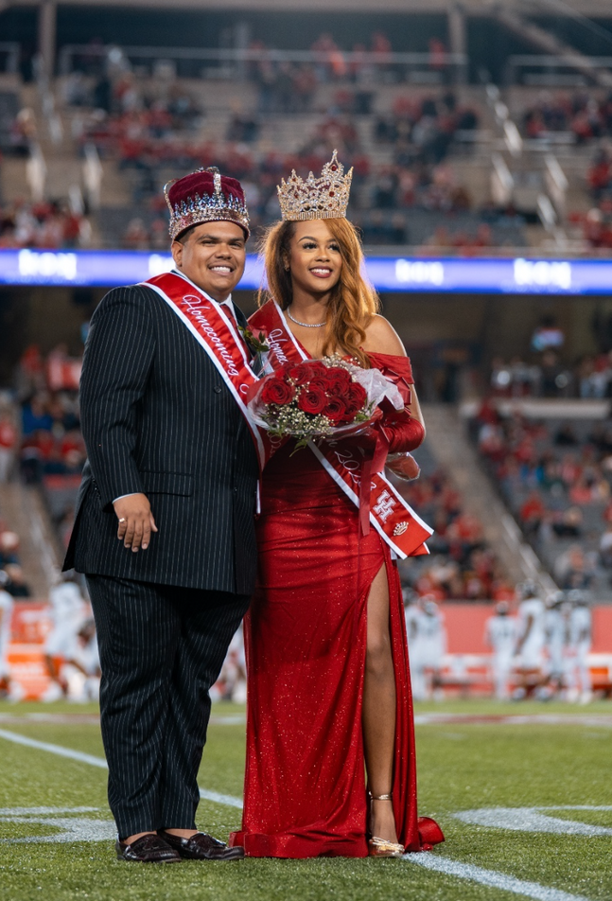
OCTOBER 21ST 2024 - OCTOBER 26TH 2024
CROWNING OF THE KING & QUEEN
PRESENTED BY
PRESIDENT RENU KHATOR AND DR. SURESH KHATOR
Saturday, October 26th, 2024
TDECU Stadium

Slide 21
OCTOBER 21ST 2024 - OCTOBER 26TH 2024
THANK YOU
ANY QUESTIONS?
www.uh.edu/homecoming
hcchair@central.uh.edu
@uhhomecoming

