Slide 1
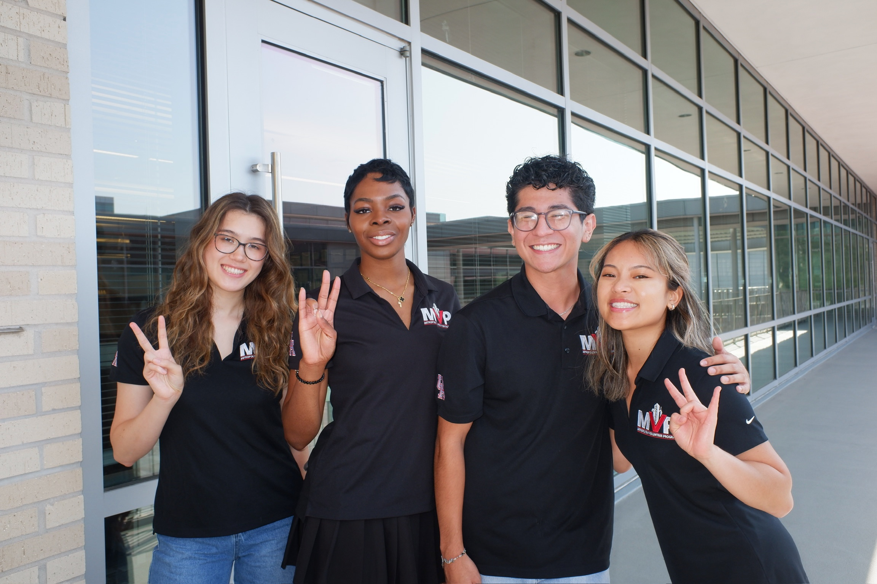

METROPOLITAN VOLUNTEER PROGRAM
SFAC FY 2026

Slide 2
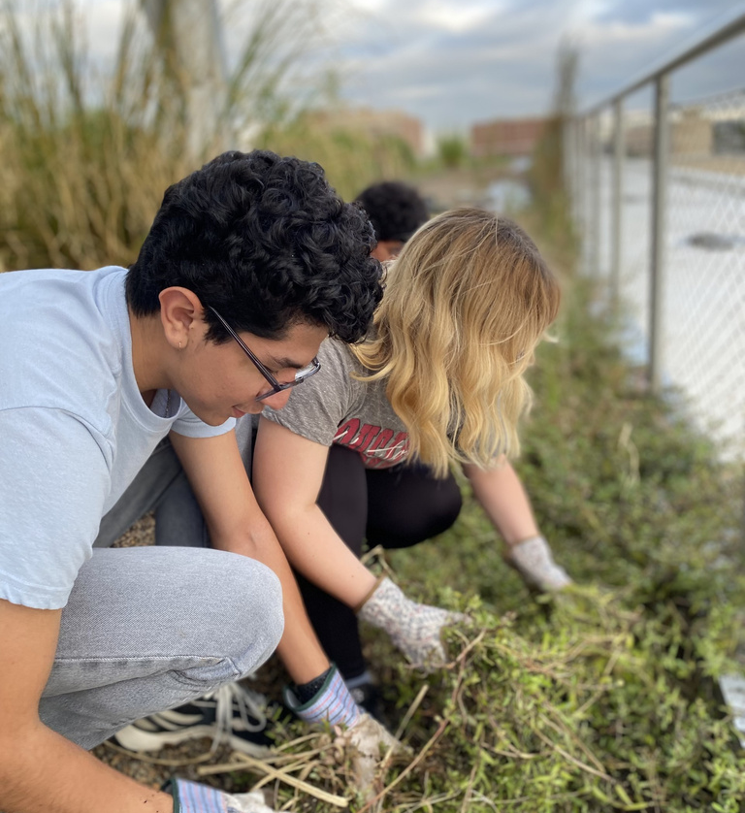
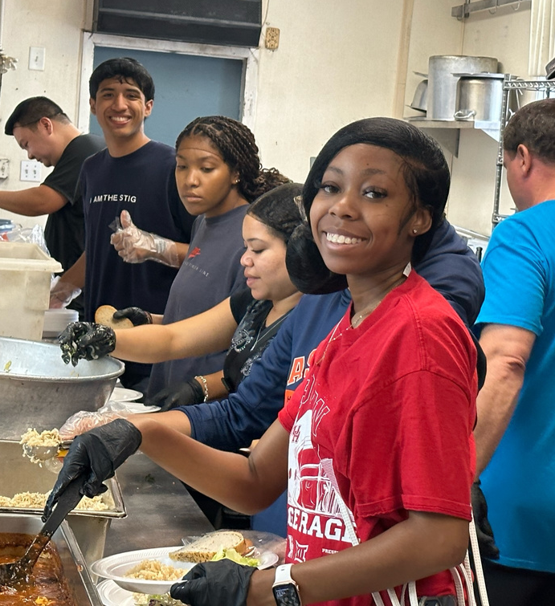
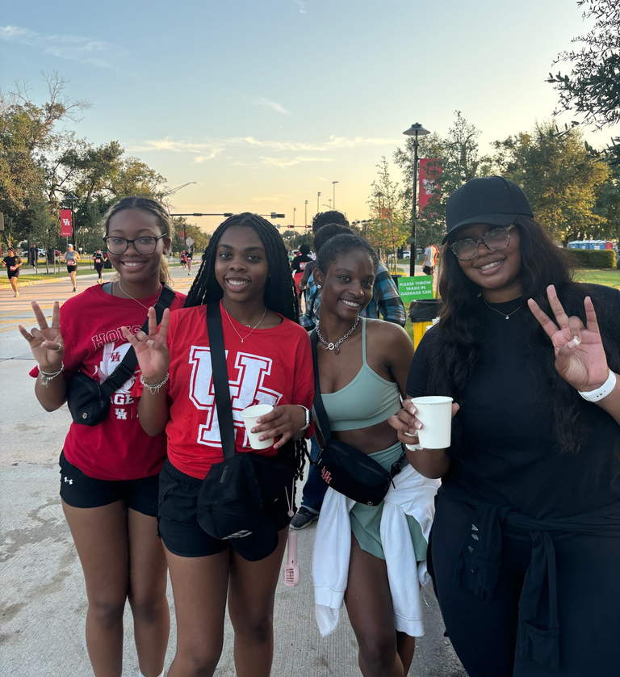
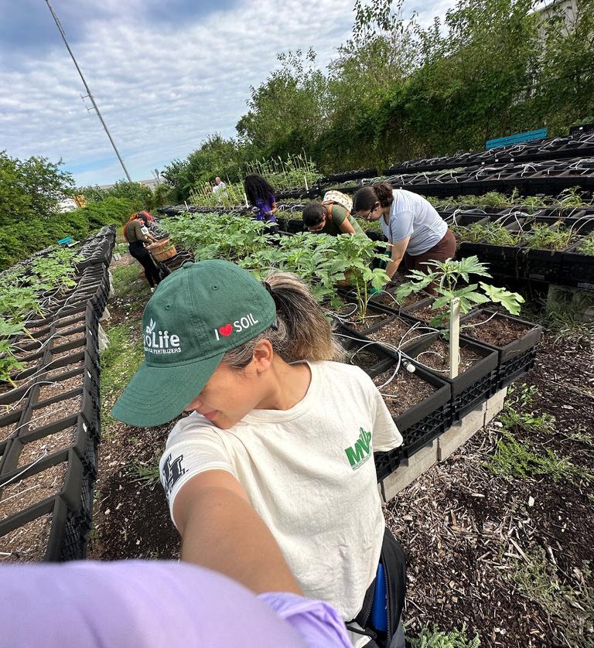
RELATIONSHIP TO DSA VALUES
Care
Collaboration
Community
Empowerment

Slide 3


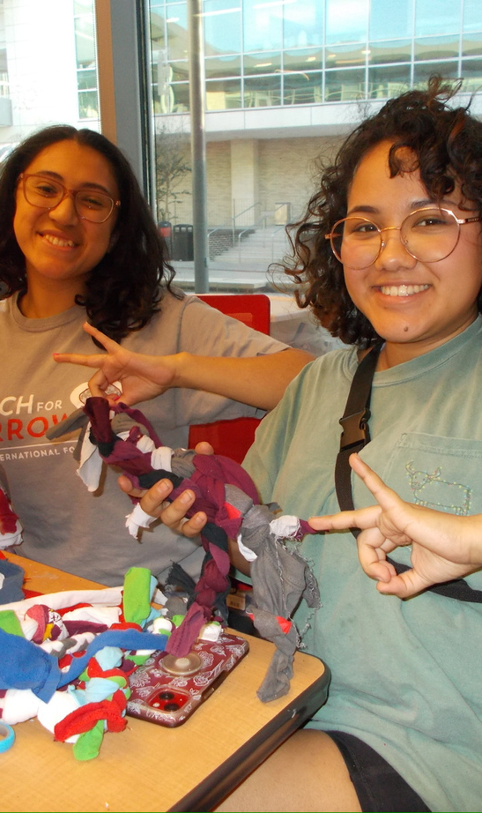
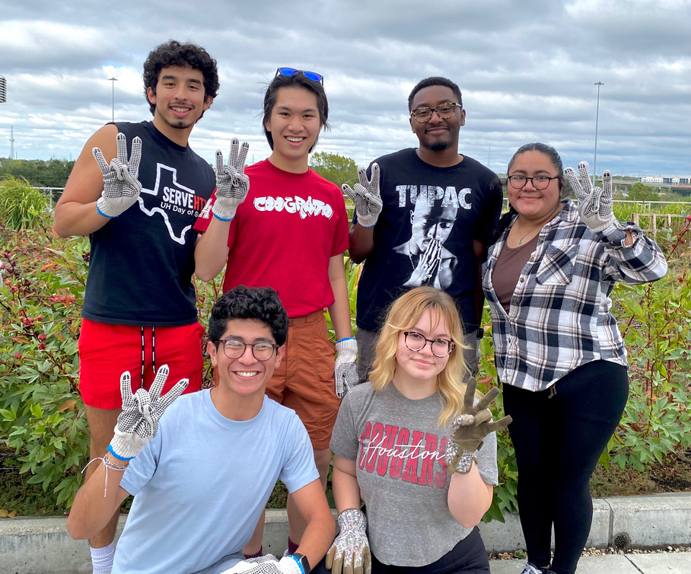

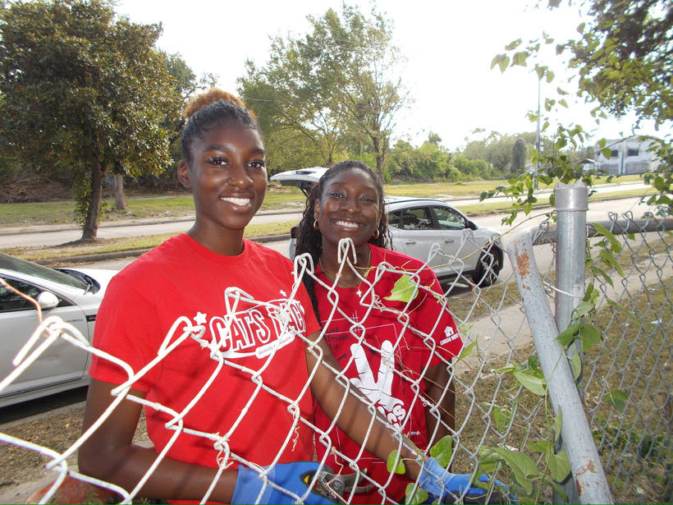

Fosters a culture of service amongst the UH community
VALUE TO THE UNIVERSITY OF HOUSTON
Forges partnerships between UH and local nonprofit organizations
Fortifies UH's presence in the greater Houston community
Connects students with University Resources

Slide 4

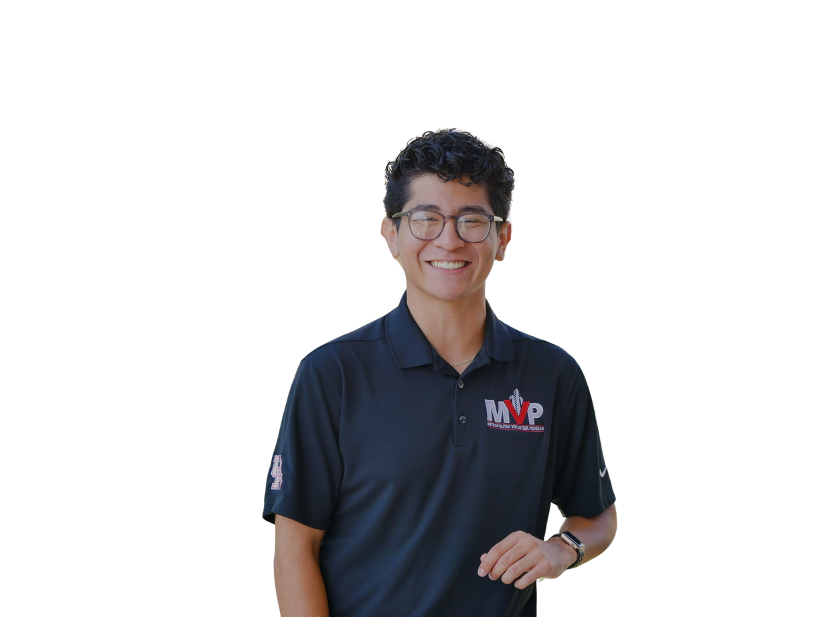
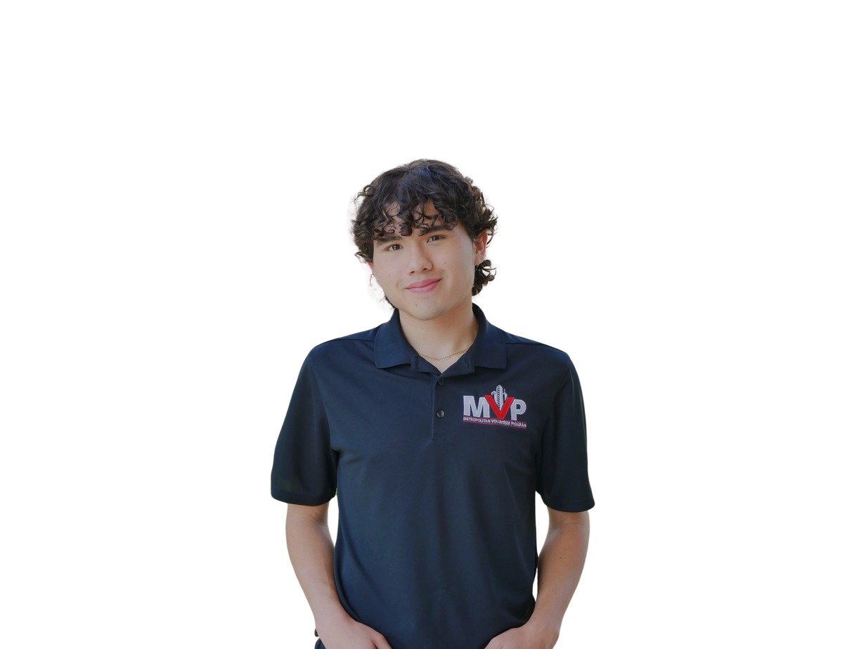
MEET OUR TEAM
Omar Castanon
Director
Strategic Communications
Class of 2025
Ernesto Alvarez
Assistant Director
Marketing
Class of 2027
Isabelle Weng
Marketing Chair
Marketing
Class of 2026

Slide 5

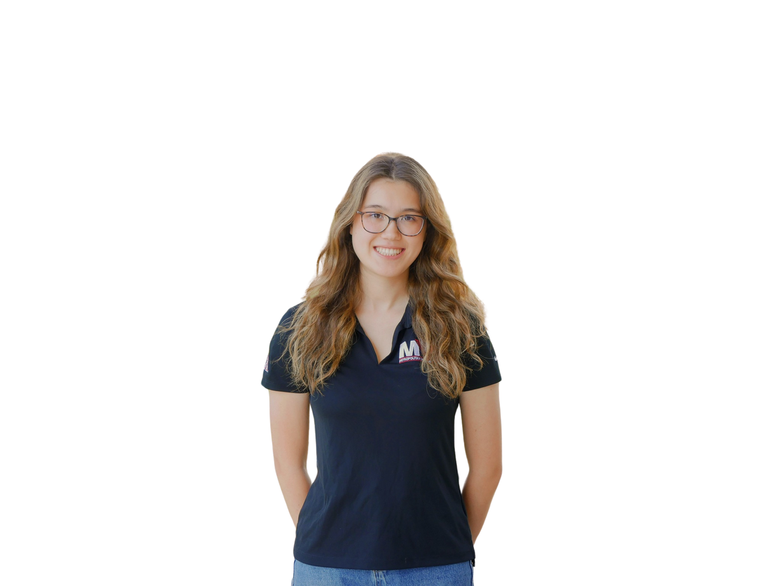
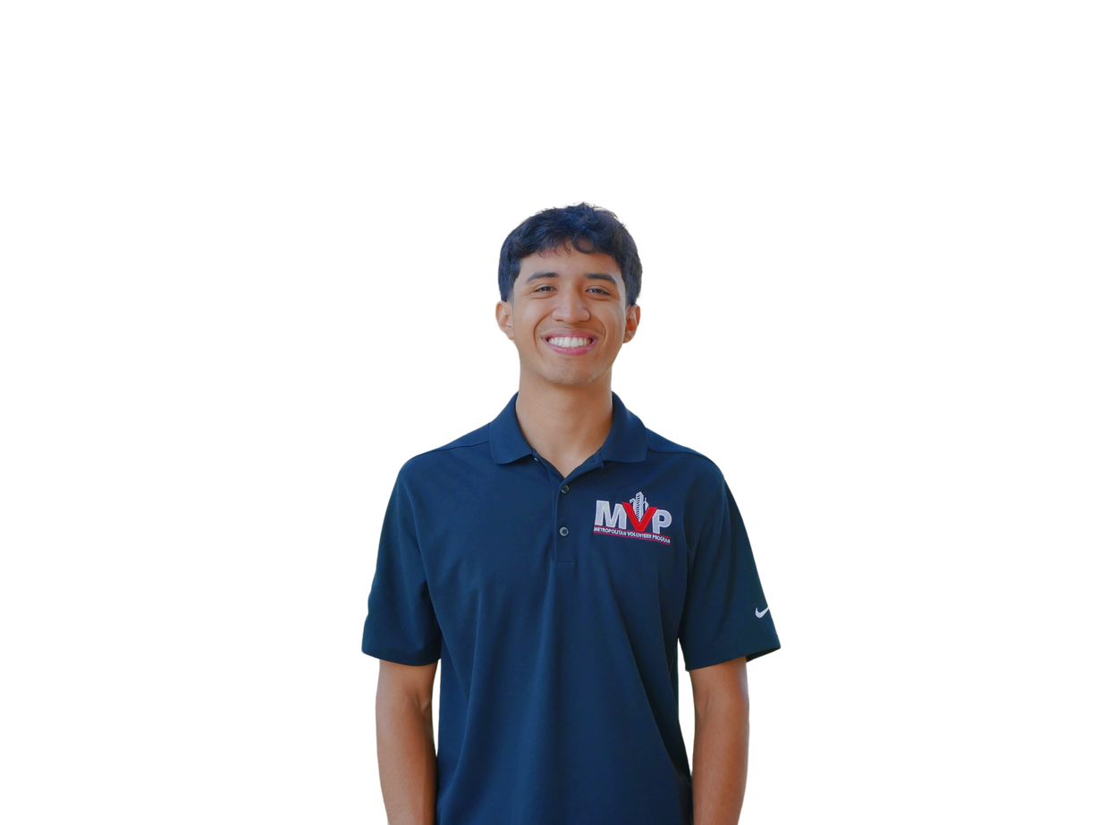
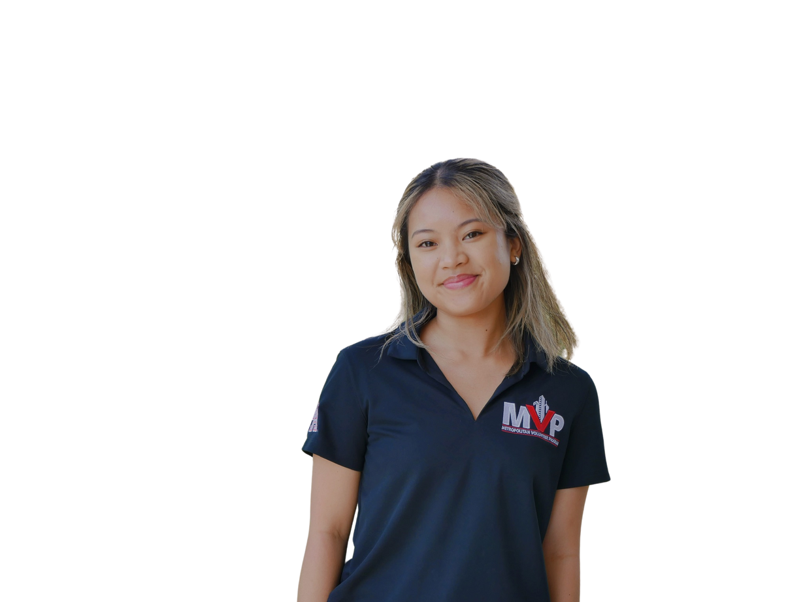
MEET OUR TEAM
Erick Martinez
Health & Wellness Chair
Kinesiology
Class of 2025
Dami Lambo
Hunger & Homelessness Chair
Management information Systems
Class of 2026
Sydney Guico
Environment & Sustainability Chair
Supply Chain Management
Class of 2026
Haley Romine
Children and Education Chair Psychology
Class of 2026

Slide 6
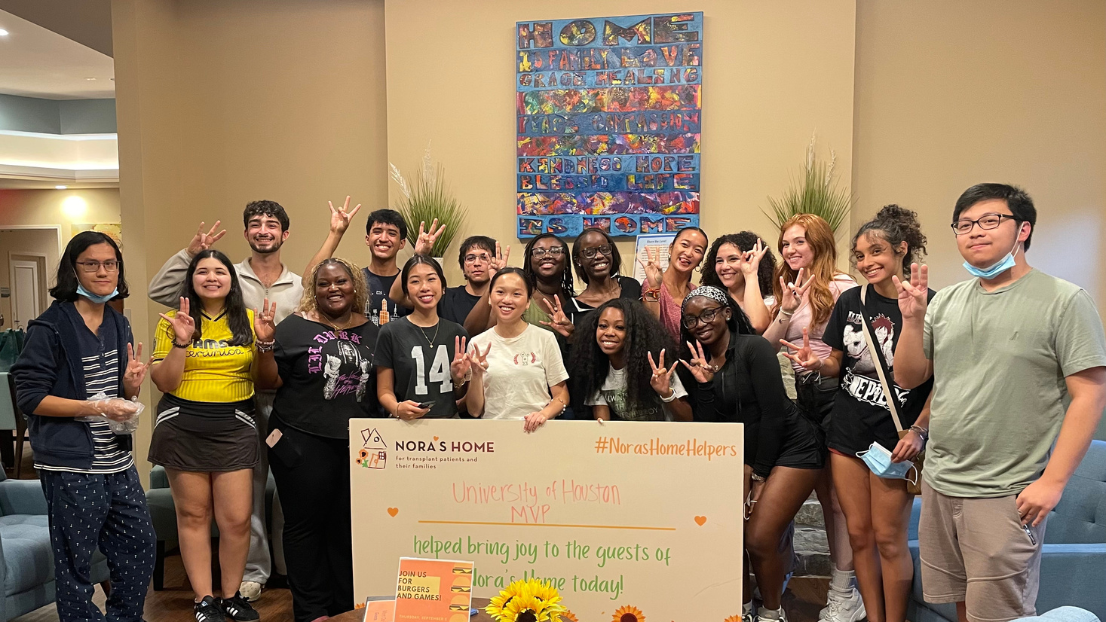
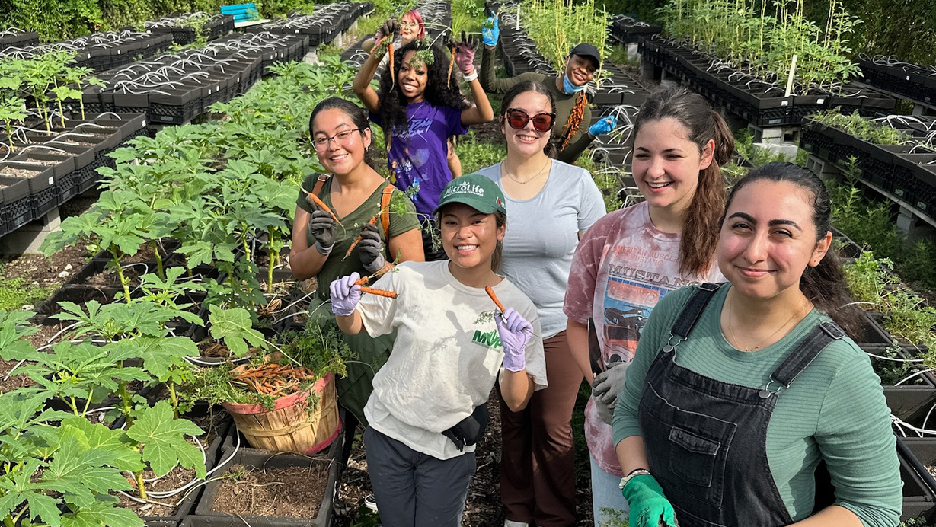
HEALTH AND WELLNESS PROJECTS
  Focus on developing overall health around the Houston community
  Volunteer Tasks:
    Sort medical supplies
    Help facilitate charity walks
ENVIRONMENT AND SUSTAINABILITY PROJECTS
  Focus on beautifying the Third Ward, the greater Houston area, and UH campus
  Encourage students to become more aware of sustainability measures
  Volunteer Tasks:
    Outdoor beautification
    Care for animals in need

Slide 7
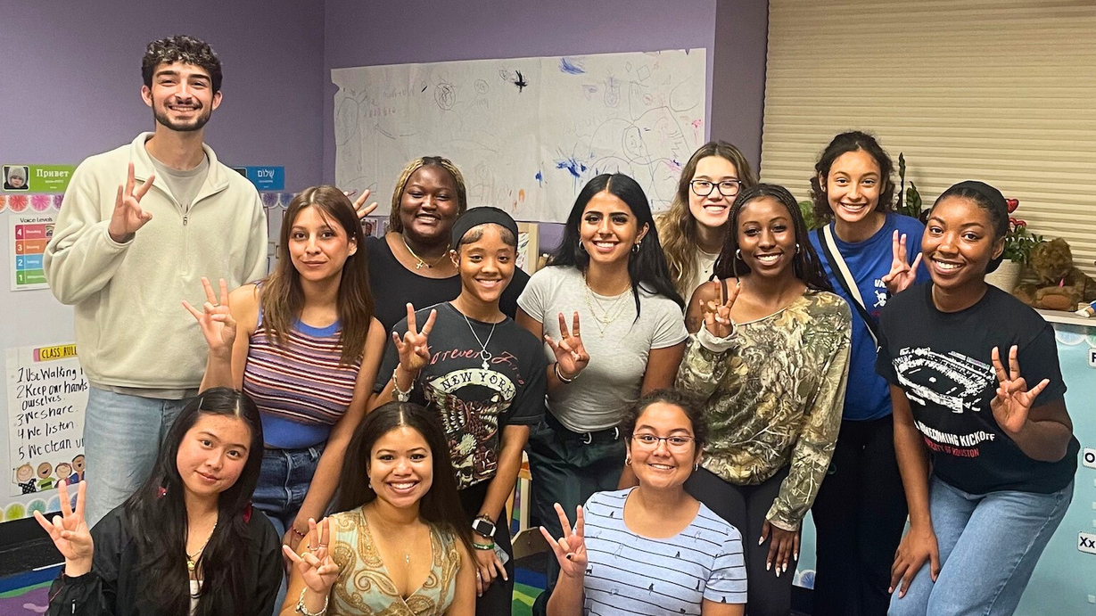
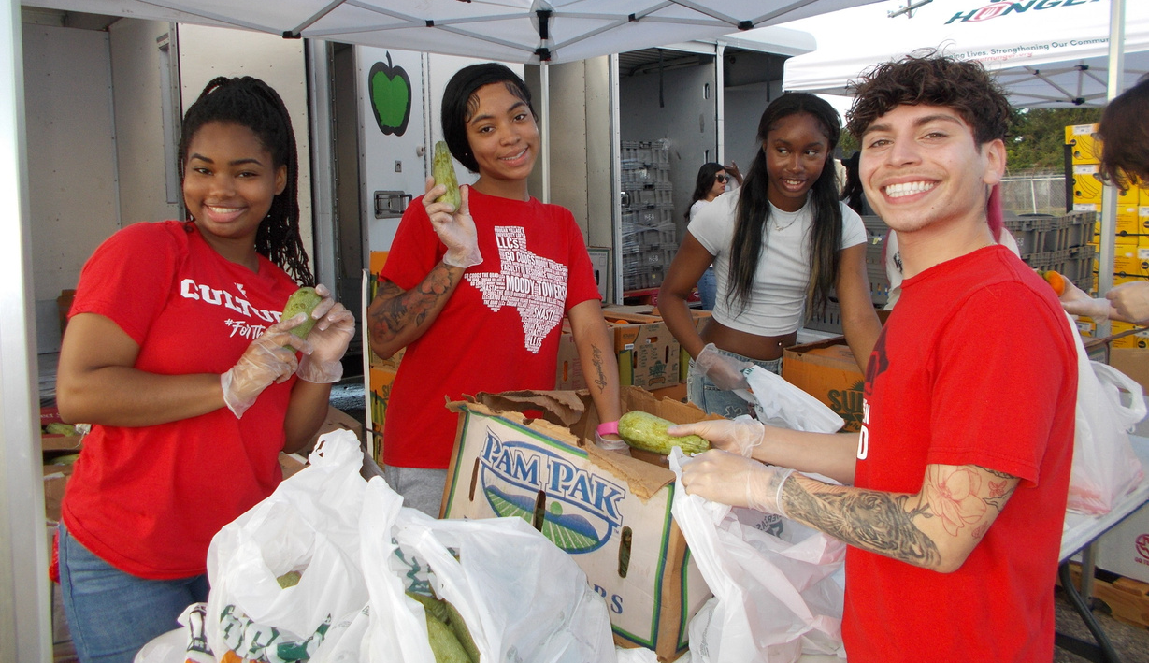
CHILDREN AND EDUCATION PROJECTS
  Focus on investing in youth and future generations through mentorship and support for programs that educate
  Volunteer tasks:
    Tutor and mentor children
    Provide support for childcare programs
HUNGER AND HOMELESSNESS PROJECTS
  Focus on combatting hunger on campus and in the community and serving people experiencing homelessness
  Volunteer tasks:
    Packing food for distribution
    Serving at soup kitchens
    Preparing in-kind donations to provide immediate relief for people experiencing homelessness

Slide 8
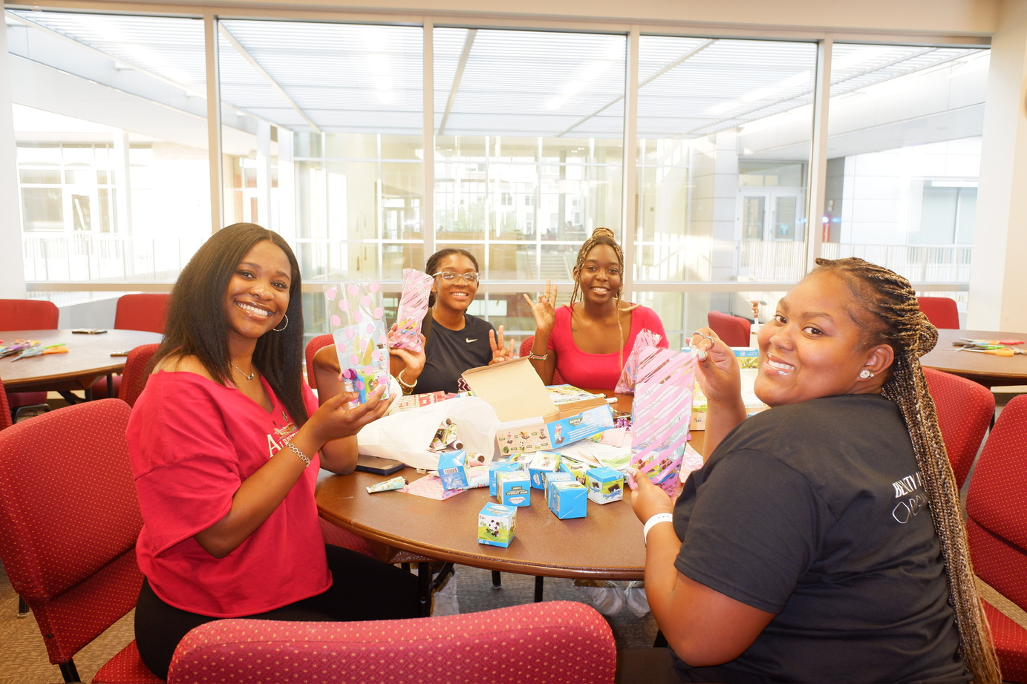
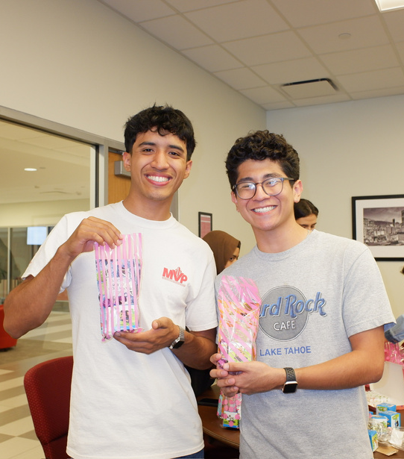
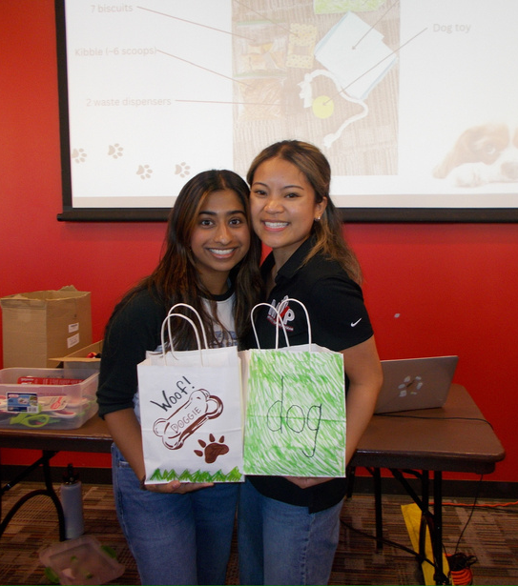
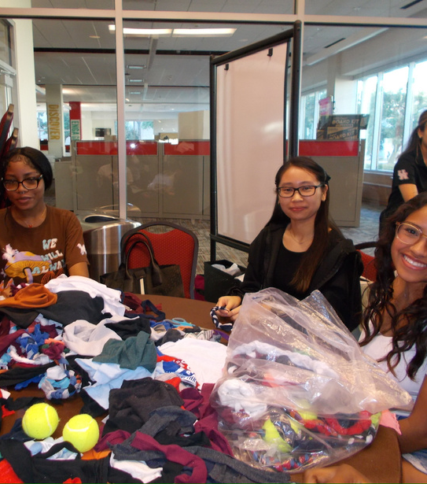
SERVICE NIGHTS
  On-campus event held once a month
    Aimed to provide quick and engaging volunteering opportunity for students
  Recurring tasks include
    Animal Care Packages
    Kit Assembly: sanitation, for patients, relief from cold/warm weather

Slide 9
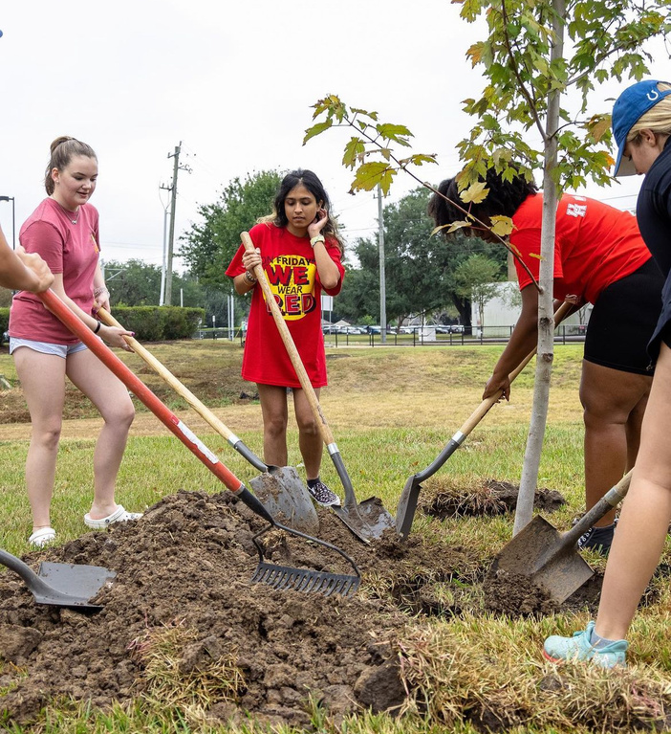
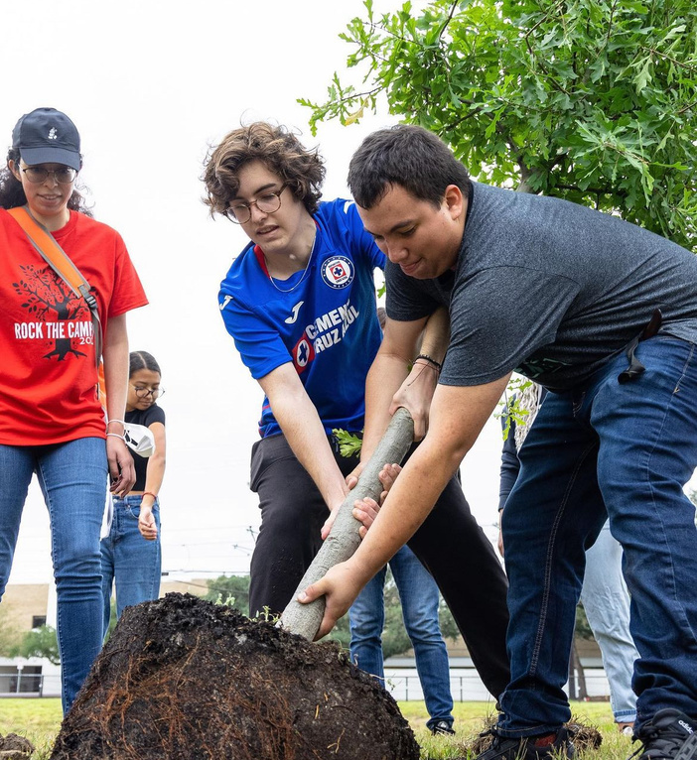
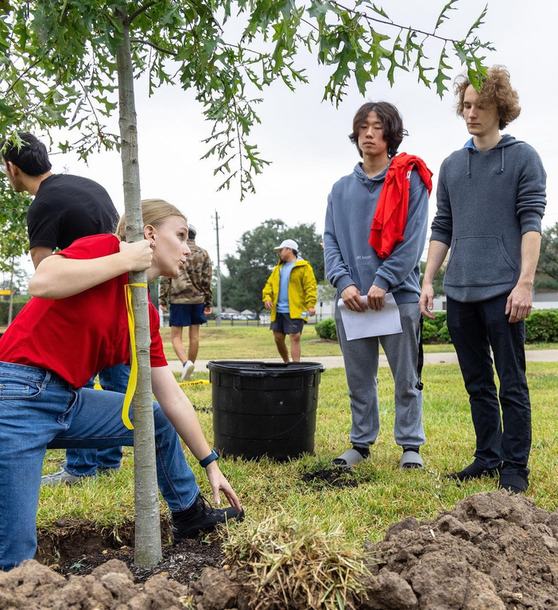
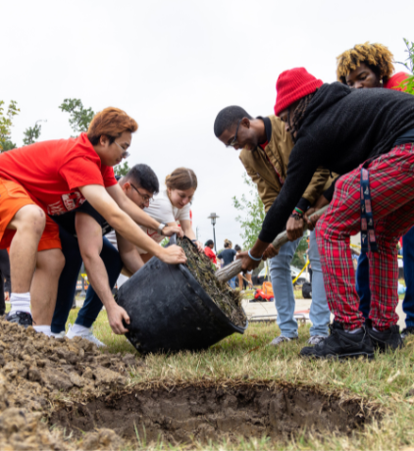
ROCK THE CAMPUS
  Annual on-campus beautification event
  Entire UH campus invited to service event
  Fall Term
    In collaboration with the Homecoming Board during Homecoming Week

Slide 10
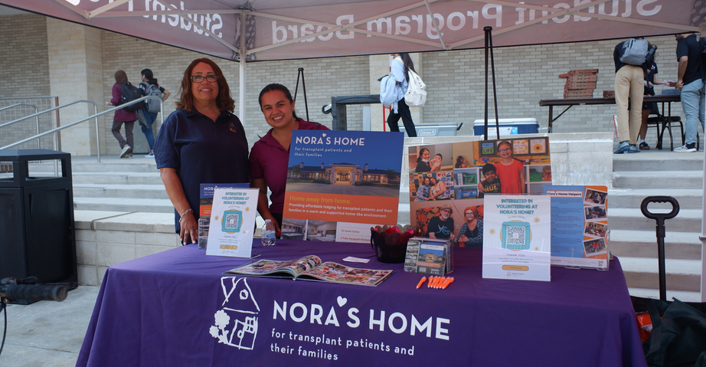
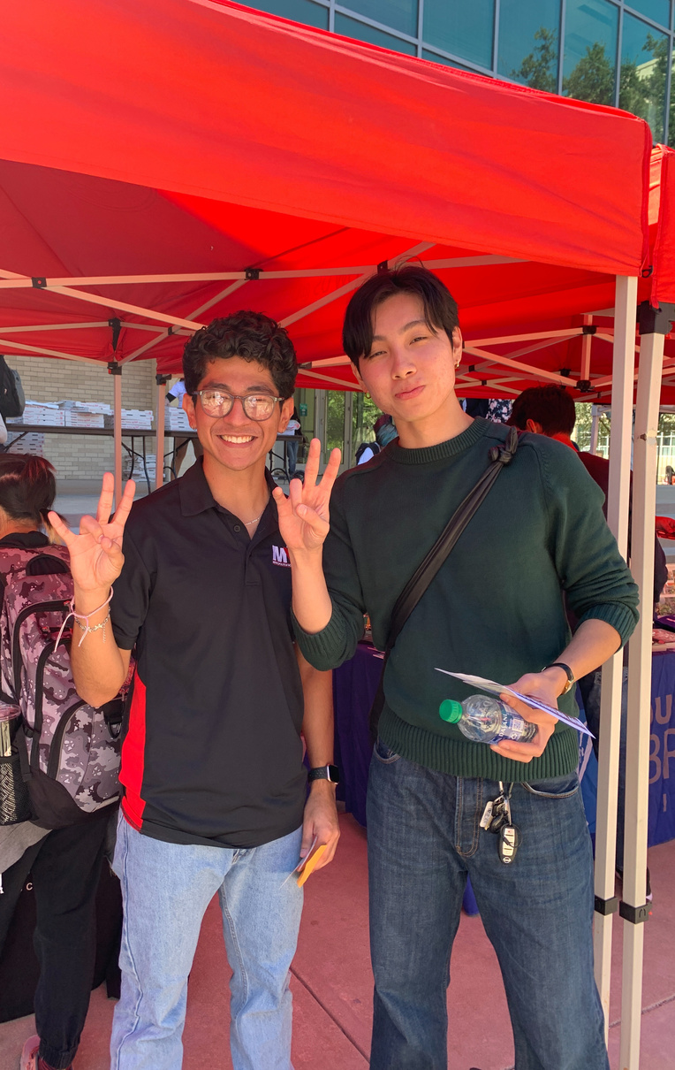
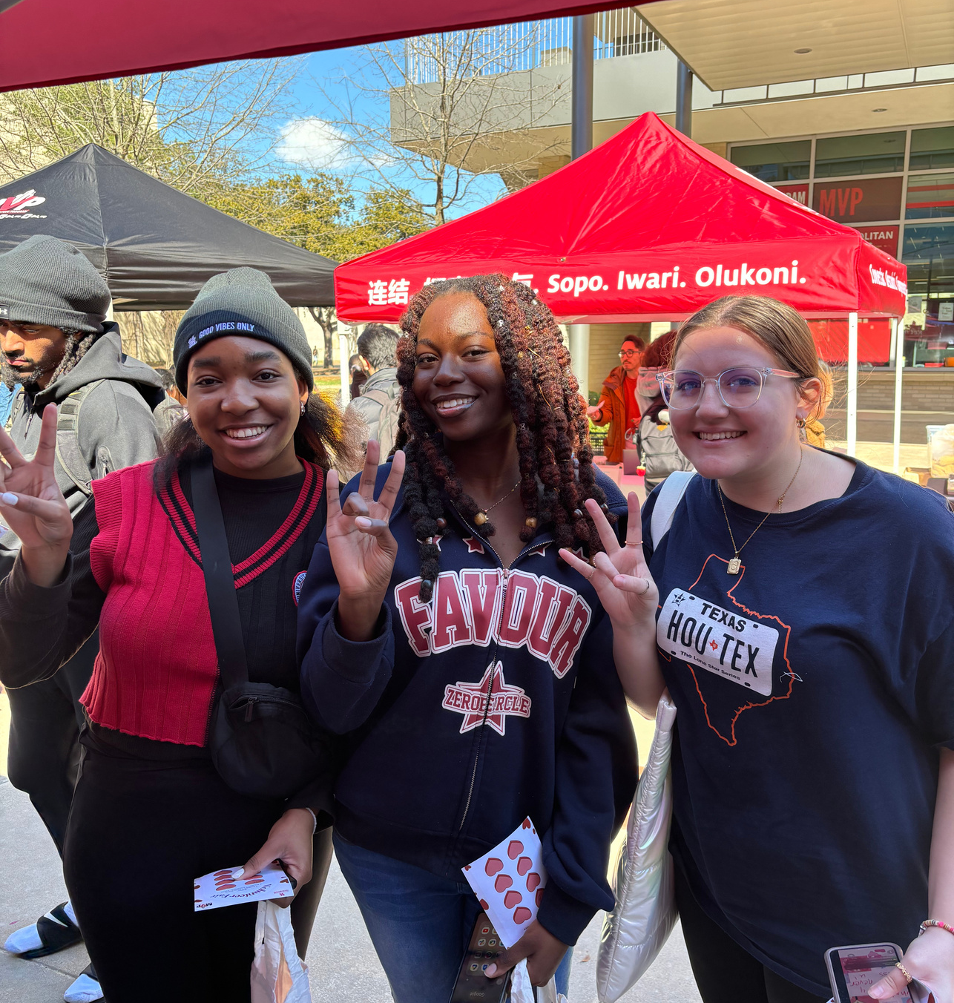
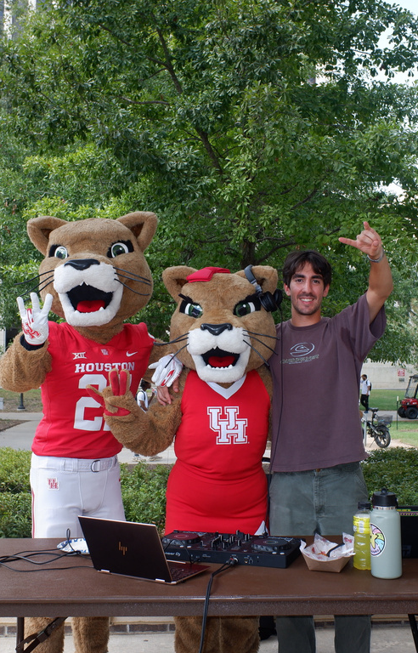
VOLUNTEER FAIRS
  Semi-annual on-campus event to connect UH students to community partners
  Encourages students to connect with our partners and volunteer outside of MVP-sponsored events for service awards and personal Interest
  Over 20 community partners In attendance between fall and spring

Slide 11
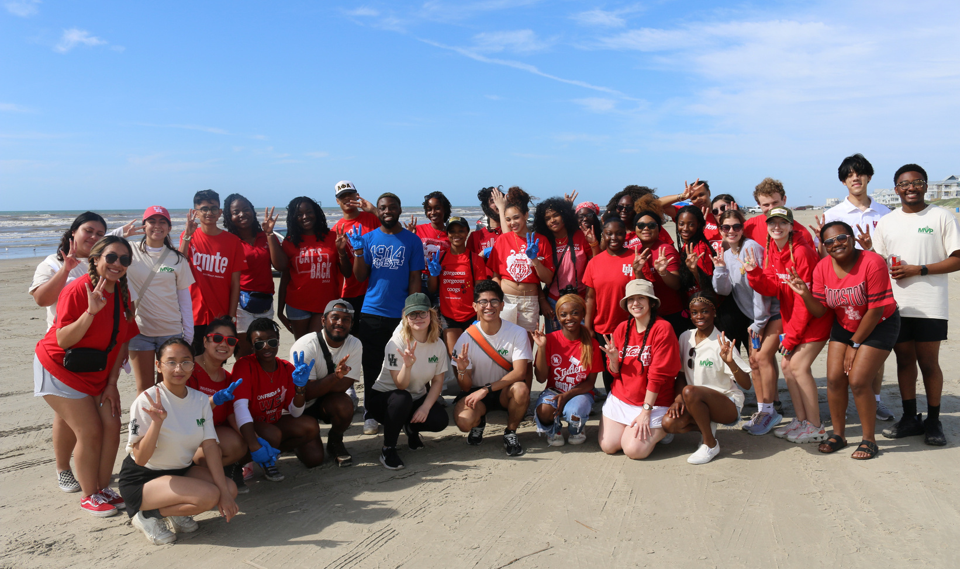
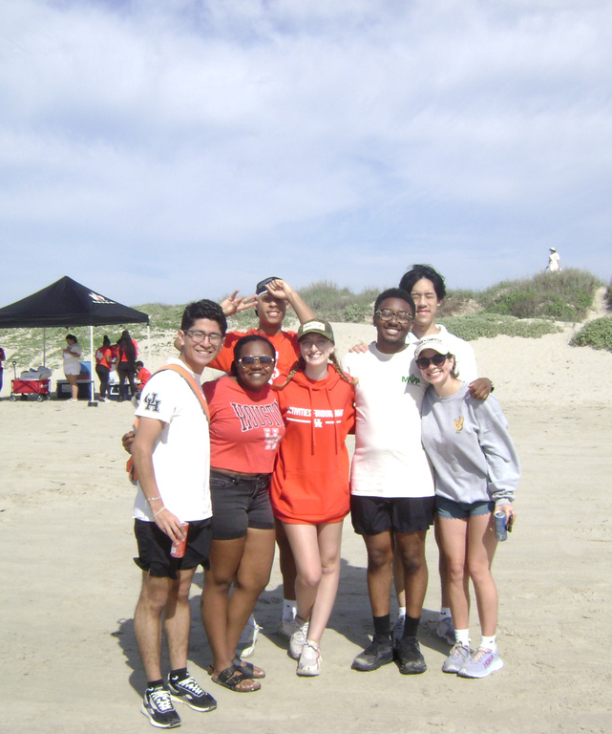
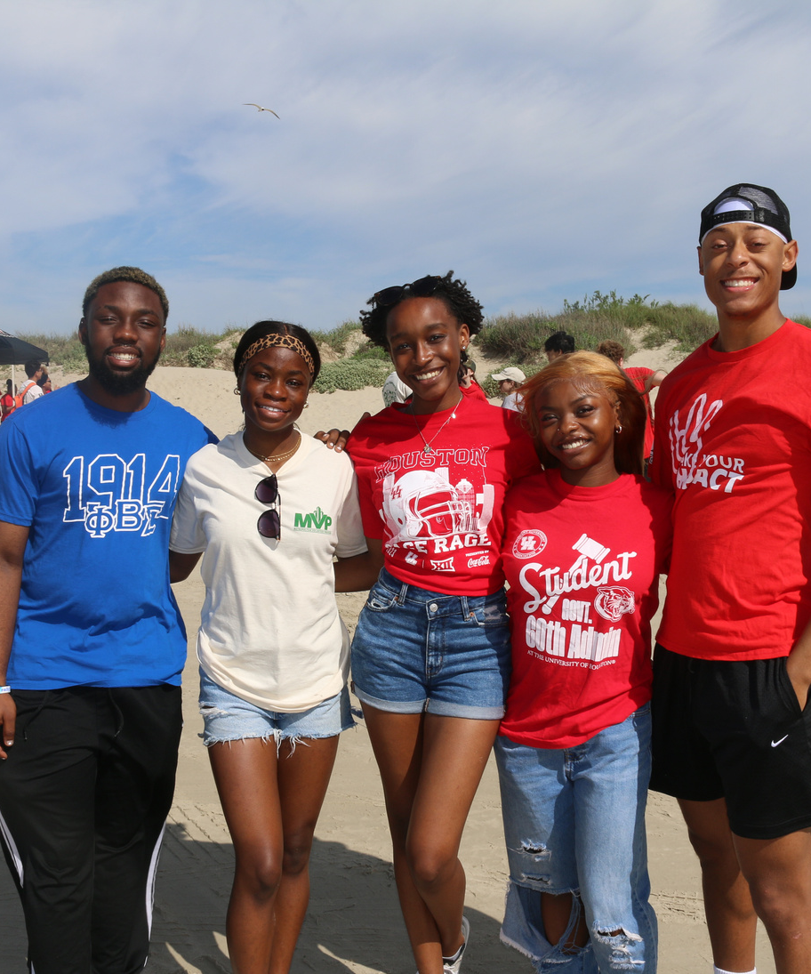
ADOPT A BEACH
  Annual Beach Clean-Up Event
    Takes students off campus to care for the greater Texas environment
  Collaboration with the Texas General Land Office

Slide 12
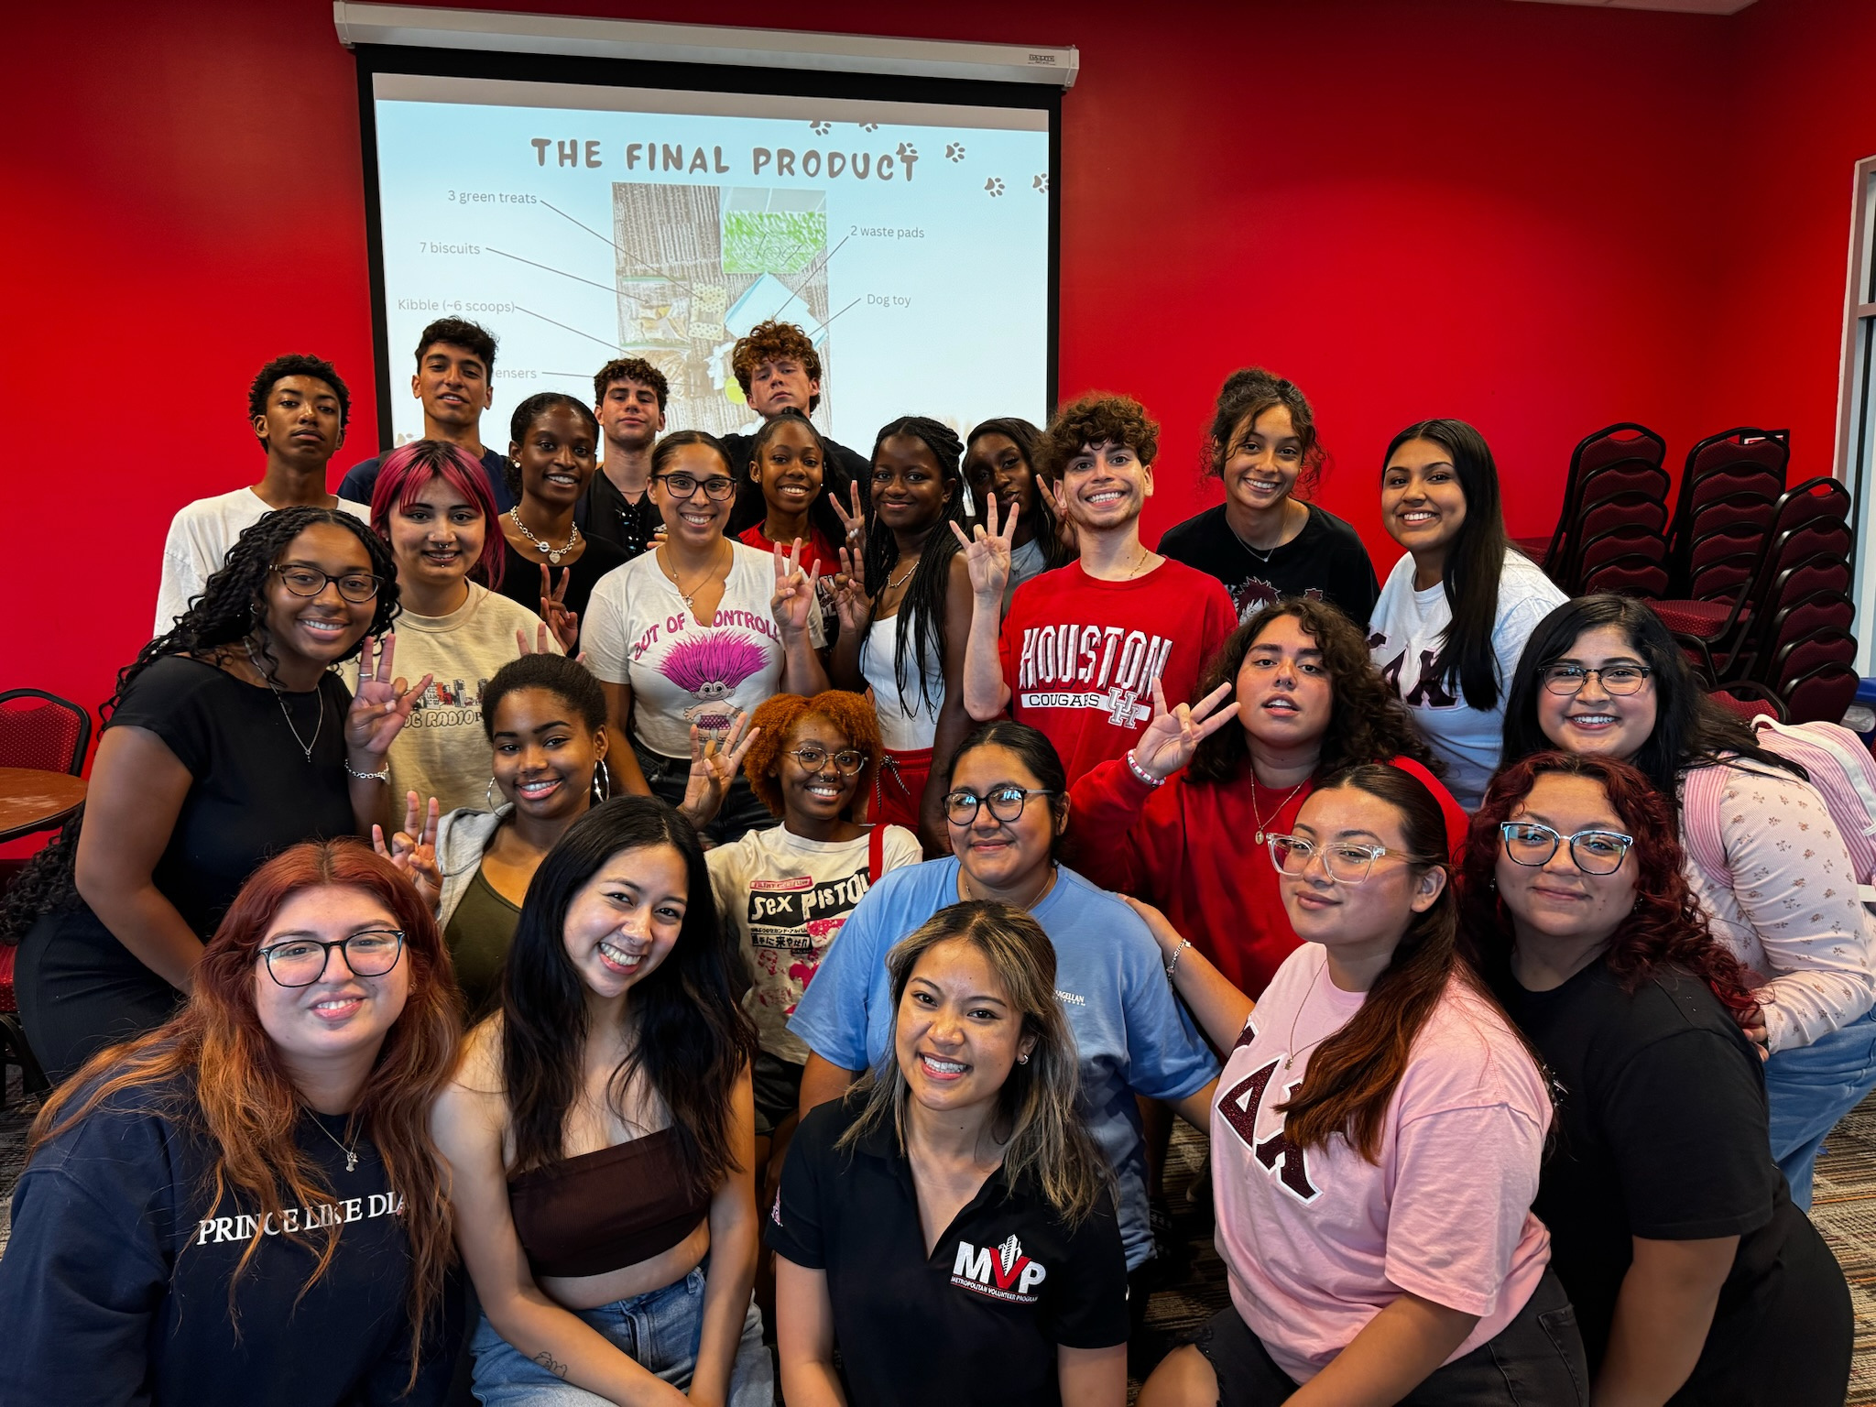
EVALUATIVE DATA

Slide 13
Impact on the Community
1,615 UNIQUE VOLUNTEERS
3,289 HOURS OF SERVICE
Valuation of a Volunteer Hour: $33.49
=$110,148.61 Estimated Monetary Value of Our Impact
http://independentsector.org/resource/value-of-volunteer-time/

Slide 14
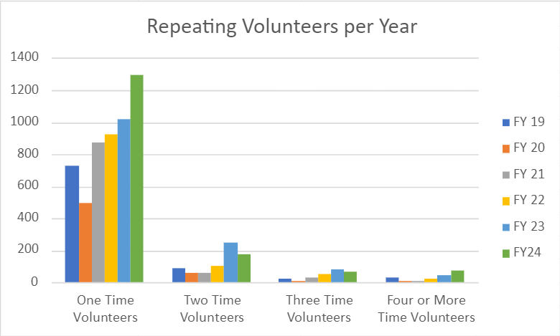
VOLUNTEER NUMBERS

Slide 15
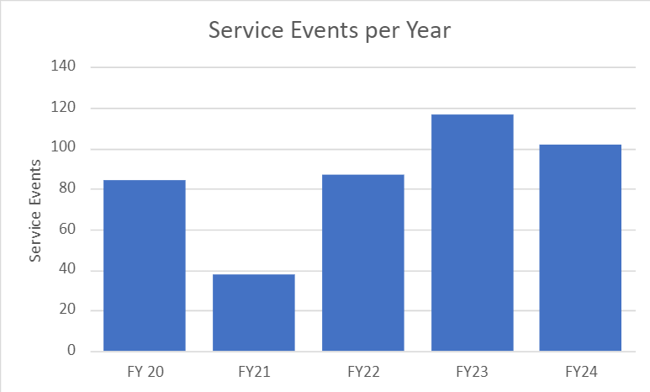
EVENTS HOSTED

Slide 16
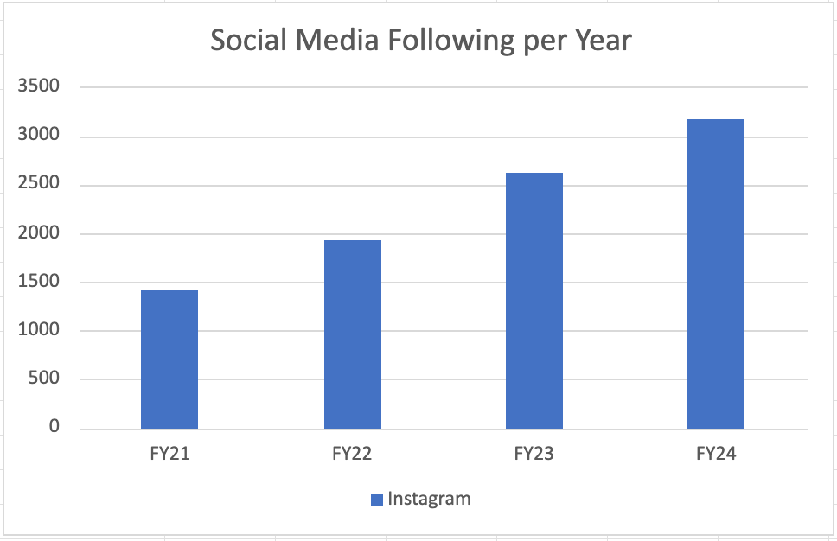
SOCIAL MEDIA GROWTH

Slide 17






















COLLABORATIONS

Slide 18
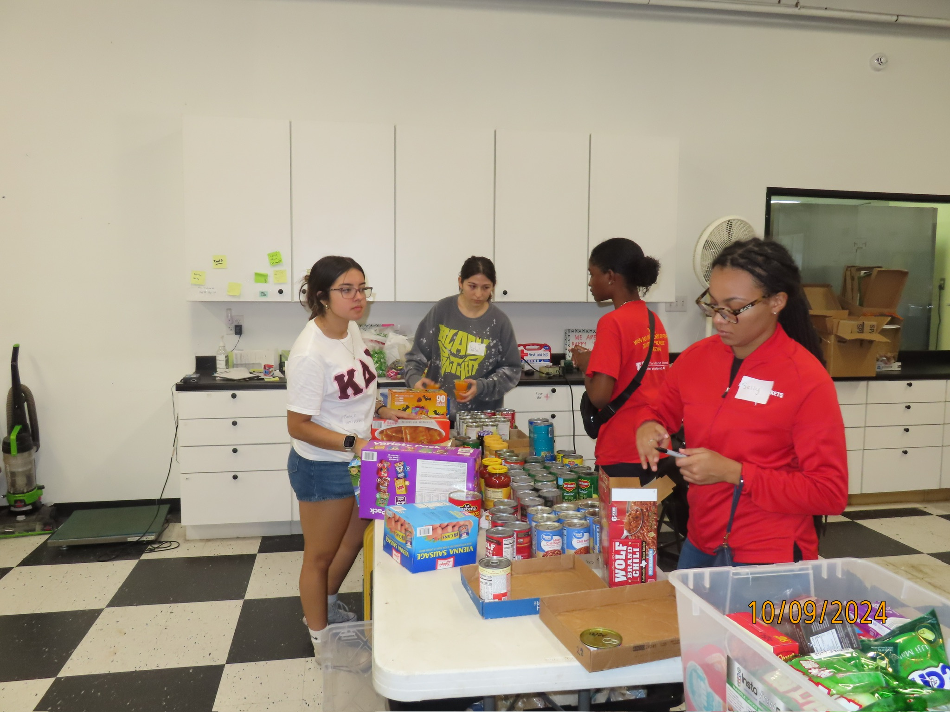
REQUESTS

Slide 19
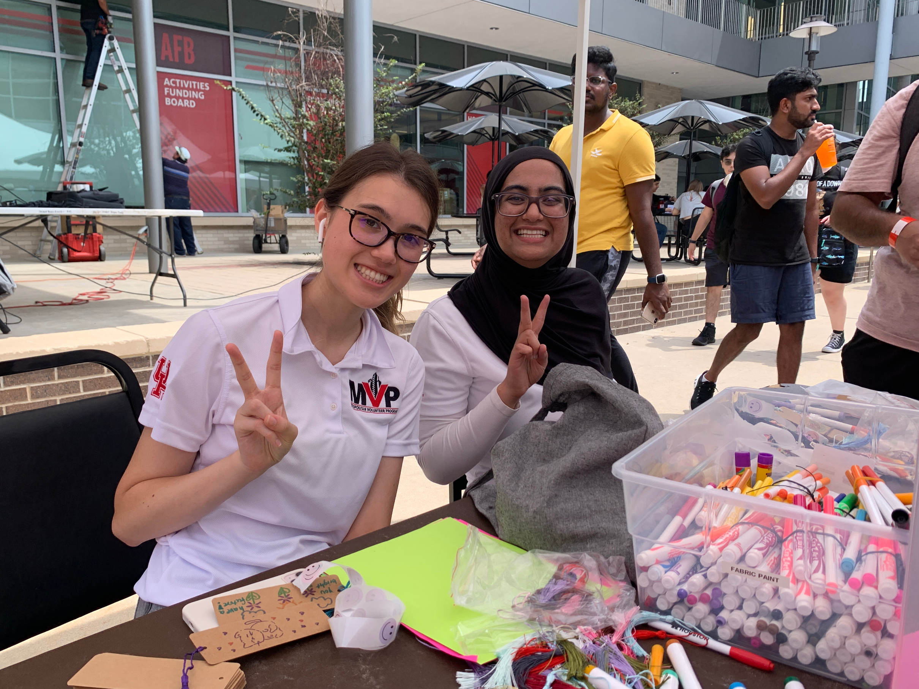
BE THE MVP FY25
BASE AUGMENTATION REQUEST FOR
BE THE MVP
Chair Activity Supplies
Marketing
Entertainment
20x40 Tent and Fans
DJ Services
Food + Drinks
UH Admin Fee
Total Request
$800.00
$500.00
$1,500.00
$2,100.00
$250.00
$2,500.00
$459.00
$8,109.00

Slide 20
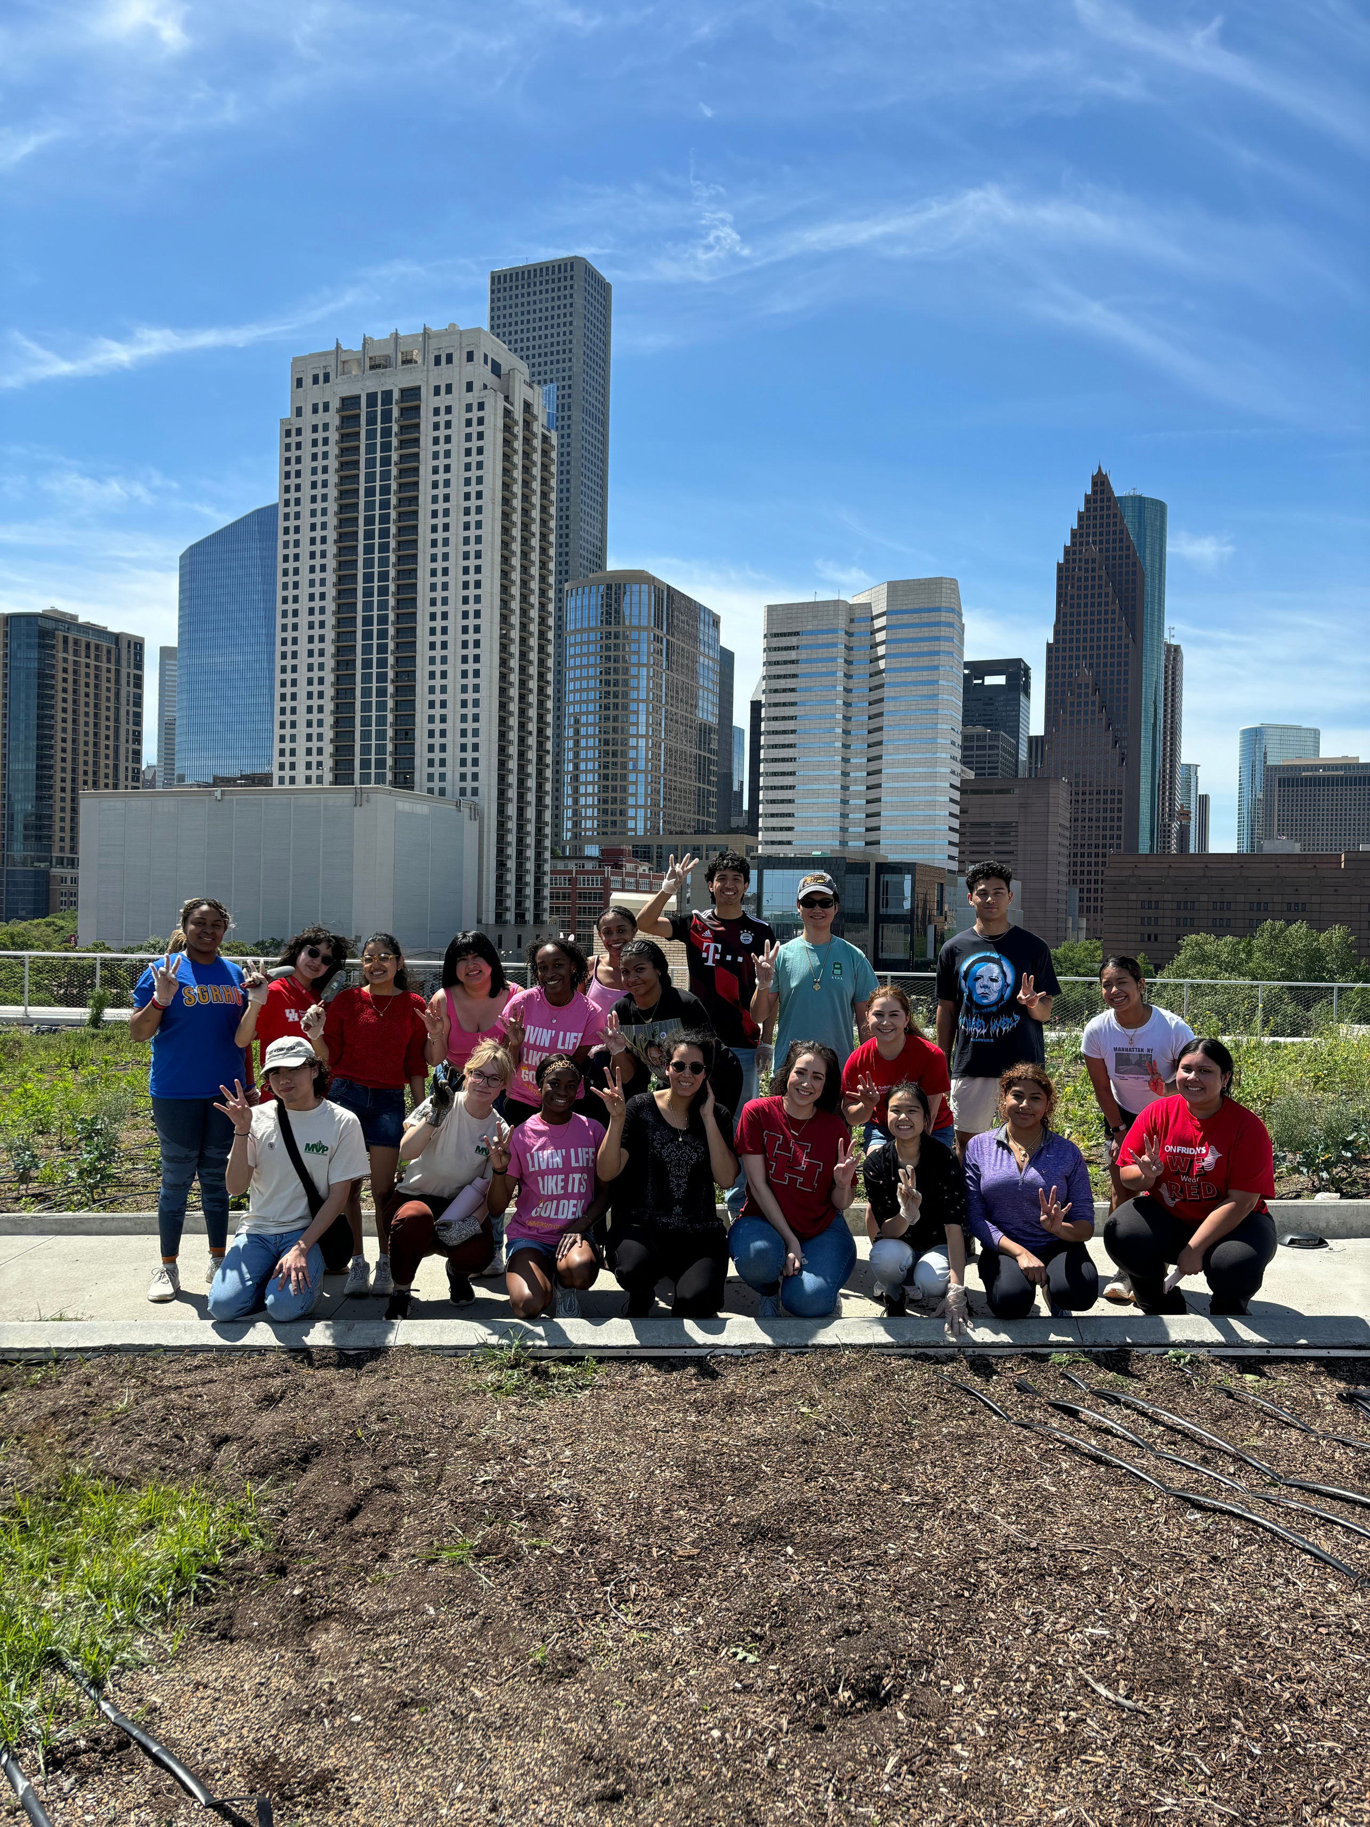
CESAR CHAVEZ DAY OF SERVICE
ONE TIME REQUEST FOR
CESAR CHAVEZ DAY OF SERVICE
$1,080.00
$750.00
$350.00
$400.00
$800.00
$202.80
$3,582.80
Transportation (2 UH Shuttles)
Food & Beverage
On-Site Service Supplies
Marketing
Event Promotional Item
UH Admin Fee
Total Request

Slide 21
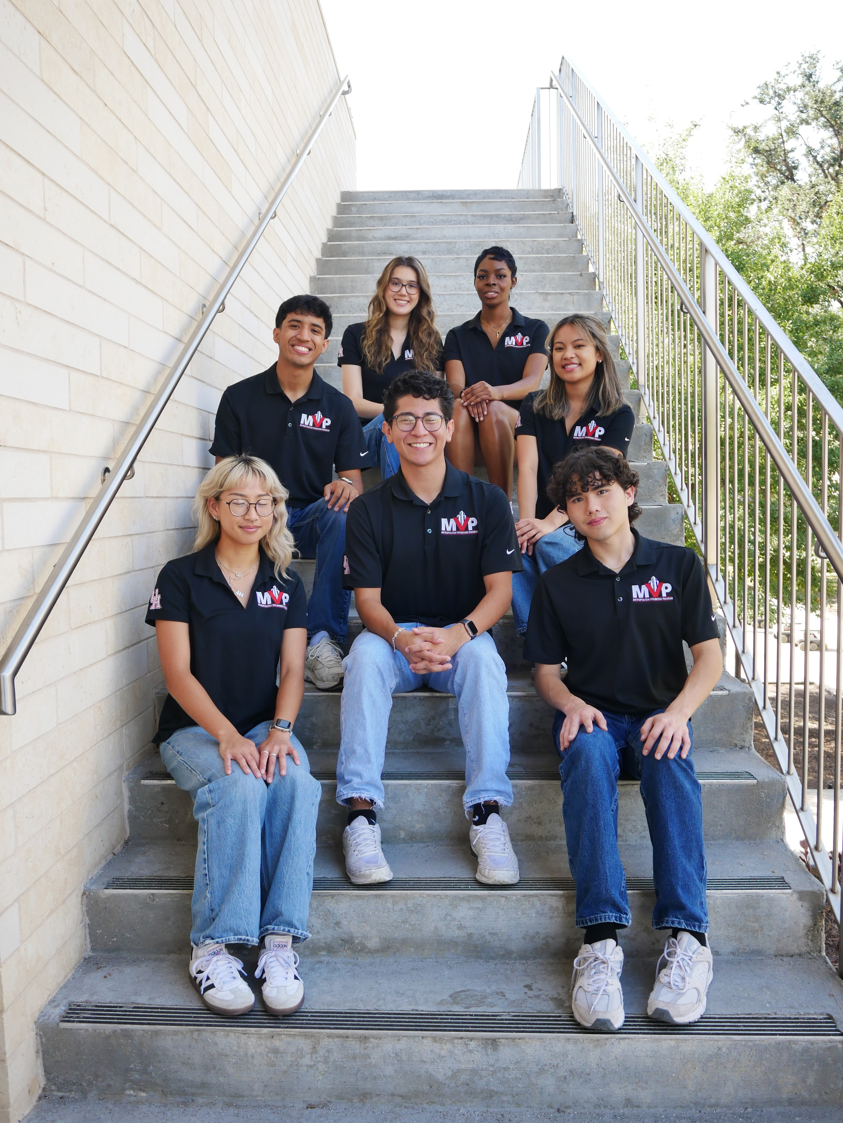
THANK YOU FOR LISTENING!

