Slide 1
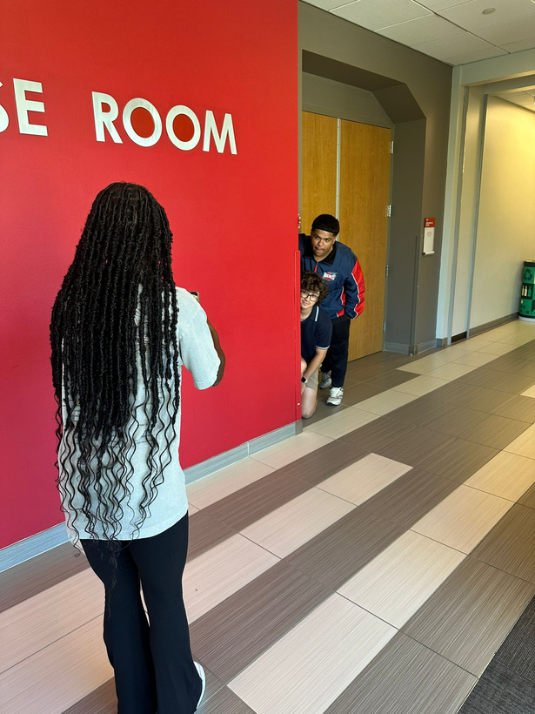
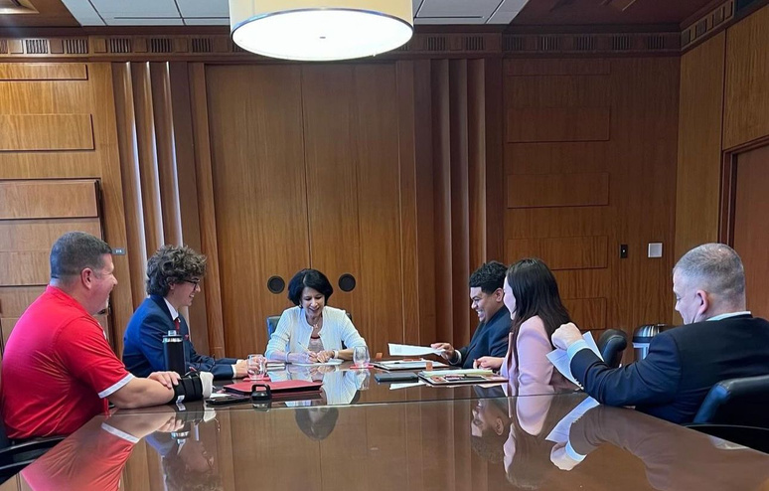
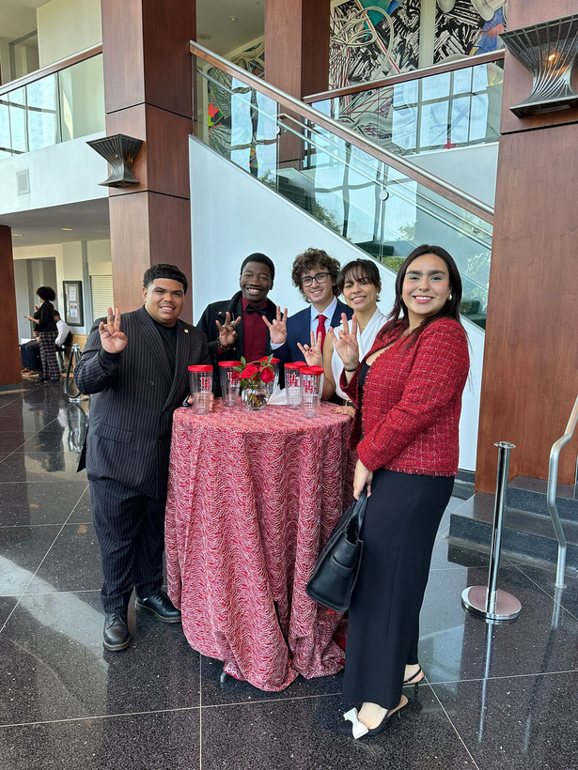
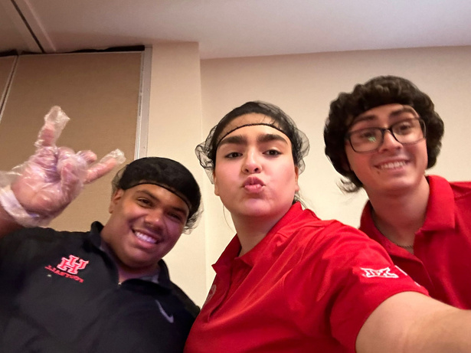
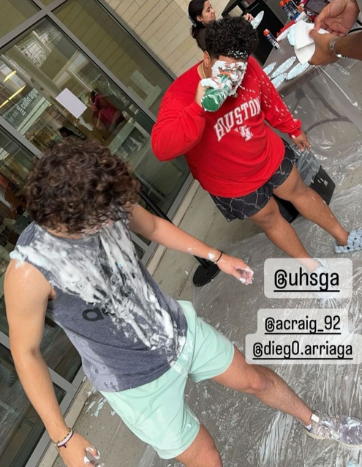
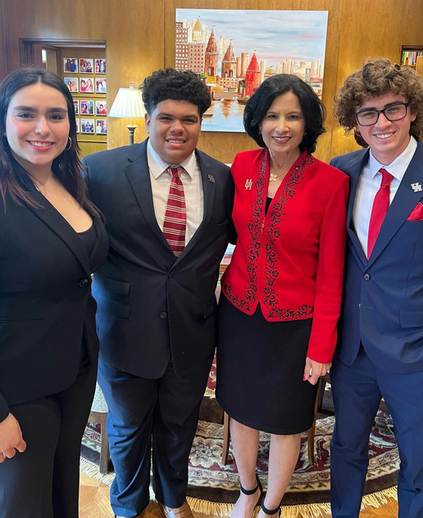
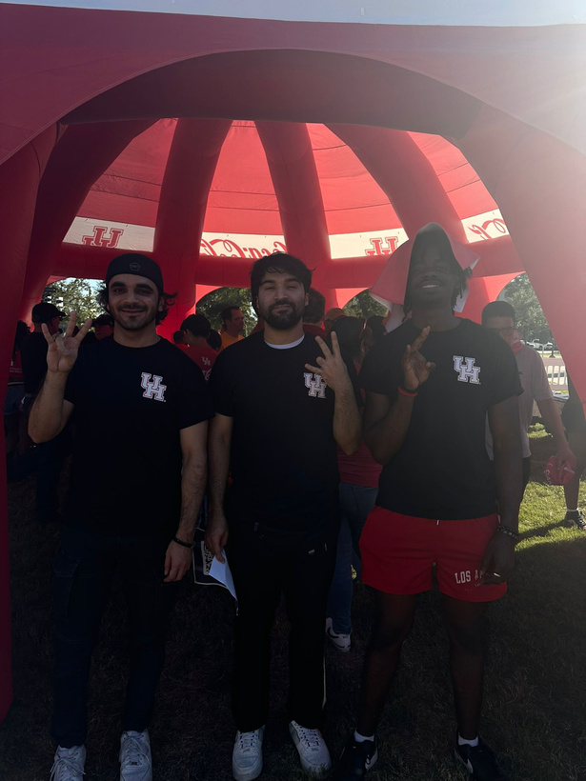
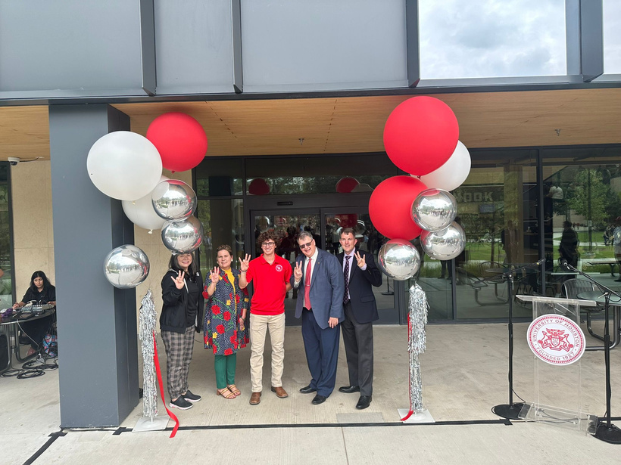
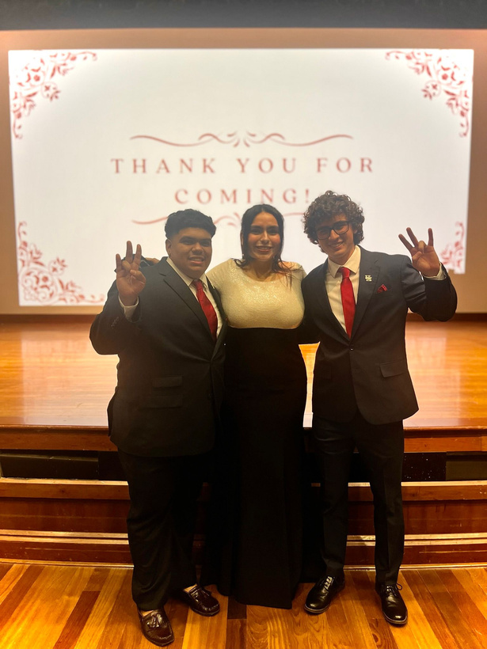
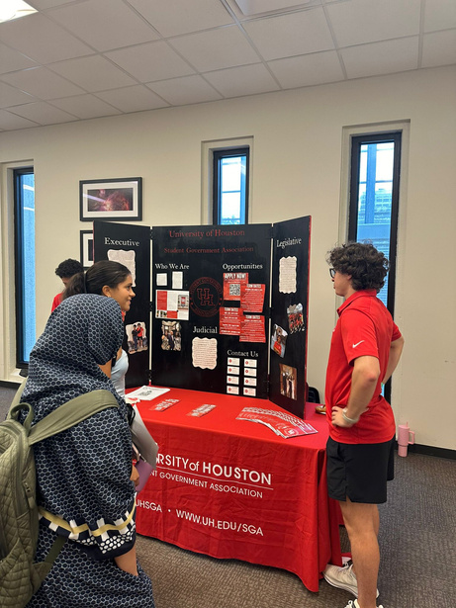
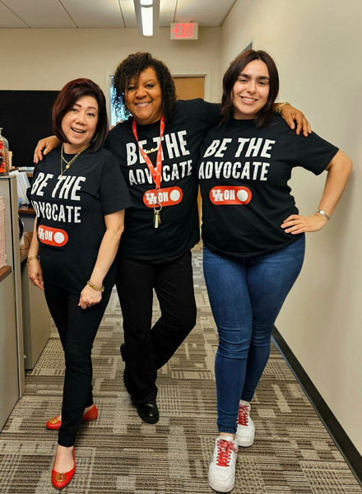
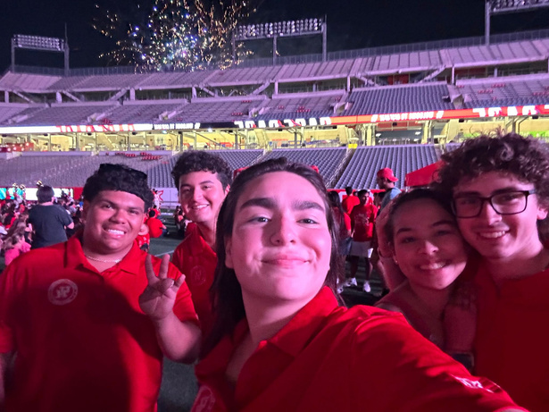
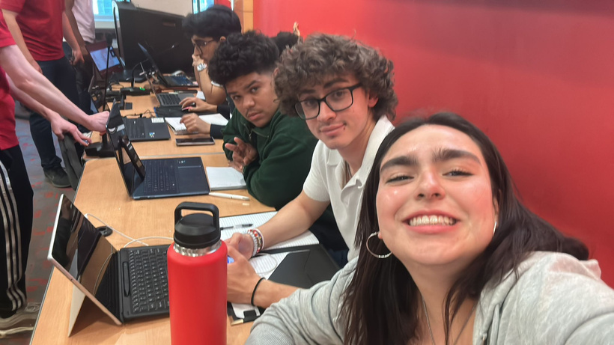
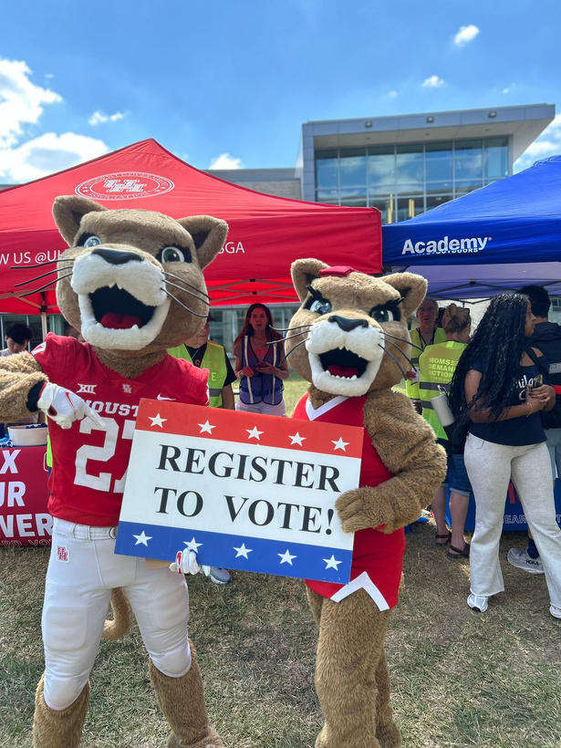
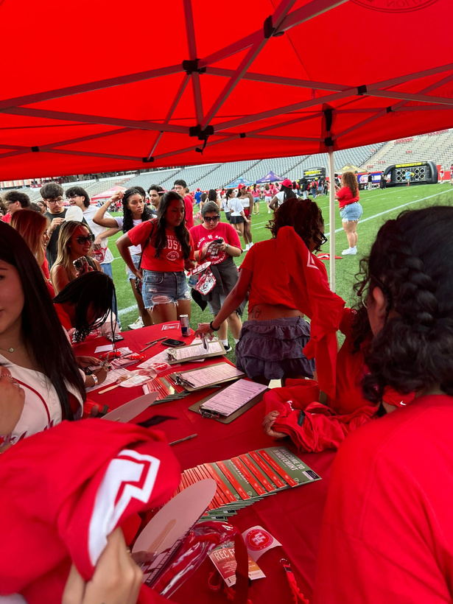
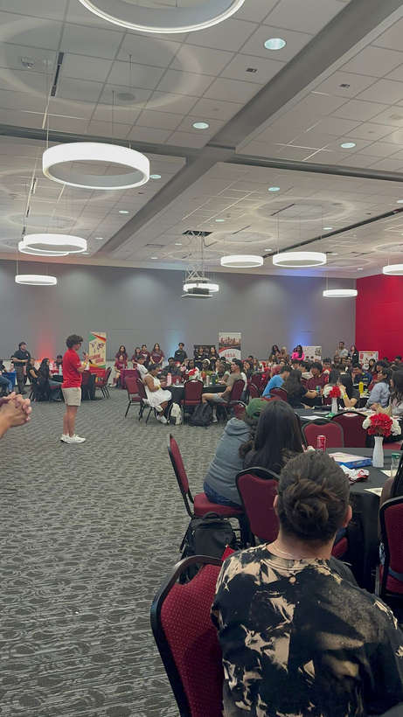
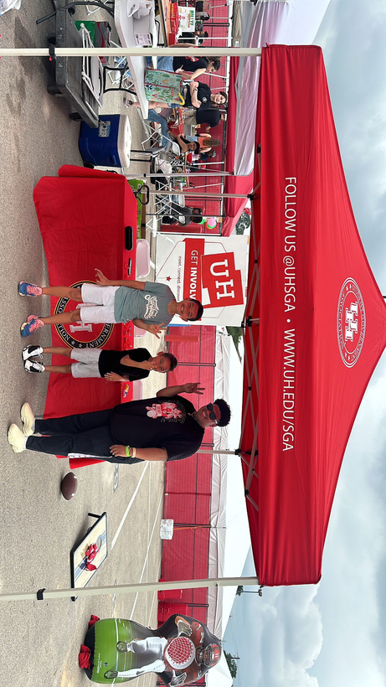
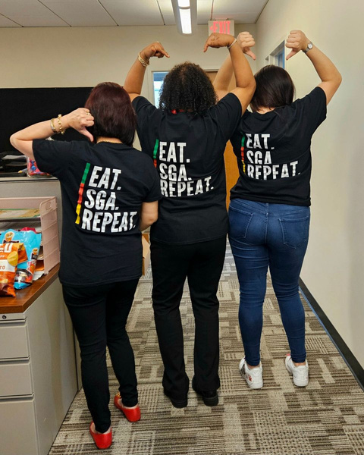
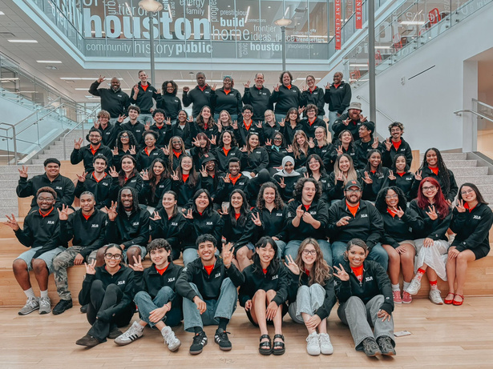
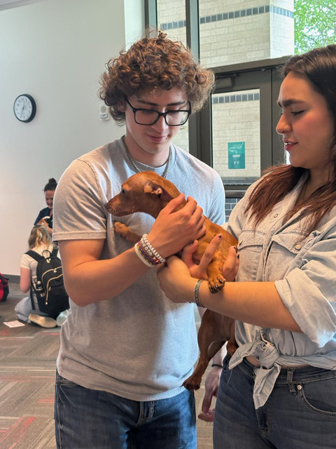
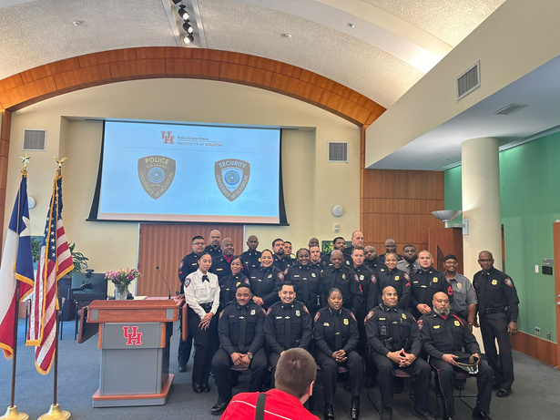
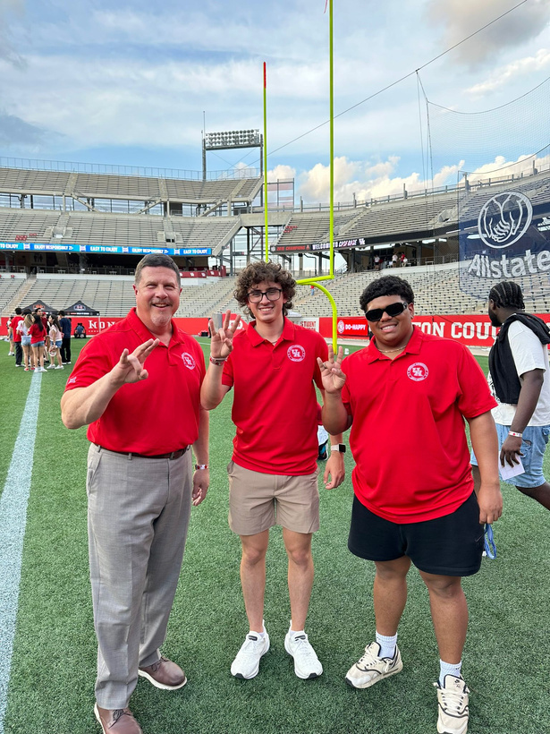
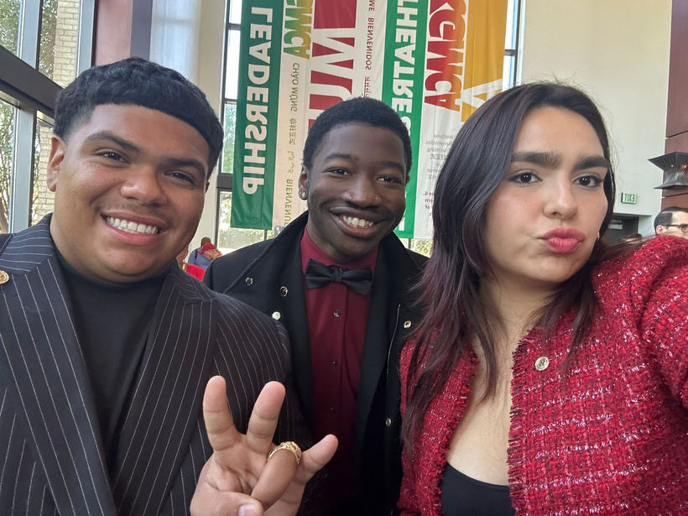
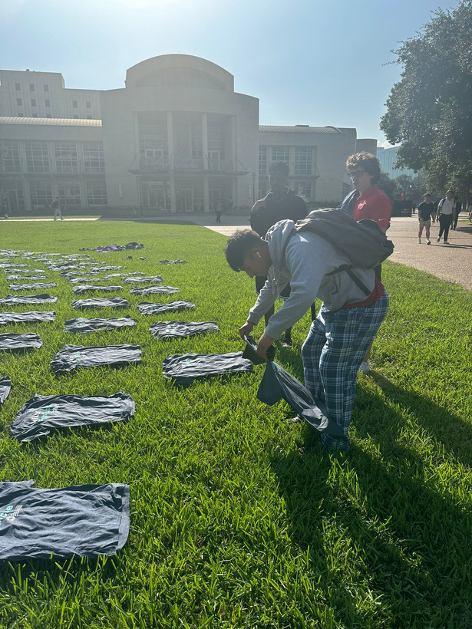

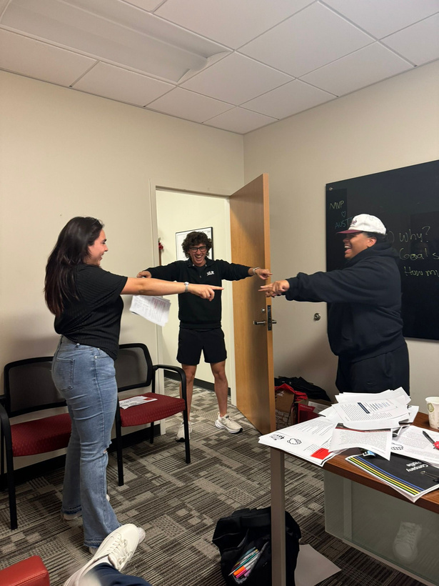
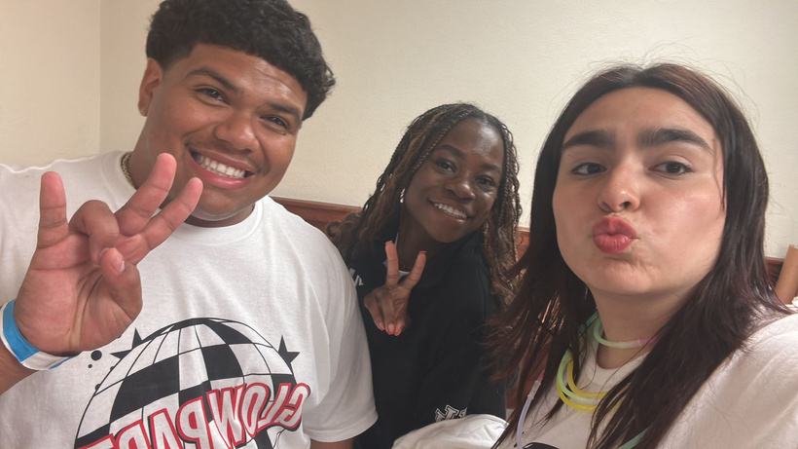
Student Government Association
STUDENT FEES ADVISORY COMMITTEE PRESENTATION
Diego Arriaga, Student Body President
Austin Craig, Student Body Vice-President
Daniela Gonzalez, Chief of Staff
28th October, 2024

Slide 2
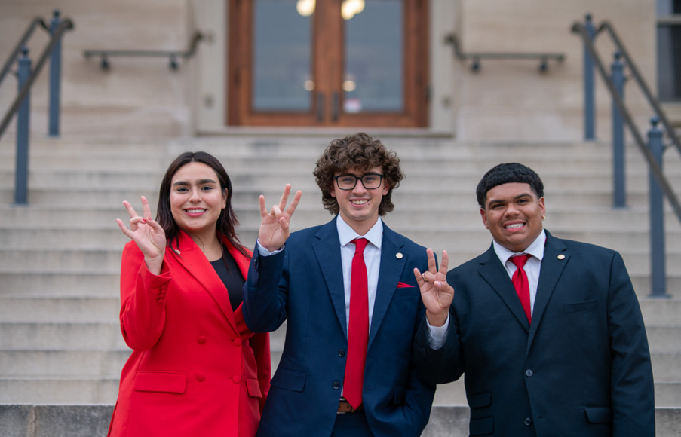
AGENDA KEY TALKING POINTS
  Mission and Purpose of SGA
  Organizational Structure
  Unit Success & Challenges
  Events & Collaborations
  Request Overview

Slide 3
Mission Statement
The Student Government Association exists to serve as the official voice through which student opinion may be expressed and empowered in the overall policy, decision-making process, and services offered at the University of Houston. As such, the Student Government Association is committed to understanding the needs of students and advocating on their behalf. Through continuous interaction with students, faculty, staff, and administration, the
organization works to improve and enhance the quality of the student experience.

Slide 4
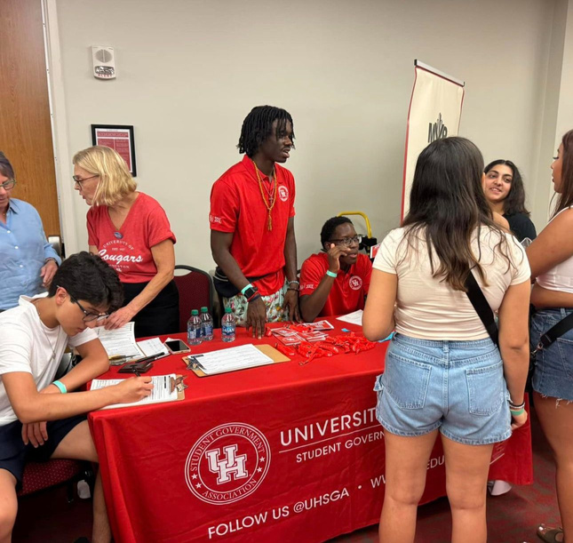
UH DSA STRATEGIC VALUES
Community
  SGA is committed to making sure all students in our community have the opportunity to have the best experience possible at the University of Houston
Collaboration
  SGA is committed to working together to advocate for students through partnerships with our community partners and campus partners to provide the best student experience
Empowerment
  SGA is committed to providing the neccessary resources and encouragement to not only students in our organization but to the student body to advocate for their experience at UH

Slide 5
EXCUTIVE BRANCH ORGANIZATIONAL STRUCTURE
All paid positions
Diego Arriaga
PRESIDENT
Austin Craig
VICE-PRESIDENT
Daniela Gonzalez
CHIEF OF STAFF
(Vacant)
Kristal Crockett-Rodgers
(Vacant)
(Vacant)
MULTICULTURAL AFFAIRS
DIRECTOR OF PUBLIC RELATIONS
DIRECTOR OF EXTERNAL AFFAIRS
DIRECTOR OF OUTREACH

Slide 6
LEGISLATIVE BRANCH ORGANIZATIONAL STRUCTURE
Paid Position
Tavagoh Cockrell
SPEAKER OF THE SENATE
(Vacant)
(Vacant)
SPEAKER PRO-TEMPORE
LEGISLATIVE CHEIF OF STAFF
(Vacant)
Aniyah Hubbard
Jason Jacobs
(Vacant)
(Vacant)
ACADEMIC AFFAIRS CHAIR
ADMINISTRATION & FINANCE CHAIR
STUDENT LIFE CHAIR
INTERNAL AFFAIRS CHAIR
GRADUATE STUDENTS CHAIR
Senate Seats
  UNDERGRADUATE AT LARGE(6)
  GRADUATE AT LARGE(4)
  COLLEGE OF ARCHITECHTURE AND DESIGN(1)
  COLLEGE OF GLOBAL HOSPITALITY AND LEADERSHIP (1)
  COLLEGE OF ARTS (1)
  COLLEGE OF BUSINESS (4)
  COLLEGE OF EDUCATION(2)
  COLLEGE OF EINGINEERING (3)
  COLLEGE OF EXPLORATORY STUDIES(2)
  LAW CENTER (1)
  HOBBY SCHOOL OF PUBLIC AFFAIRS(1)
  HONORS COLLEGE (2)
  COLLEGE OF MEDICINE (1)
  COLLEGE OF LIBERAL ARTS AND SOCIAL SCIENCES (7)
  COLLEGE OF NATURAL SCIENCE AND MATHEMATICS(4)
  COLLEGE OF NURSING(1)
  COLLEGE OF OPTOMETRY (1)
  COLLEGE OF PHARMACY (1)
  COLLEGE OF SOCIAL WORK(1)
  COLLEGE OF TECHNOLOGY(1)

Slide 7
JUDICAL BRANCH ORGANIZATIONAL STRUCTURE
Acting Chief Justice
CHRISTIAN MEDRANO
ASSOSCIATE JUSTICE
ASSOSCIATE JUSTICE
JADEN KIRVEN
CHINWE NWAEZE
ASSOSCIATE JUSTICE
ASSOSCIATE JUSTICE
DERRICK COOPER
DIAN VARUGHESE
ASSOSCIATE JUSTICE
ASSOSCIATE JUSTICE
SALIN LOPEZ
KARLA LANDA
ASSOSCIATE JUSTICE
ASSOSCIATE JUSTICE
LOVE ODUH
(VACANT)

Slide 8
DEPARTMENT OF JUSTICE ORGANIZATIONAL STRUCTURE
Paid Position
(Vacant)
ATTORNEY GENERAL
(Vacant)
DEPUTEY ATTORNEY GENERAL
(Vacant)
AUDITOR

Slide 9
ELECTION COMMISSION ORGANIZATIONAL STRUCTURE
Paid Position
(Vacant)
CHEIF ELECTION COMMISIONER
(Vacant)
DEPUTEY ELECTION COMMISSIONER
(Vacant)
ASSOCIATE ELECTION COMMISIONER

Slide 10
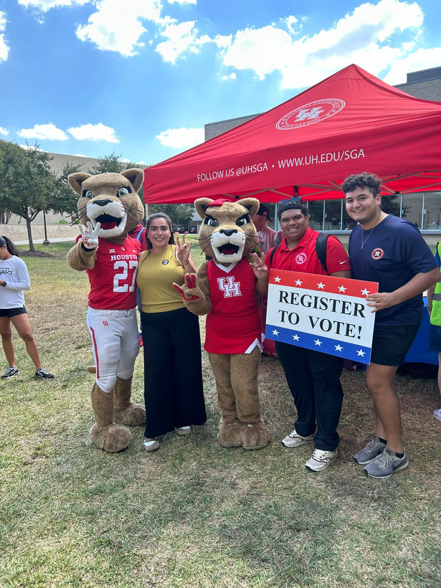

UNIT SUCCESS AND CHALLENGES
Challenge | Success
Organizational Retention | Increased engagement in the Emerging Leaders Program with this year having the most applicants at 52 Emerging Leaders Program has been proposed to be expanded and renamed to bring forth increased engagement Result: encouraging engagement, team work, and leadership while preparing the leaders of tomorrow.
Increasing Voter Registration | Registered 2,248 students to vote Have committed an estimated number of 6,000 students to vote in the upcoming elections
36.3%
Estimated Registered
Freshmen

Slide 11
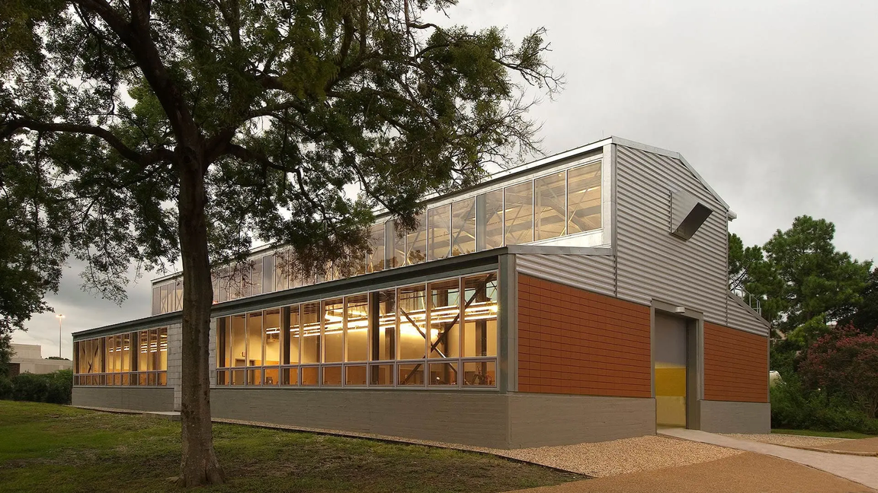
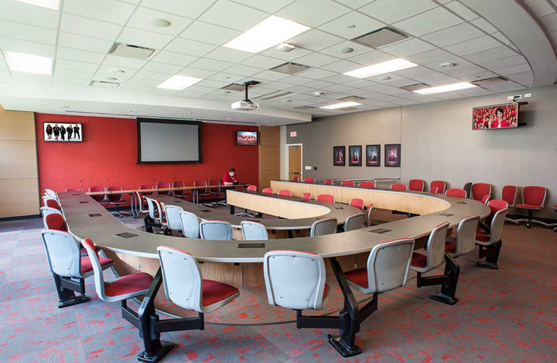
UNIT SUCCESS AND CHALLENGES
Challenge | Success
Makerspace Sustainability | Created a taskforce that meets evert two weeks, aimed at increasing sustainability for spaces such as the Keeland. Currently working with the Dean of the Gerald D. Hines College of Architecture and the Office of the Provost to possibly increase the funding by $50,000 per year till the completion of the Innovation Hub
Increased Knowledge within the organization | We hosted the SGA training at the beginning of the Fall semester Discussed several topics such as communication, our governing documents, our agendas, and other crucial topics.

Slide 12
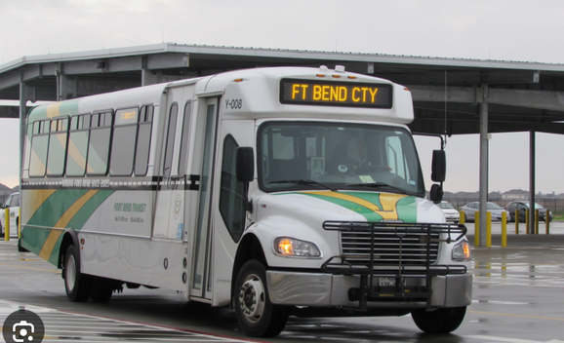
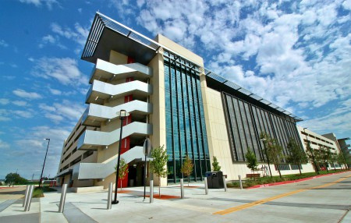

UNIT SUCCESS AND CHALLENGES
Transportation and Parking
Main Challenge: Increasing accesibility and affordability to Transportation and Parking Services
  Fort Bend: Expanded our transportation options by collaborating with Fort Bend county
  Campus Garages: Froze all garage parking prices for the next 2 fiscal years
  Citation Food Drive: Signed MOU to bring 2 citation food drives per semester to campus
Academics
Main Challenge: Increasing University Academic ranking and student success
  CTAP Expansion: We are currently working with the Bookstore Advisory Committee, Faculty Senate, and Office of the Provost to expand the College Textbook Assessibility Program
  Student Success Commission : In partnership with the Office of the Provost we created this commission to tackle academic issues and student success
  Syllabus Improvement: Established a set format to be used by all professors to release syllabuses prior to the year comencing

Slide 13
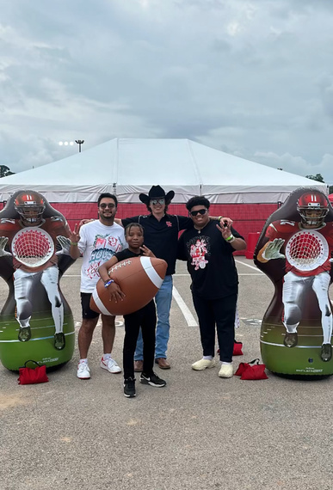
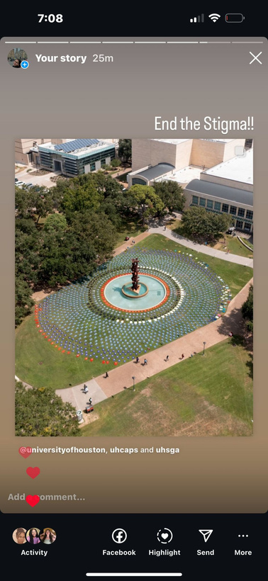
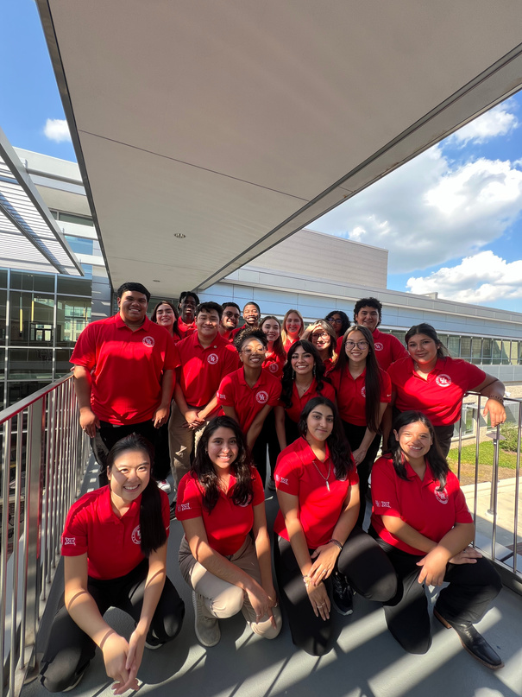
EVENTS AND COLLABORATIONS
SGA X Doctors Without Borders
Big 12 Conference
Water Balloon Fundraiser
  Fundraised over $600 for medical resources .
Attended a conference in Iowa State University where we were able to share initiatives and discuss future advocacy in partnership with all Big 12 schools.
FIESTA Tent
End the Stigma
Hosted a FIESTA tent during family night to bring fun activities for kids and increase engagement with past and future cougars .
Collected over 1,100 shirts, each representing each life lost to suicide on college campuses per year, from different departments and organizations on campus and then donated the to cougar closet.
SGA Training
Trained our senators and leadership team to prepare for the semester by going over communication skills, leadership, & governing documents.
HSI Day
Worked on the HSI Day planning committee to participate in any capacity, mainly volunteering. We were able to represent our 33% Hispanic population.
Voter Registration Finale
Registered a total of 348 students to vote on the last day of voter registration. This was in collaboration with 3 differnt groups throughout campus.

Slide 14
EVENTS AND COLLABORATIONS
Weeks of Welcome
Participated in over 10 events in during weeks of welcome engaging with over 15,000 students. Below are our hosted/highlight events:
  Be the Advocate: Increase engagement and knowledge of what SGA is. Turn out was 60 people.
  Glow party: Was a key organization in providing glow items, volunteers, and helping with logistics. it had over 800+ students in attendance
  Speed Friending: MC’d, Volunteered, and coordinated events with the Health and Wellness Departments.
  Shastas Open House: Had an attendance of over 150 students come by our office
  Healthy Tailgate: In collaboration with DOS and the Health & Wellness Center by volunteering to provide food to students, staff, faculty, and guests.
  Student Mixers: Tabled at every student mixer as well as gave out promotional items and taught the importance of SGA and for students voices to be heard

Slide 15
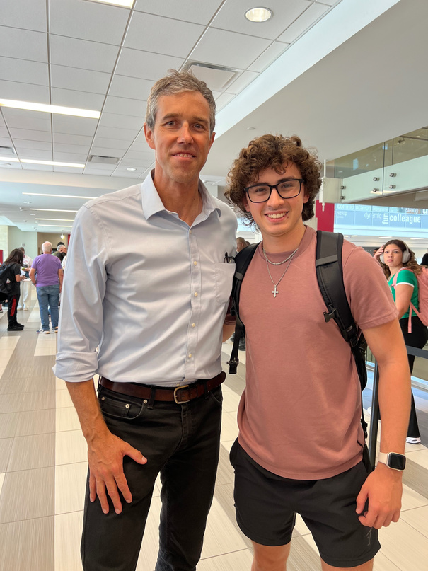
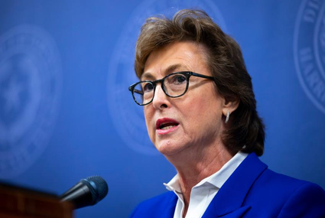
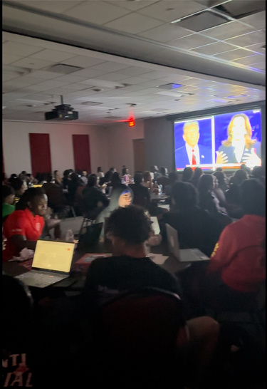
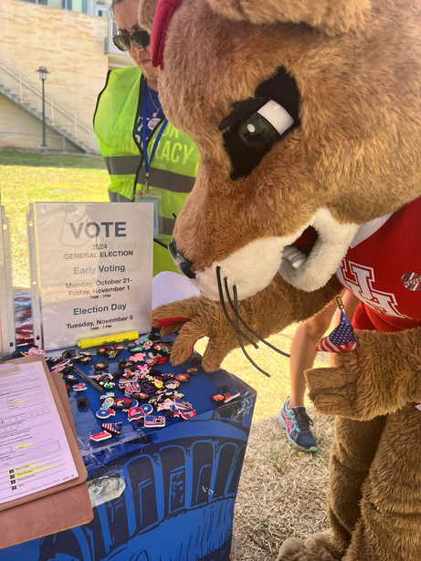
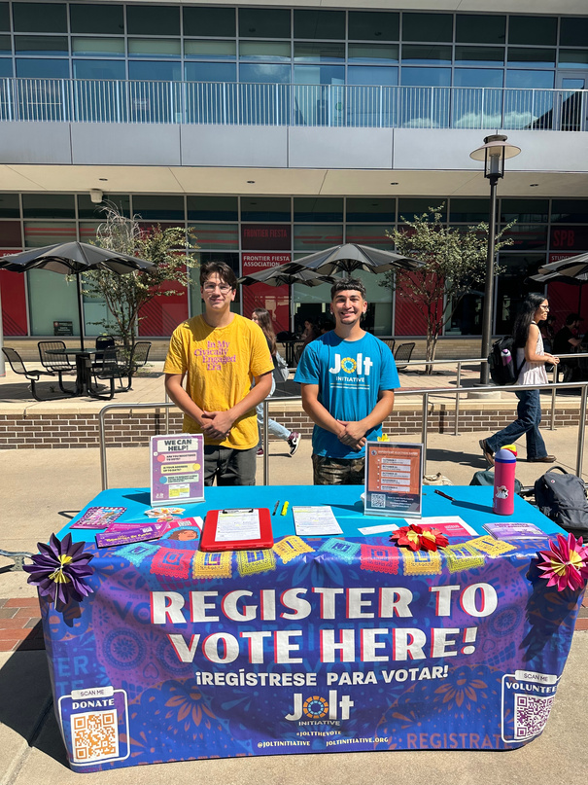
EVENTS AND COLLABORATIONS
Preparing for the Polls with Beto
Press Conference with DA
After 4 months of hard work and writing a proposal, the District Attorneys Office gave the Student Government Association $63,250 for our Sexual Assault Initiative.
Held voter registration tabling with special guests and registered over 150 students in two hours.
Presidential Debate Watch Party
National Voter Registration Day Bonanza
SGA collaborated with Phi Beta Sigma Fraternity Inc. to watch the Presidential Debate. We had a turn out of approximately 150 students.
Partnered up with Move Texas and registered 116 students to vote while having fun activities like giant jenga, spray tattoos, photobooth, and painting wall.
Hispanic Voter Registration Party
Ready to Vote with Beto
Partnered up with UH BLACK to have a conversation about voter registration. In this event, we were able to engage with over 400 students and register 178 students to vote.
We partnered up with Somos UH, and focused on registering Hispanic students to vote during Hispanic Herritage Month.

Slide 16
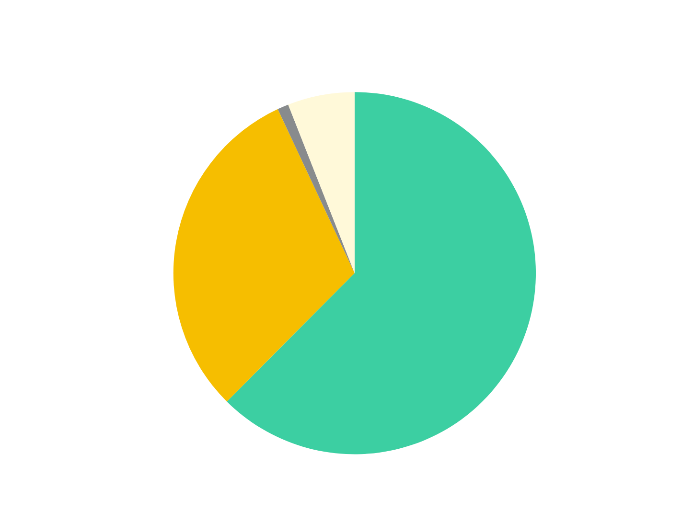
BUDGET OVERVIEW
Total Budget: $171,906
Budget Node | FY24 Budget | FY24 Actuals | Variance | FY25 Budget
Salary and Wage | $131,765 | $62,678 | $69,087 | $107,822
Maintenance & Ops | $51,574 | $41,035 | $10,539 | $52,800
Travel & Business | $1,500 | $1,502 | $(2) | $1,500
Admin Charges | $9,175 | $6,313 | $2,862 | $9,784
TOTAL | $194,014 | $111,528 | $82,486 | $171,906

Slide 17
BE THE ADVOCATE FY26
One - Time Request
Total Request: $2,650
Be the Advocate is an event increase constituency engagement, institutional information and centralization of information regarding not only SGA but the shared governmenance model at UH. This is done by hosting a mutli-tabling event. we are requesting $2,650 to go towards outreach, food, and promotional items for students

Slide 18
END THE STIGMA FY26
One - Time Request
Total Request: $1,060
End the Stigma is an Event recognizing the need to continue the conversation of mental health by honoring the 1,100 students who commit suicide every year across college campuses. SGA is requesting $1,060 to increase the marketing and awarness of the event by increased tabling as well as begin tracking student engagement.

Slide 19
INTERNATIONAL MOTHER LANGUAGE DAY FY26
One - Time Request
Total Request: $2,120
International mother language day is an event created to recognize all the languages of the various cultures across UH. We are requesting $2,120 to cover the food court of food for the event as well as the tabling and outreach neccessary to truly engage the student body

Slide 20
SGA SENATE FORUM/CONFERENCE FY26
One - Time Request
Total Request: $2,120
The SGA Senate Forum is an oppurtunity to bring a greater awarness and engagement with students specifically by interacting with Senator Candiates from all parties in the election. SGA is requesting $2,120 to cover the cost of food, tabling as well as the marketing and outreach necessary for a event of this size.

Slide 21
SHIELA JACKSON LEE EMERGING LEADERS PROGRAM FY26
One - Time Request
Total Request: $1,590
The SJL Emerging Leaders Program aims to develop future campus and community leaders through interactive learning experiences and internships within SGA. As the responsibilities of the Emerging Leaders within our organization have expanded, the 61st administration would like to increase the funding of the program to improve further the outcome of the program and the student-to-student engagement rate within the program. Hereby, creating the leaders of tomorrow within the organization and the university. $1,500 would cover all the event expenses including, food, outreach/collaboration, marketing, decorations, etc and $90 would cover the business and administrative fees.

Slide 22
STIPEND FOR ATTORNEY GENERAL
One - Time Request
Total Request: $1,272
The attorney general is a crucial portion of SGA and carries out extensive duties with the stipend for the position it brings about greater interaction for students to apply for the position as well as accurelty compensate the student for the responsibilities necessary for the position.

Slide 23
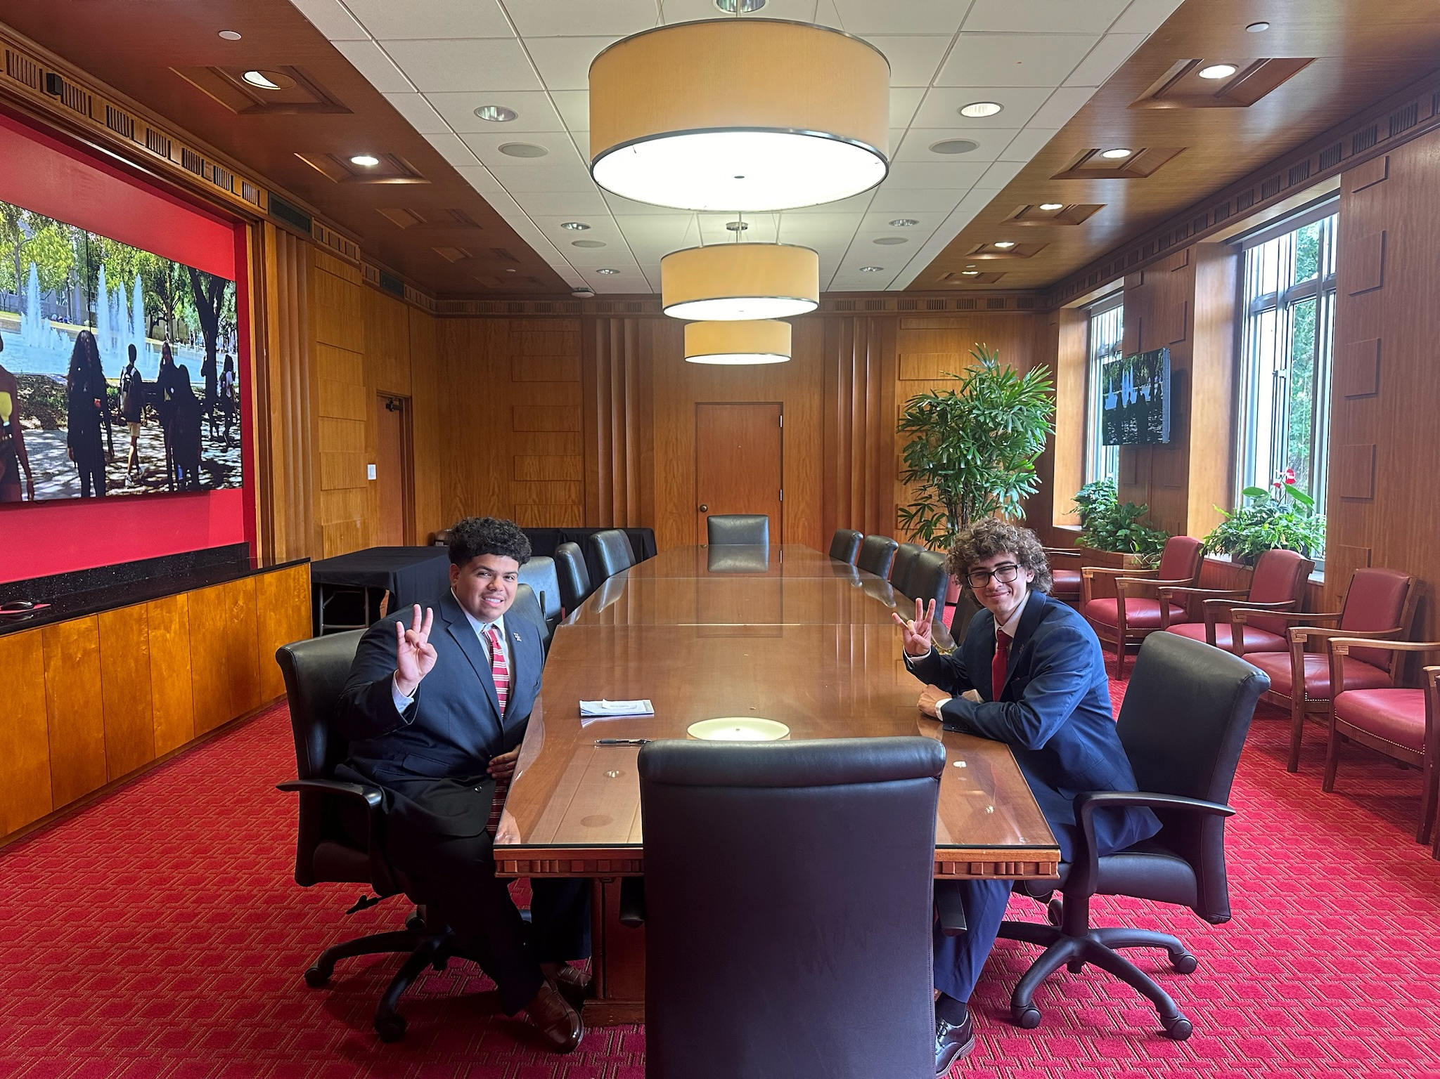
Thank you!
STUDENT GOVERNMENT ASSOCIATION
Diego Arriaga, Student Body President
Austin Craig, Student Body Vice-President
Daniela Gonzalez, Chief of Staff
28th October, 2024

