Slide 1
Student
Program
Board
SFAC PRESENTATION

Slide 2
Mission and Purpose of SPB
Organizational Structure
Today’s Agenda
Our Board
Unit Successess and Challenges
Past Attendance
Key Talking Points
SPB Major Events
Request Overview

Slide 3
MISSION
The Student Program Board’s mission is to enhance the student experience at the University of Houston and bring the UH community together through entertaining, thought-provoking, and exciting events. SPB exists to create programs with social, cultural, and intellectual aspects for the student body throughout the year which all students are encouraged to attend. SPB will also provide opportunities for students to excel in leadership roles and assist in enhancing the student experience through our many committees.

Slide 4
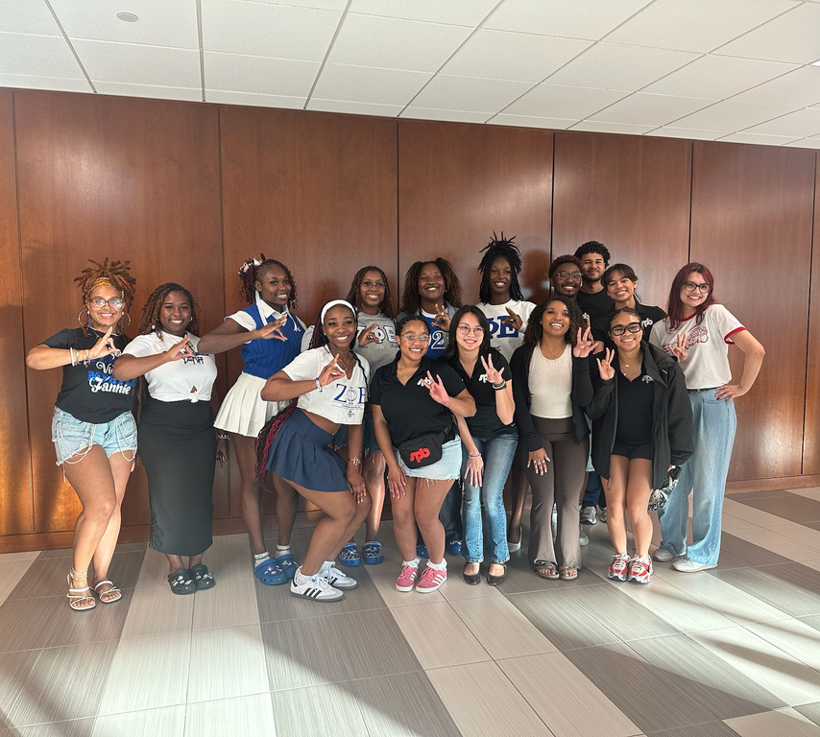
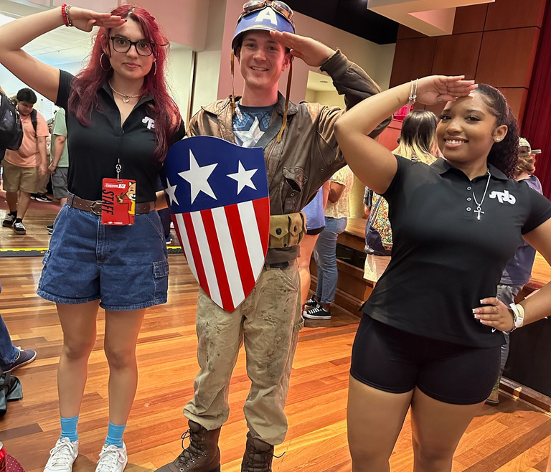
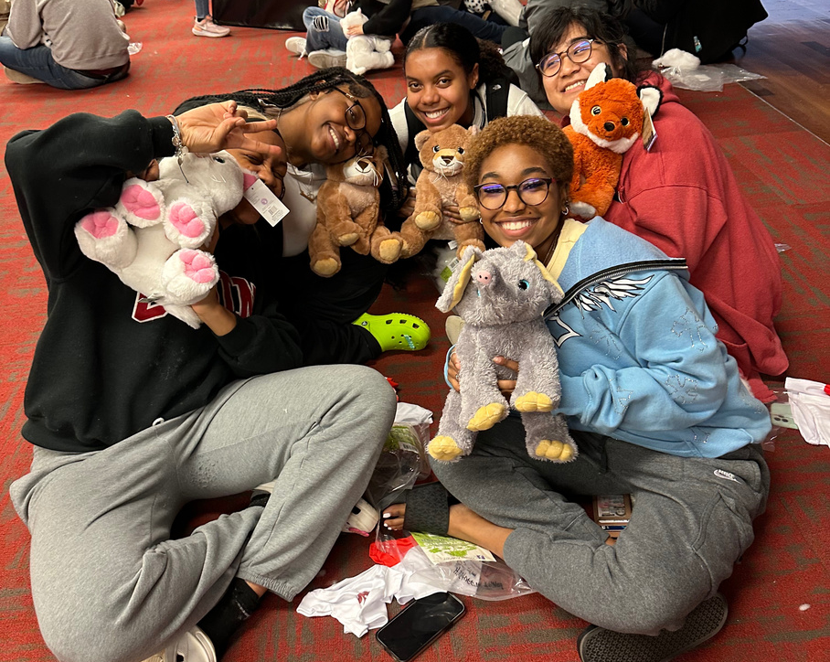
UH DSA Strategic Values
Innovation
SPB will provide programs and services that meet the evolving needs of our community. We embrace improvement, adaptability, and professional development through our programs.
Collaboration
SPB will build strength through creative innovation, research, and partnerships in everything we do
Integrity
We hold ourselves accountable for delivering exceptional programs, services, and facilities with care, honesty, and transparency about our processes and outcomes.

Slide 5
Organizational Structure
President
Advisor
Graduate Assistant
Vice President of Membership
VP of Marketing & Assessment
Cinema
Special Events
Outreach
Performances
Co-Chair
Co-Chair
Co-Chair
Co-Chair
Committee Members
Major Events
E-Sports
Co-Chair
Co-Chair

Slide 6
The SPB Board

Slide 7
SPB Exec Board
Jordan Porter
President
Anthropology
Class of 2025
Gwyneth Tan
Vice President of Marketing and Assessment
Strategic Communications
Class of 2025
Keyera Joseph
Vice President of Membership
Business Administration
Class of 2027

Slide 8
SPB Chairs
Madison Marshal
Major Events
Public Health
Class of 2025
Braeden Williams
E-Sports
Political Science Class of 2026
Trinity Drake
Cinema
Nursing
Class of 2025

Slide 9
SPB Chairs
Olivia Candelaria
Performances
Business
Class of 2027
Elaine Vo Outreach
Biology
Class of 2025
Cessabella Astraquillo
Special Events
Chemical Engineering
Class of 2026

Slide 10
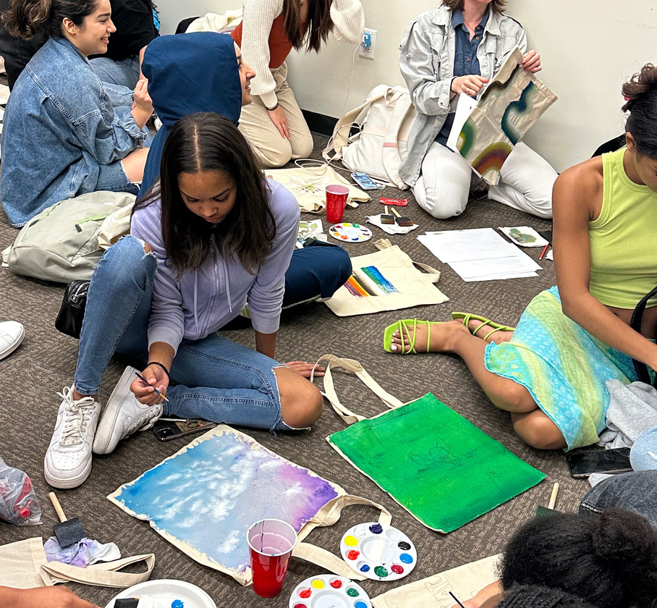
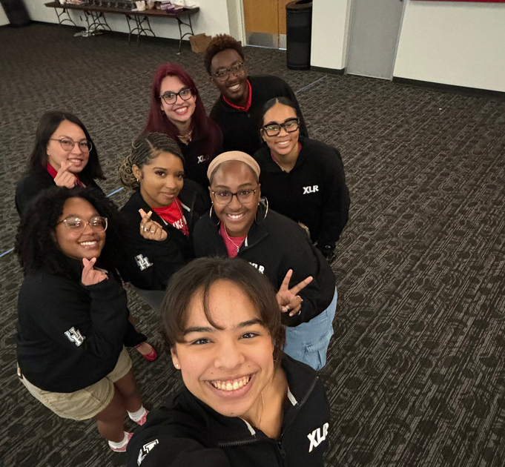
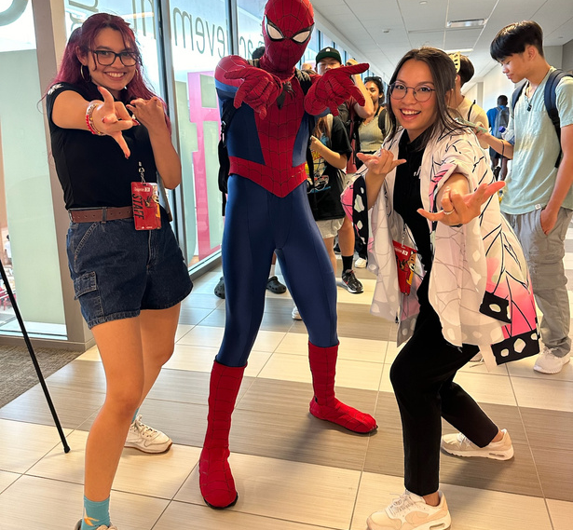
Unit Successes

Slide 11
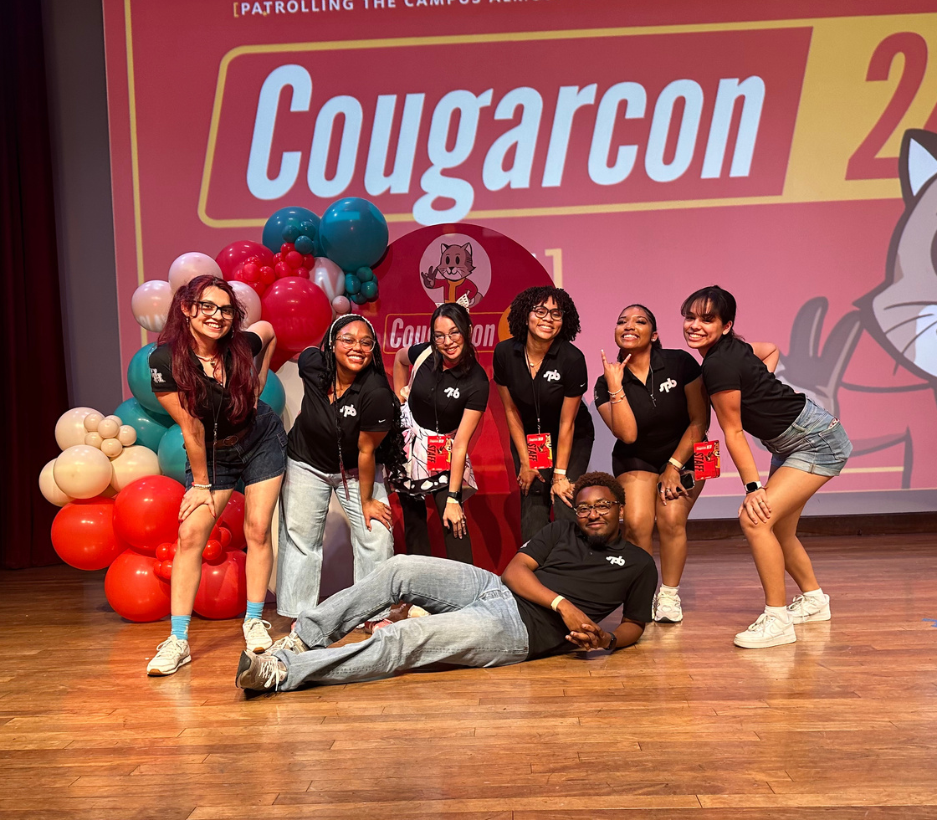
Unit Accomplishments
Board Retention & Expansion
Improved Marketing Approach and Execution
Increased Collaborations with other organizations and departments

Slide 12
SPB BOARD
COMPOSITION
The Board is made up of previous SPB Committee members, SPB volunteers, members who previously served on another USO, and NEW leaders
Started a new Co-Chair Program to offer new opportunities to committee members in hopes of gaining higher retention

Slide 13
IMPROVED
MARKETING
Utilized Instagram analytics to post about events during peak engagement times for increased student interaction
Placing marketing materials in high traffic areas on campus as well as targeting low traffic areas to reach new demographics
Implemented a system for SPB Chairs to bring their visions to life
Monthly surveys conducted seeing what is most effective and memorable and what can change and improve

Slide 14
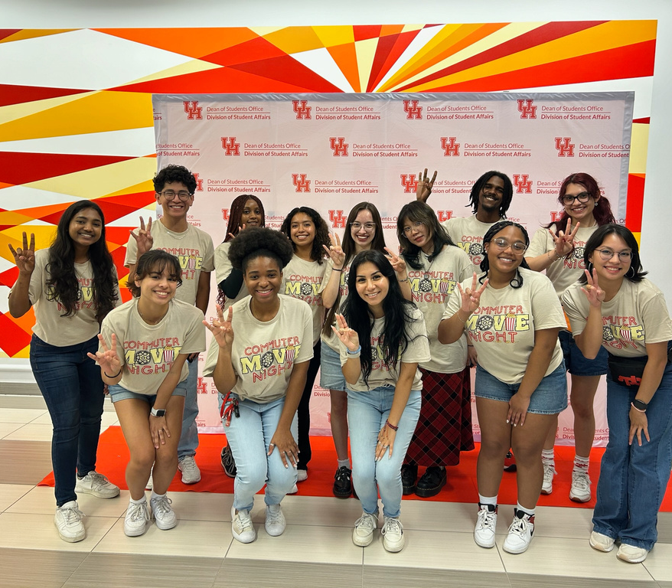
Collaborations
We have a goal of partnering with at least one campus organization per SPB event
Reaching out to other USOs for marketing collaborations and networking
In-person conversations
Social Media Sign-up links
Email relays

Slide 15
Unit Challenges

Slide 16
Unit Challenges
Adapting to Changing Student Preferences
Member Recruitment and Retention

Slide 17
Changing Student Preferences
Challenge
Solution One
Solution Two
Risk of event offerings becoming less appealing to the student body over time.
Conduct regular surveys to gather feedback and stay attuned to changing preferences.
Continuously monitor the current trends in media and among the student body.

Slide 18
Member Recruitment and Retention
Challenge
Solution One
Solution Two
Turnover due to changing student schedules
Develop mentorship and leadership programs to enhance volunteer engagement and commitment
Implement targeted recruitment strategies that emphasize the benefits of involvement.

Slide 19
2
4
FY Attendance
15,990
12,687
10,095
7,714
1,716

Slide 20
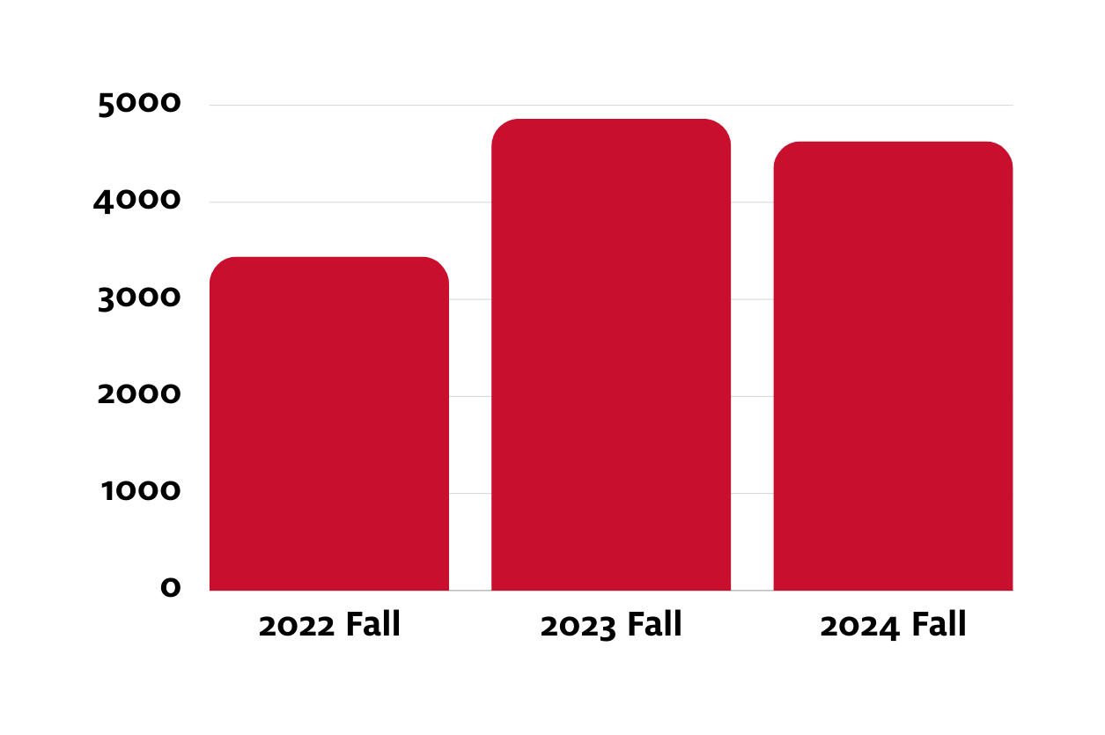
Attendance Comparison
4861
4629
Reasoning
3441
Planned events a month in advance
More collaborations
Implementation of a marketing strategy
Returning officers/members becoming an officer
*Doesn’t include Homecoming Concert

Slide 21
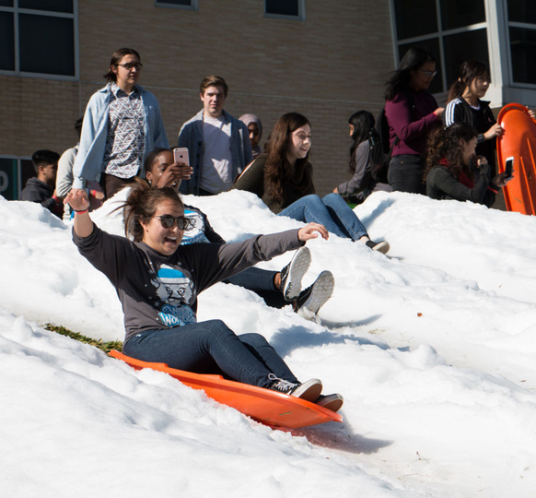
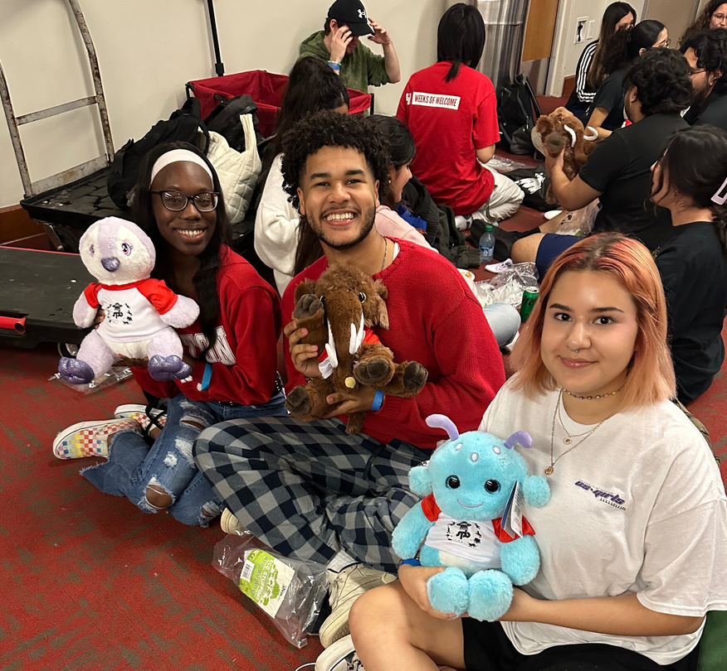
Major Events

Slide 22
COUGARCON
Second Annual Collaboration
SPBs first time collaborating on CougarCon with UH ESports, LARP at UH, COUGARCS, GCEAUH, Anime No Kai, and more (over 6 RSOs)
Increase in Attendance
CougarCon attandance increase from 1,100 in 2022 to 1,409 attendees in 2023 (28% increase) to 2,200+ in 2024 (48% Increase)
Event Components
Free food and drinks, an ESport tournament, cosplay contest, LARPing, Artist Alley (all student vendors), and standing games

Slide 23
Homecoming
Concert
Background Information
Homecoming Board Collaboration
Lynn Eusan Park Concert
Student Openers
2,109
1,387
1,213
826
Proposed Additions
Student Polls
Student Opener Outreach

Slide 24
Winter Wonderland
Background Information
15th annual event
Keeping tradition
T-Shirts, sledding
Proposed Additions
Collaboration with CCA
“Winter Around the World”
Different Merchandise
Expansion Area Location

Slide 25
Fiesta Concert
Background Information
Fiesta Partnership
Occurring since 1939
Top Attending SPB Event
Proposed Additions
Location Change
Student Polls

Slide 26
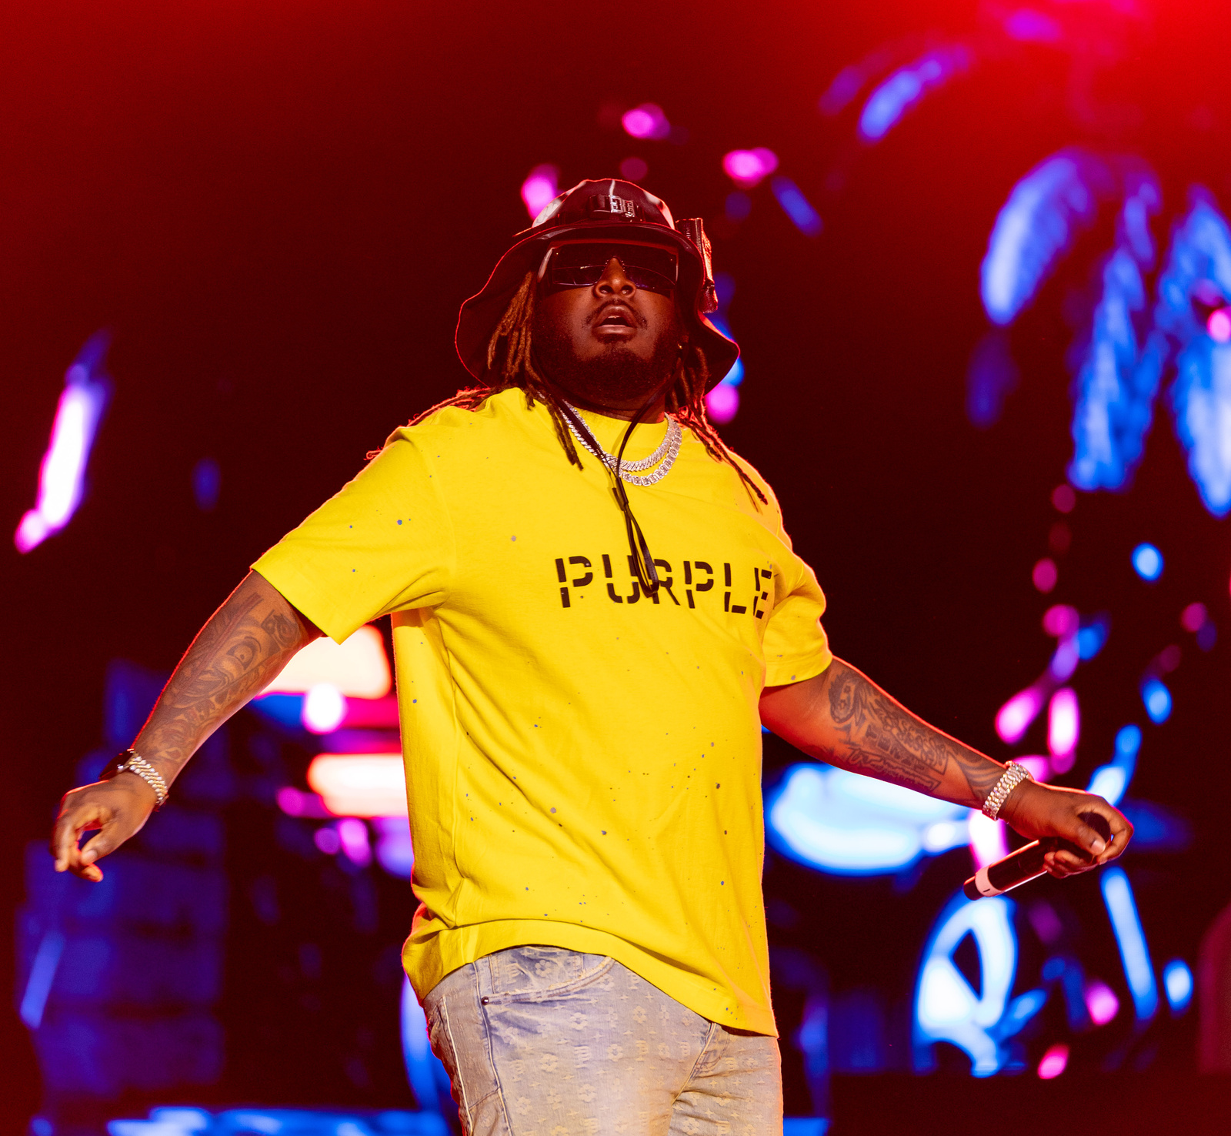
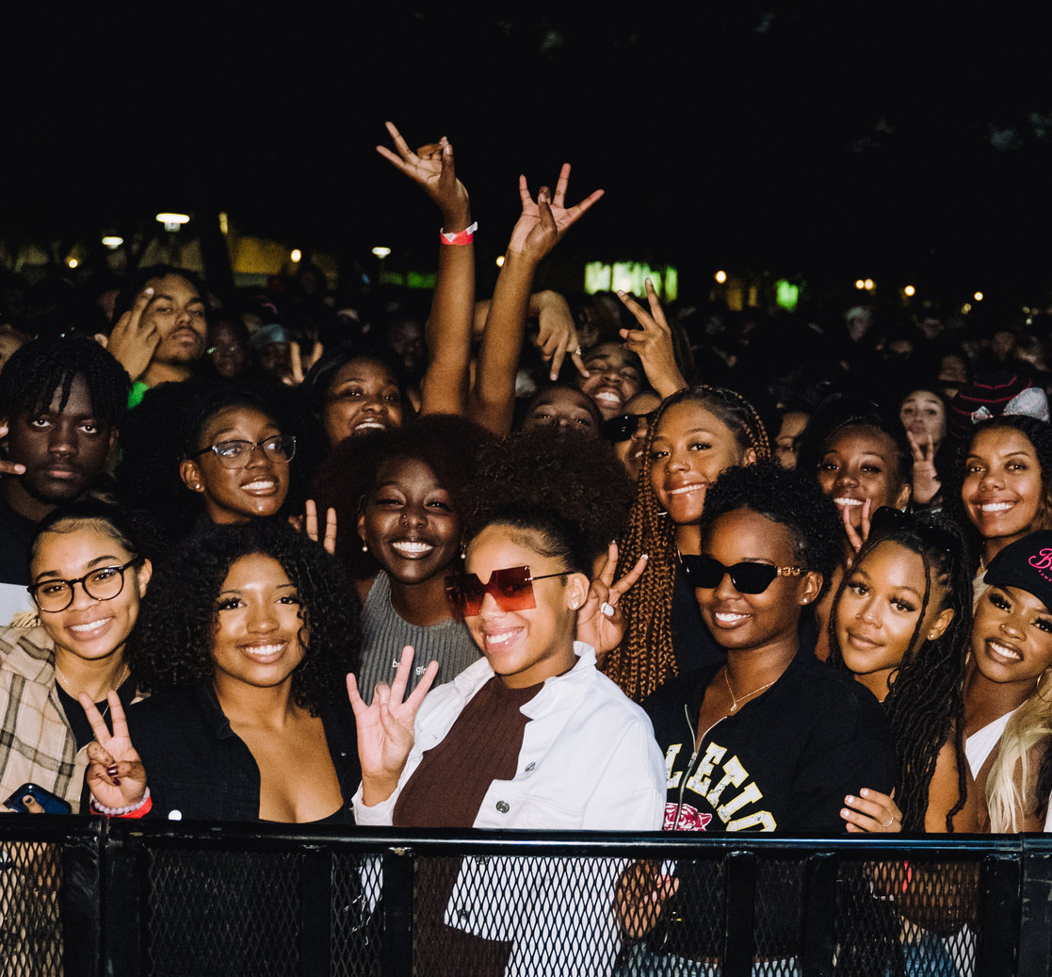
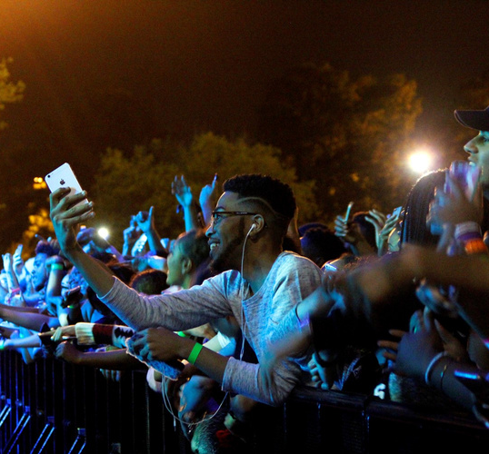
Requests Overview

Slide 27
BAR: HOMECOMING CONCERT

Slide 28
BAR: CINEMA PROGRAMMING BUDGET

Slide 29
BAR: FIESTA CONCERT

Slide 30
BAR: ESPORTS CHAIR POSITION

Slide 31
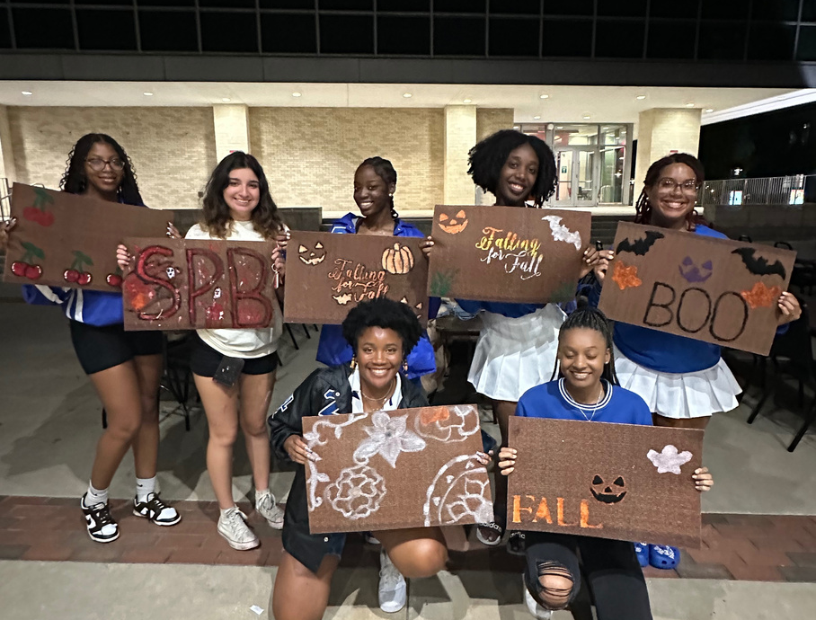
THE END
THANK YOU FOR YOUR TIME

