Slide 1
To promote health, wellness, and the pursuit of self-actualization through education, outreach, and prevention.
SFAC FY25 Presentation

Slide 3
95.7% of students agreed to strongly agree that “After attending this program, I feel more like am a part of the UH Community”
96.8% of students agreed to strongly agreed that “This event eased my stress”

Slide 4
“The extremely comfy rocking chair. I even fell asleep for an hour. I rarely nap. After I woke up, I felt well rested.”
“I like to space a lot. The chairs are very comfortable, I especially like the cushions so we can sit on the floor comfortably and work at the low table”
“I like how relaxing the lounge space is, the fun activities and the overall vibe and experience of the experience.”
“Learned about additional resources and various ways to address concerning situations and/or mental health statuses of students”
“Ways to talk to people who shows concerns of mental health not being well.”

Slide 5
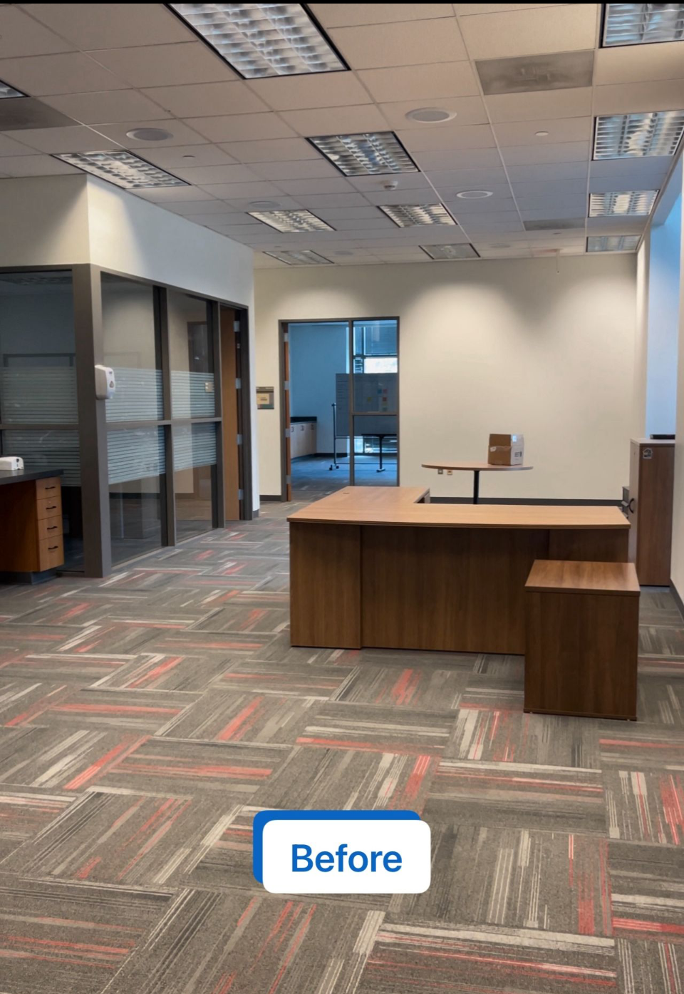
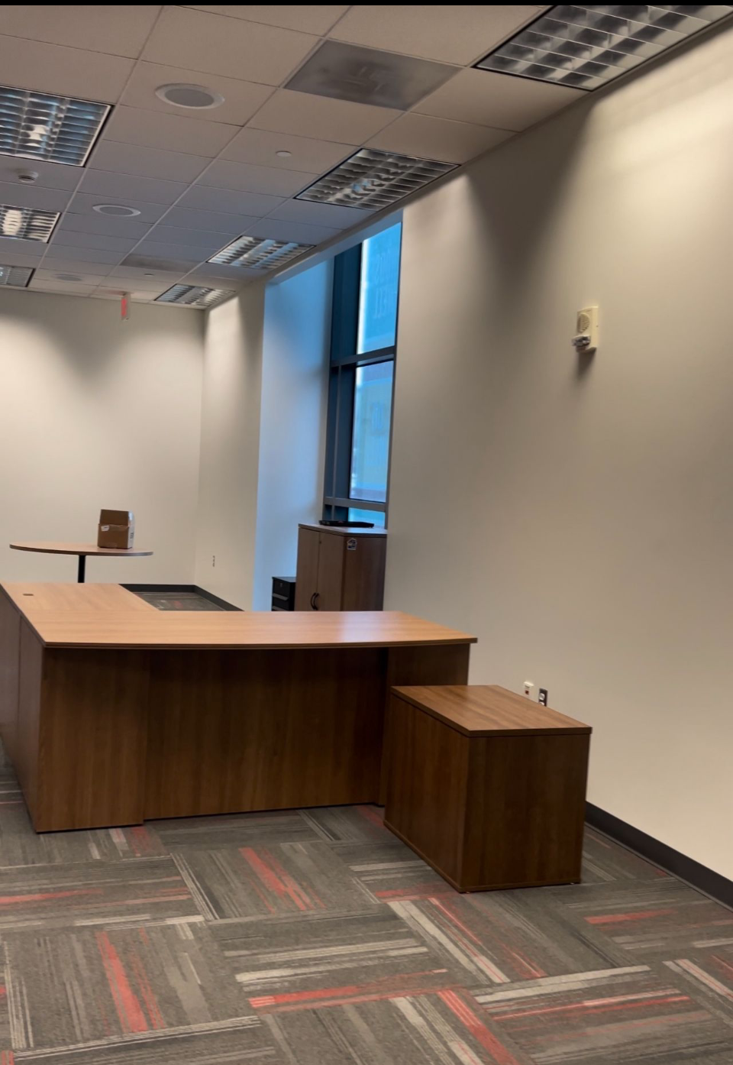
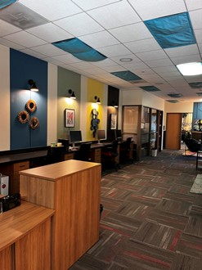
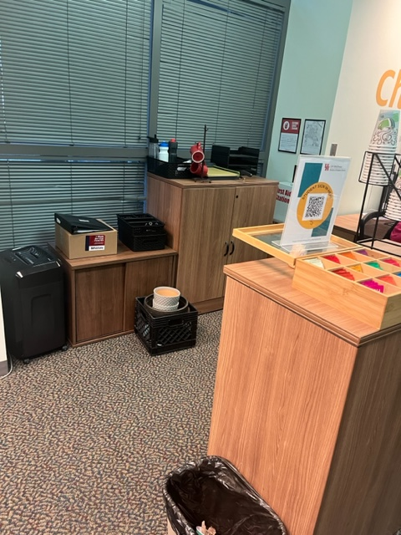
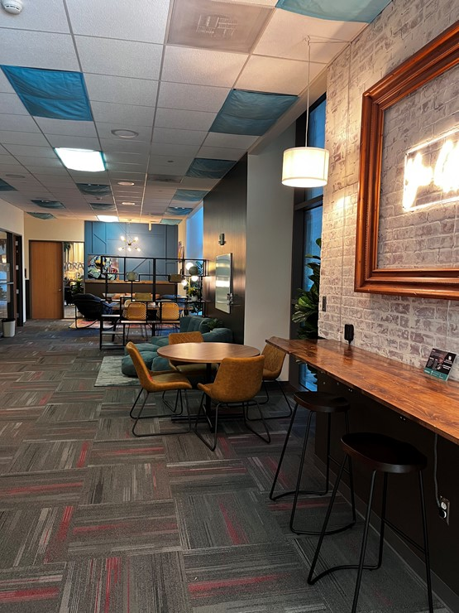
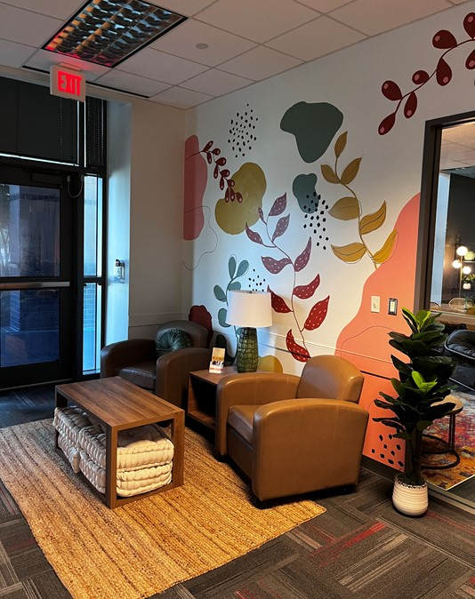
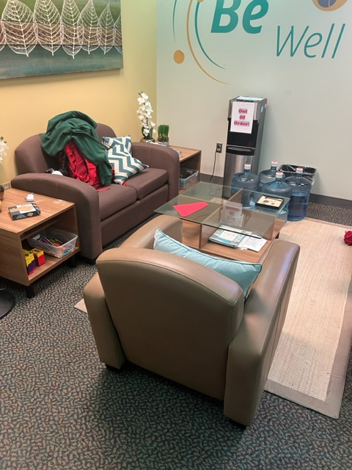
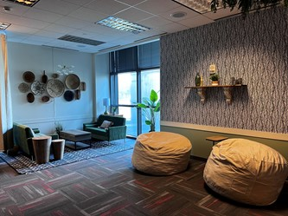
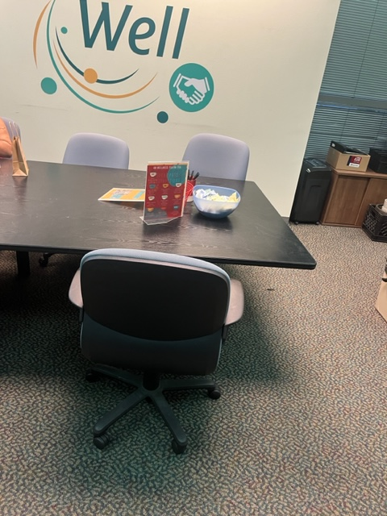
AFTER
BEFORE
UH Wellness

Slide 6
Challenges
Marketing and Communication
Peer Education
Role within Larger Campus

Slide 7
Needs
FY25 One Time Requests
 | Includes admin fee
Mental Health Programming | $7,685
Sexual Health Education Resources | $2,650
Total Ask | $10,335

Slide 8
Needs
 | Includes admin fee
Health Promotion and Peer Education Specialist | $75,514
Peer Education Professional Development | $2,120
Mental Health Programming | $7,685
Wellness Ambassadors Program | $2,120
Sexual Health Education Resources | $2,650
Mindfulness Space Furniture Lifecycling | $1,590
Total | $90.089
FY26 Base Augmentation
Requests

Slide 9
Budget

