Slide 1
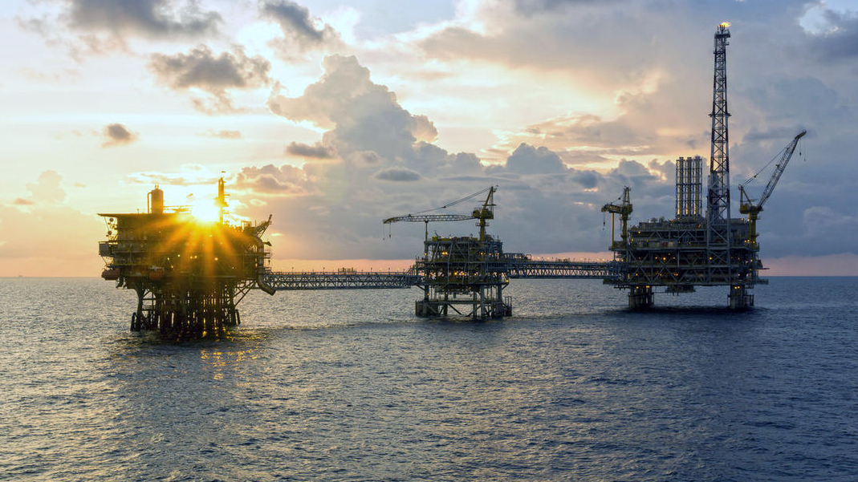


E&P Opportunities In India
Email :- facilitationoal@dghindia.gov.in Web: www.dghindia.gov.in
Phone- +91-120-2472000 Fax- +91-1202472049

Slide 2
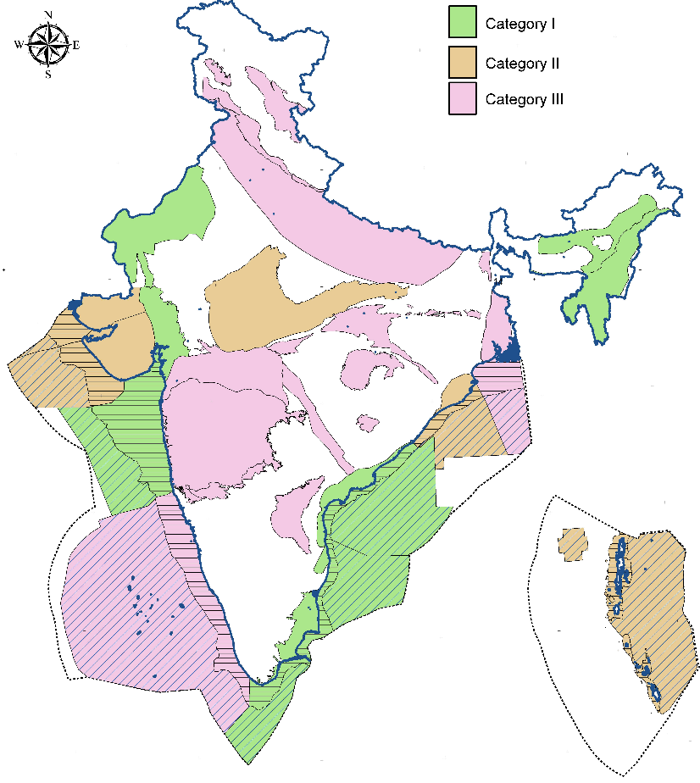
Indian Sedimentary Basins and Categories
26 sedimentary basins || 3.36 Million Sq. Km.
Basin Category Description
Basins Types
7 Commercially Producing Basins
Area: 1 Mn Sq Kms
Resource: 21,487 MMTOE
Category-I
1.32
million sq.km
5 Discovered Basins but not yet commercially developed
Area: 0.78 Mn Sq Kms
Resource: 1.951 MMTOE
Category-II
1.63
million sq.km
Category-III
14 Prospective Basins but Undiscovered
Area: 1.59 Mn Sq Kms
Resource: 1,543 MMTOE
0.41
million sq.km
Discovered Inplace
12.1 BTOE
Estimated
Ultimate Recovery
4.2 BTOE
Produced
2.6 BTOE
Geographical Area | Million sq.km
Mainland & Islands | 3.29
Exclusive Economic Zone | 2.36
Total Area | 5.65
Sedimentary Bain | 3.36
Total Inplace
25 BTOE
Undiscovered Risked Potential
12.9 BTOE
Yet-to-Find
(YTF)
3.9 BTOE
Reserve + Contingent Resources
1.6 BTOE

Slide 3
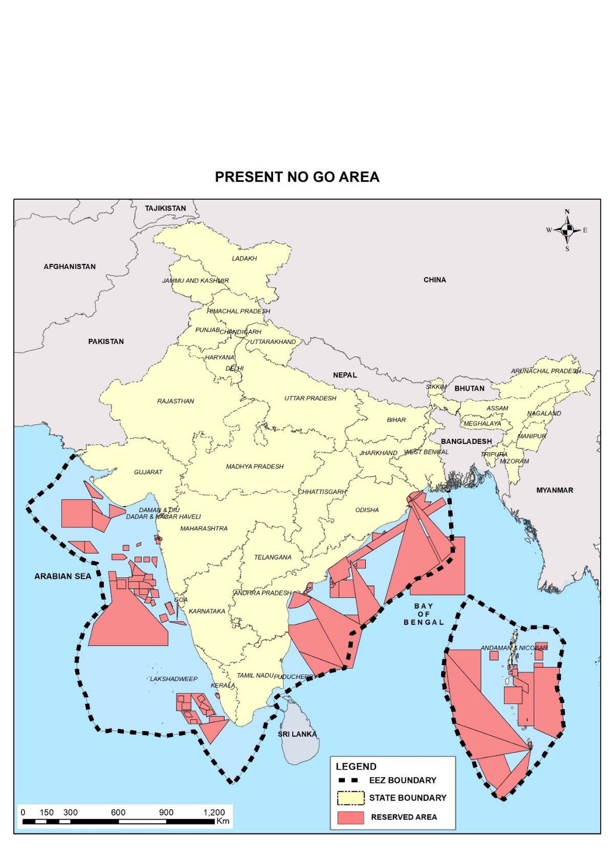
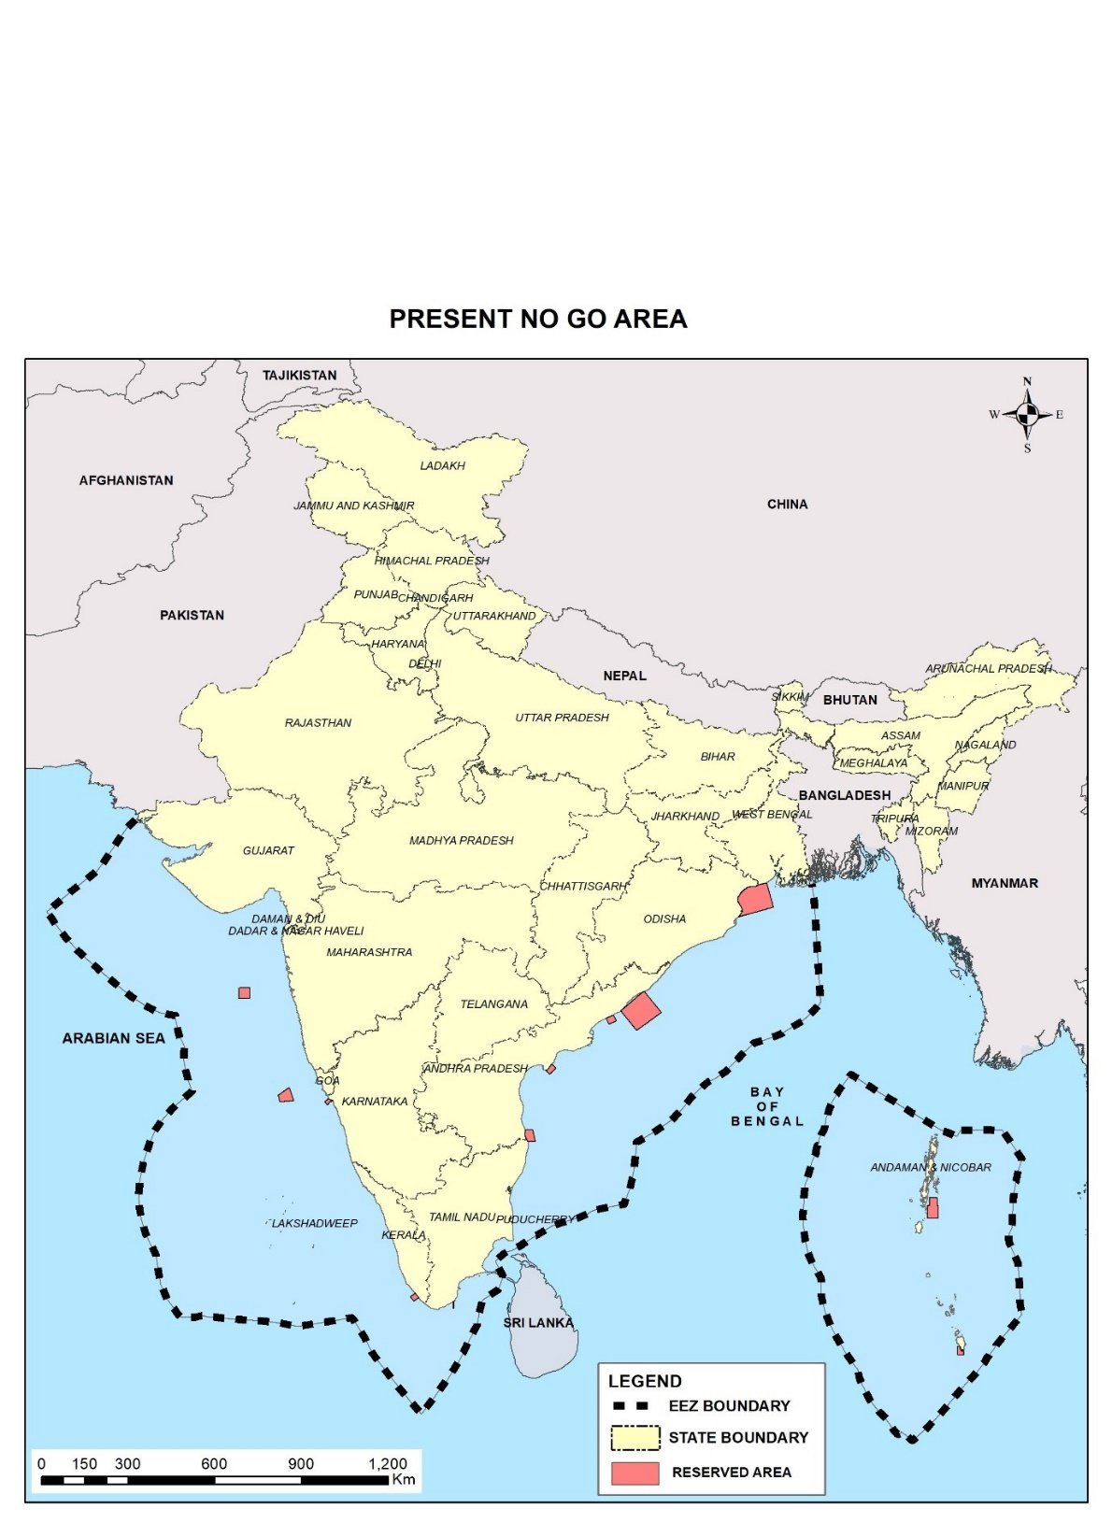
No-Go Areas Opened for E& P Activities
99% of earlier No-Go areas (~1 mn sq.km) opened for E&P
Earlier
Now

Slide 4
The Open Acreage Licensing Policy (OALP) EoI & Bidding Process
NDR Portal
EoI Portal
E-Bidding Portal
https://www.ndrdgh.gov.in/NDR/
https://online.dghindia.org/oal
https://ebidding.dghindia.gov.in/
Registration on NDR Portal to access G&G data
Unique Identification Numbers of the sectors (available in NDR portal)
Invitation of bids through NIO
Carving out blocks from the areas of interest
Online Payment of Application fee
Bidders Should have digital signature Certificate
Note Unique Identification (UID) Number
Participation Bond & Due-Diligence Report of Prospectivity
Bid Submission and Evaluation
Award of Contract

Slide 5
Current Opportunities

Slide 6
OALP Bid Round -IX
8 Blocks | Addl. 20 Expression of Interest received | ~ 1,35,000 + SQ KM Area
Till date 8 Blocks encompassing 41,860 sq. km. finalized
Additional 20 EoIs received covering ~ 95,000 sq.km. area under block finalization.
NIO for bid round IX to be floated shortly for International Competitive Bidding in the month of August’2023

Slide 7
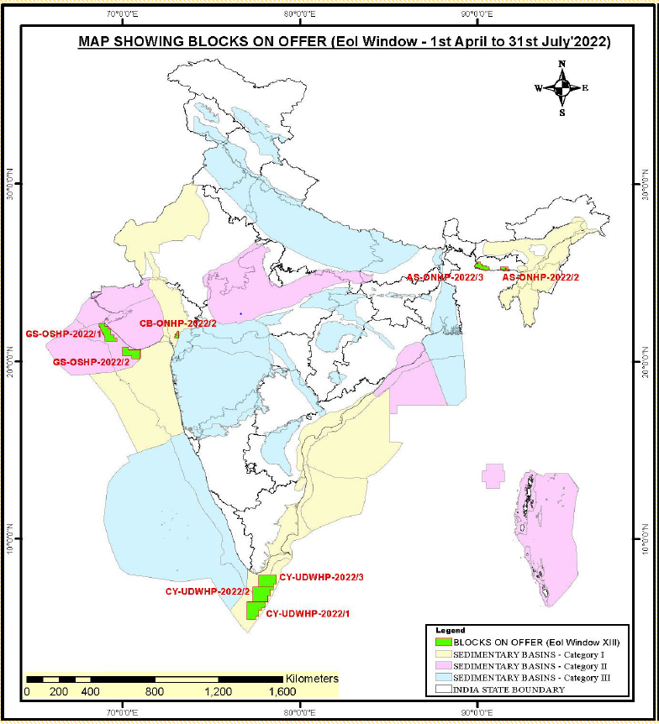
Bid Round -IX
List of Finalized 8 Blocks
S.N. | Basin Category | Basin | Name of Block | Area (SKM) | Type
1 | I | Cambay | CB-ONHP-2022/2 | 713.92 | Onland (3,666 SKM)
2 |  | Assam Shelf | AS-ONHP 2022/2 | 784.32
3 |  | Assam Shelf | AS-ONHP 2022/3 | 2,168.09
4 |  | Cauvery | CY-UDWHP-2022/1 | 9,514.63 | Ultra-Deep water (27,154 SKM)
5 |  | Cauvery | CY-UDWHP-2022/2 | 9,844.72
6 |  | Cauvery | CY-UDWHP-2022/3 | 7,795.45
7 | II | Saurashtra | GS-OSHP-2022/1 | 5,585.61 | Deep Water (11,039 SKM)
8 |  | Saurashtra | GS-OSHP-2022/2 | 5,453.96
Total Area |  |  |  | 41,860.7
Blocks under Finalization
Additional 20 EoIs received covering ~95,000 sq.km. in East Coast Basins like Krishna-Godavari & Mahanadi and West Coast Basins like Saurashtra, Kutch, Mumbai etc.

Slide 8
Blocks
in
Category – I Basins

Slide 9
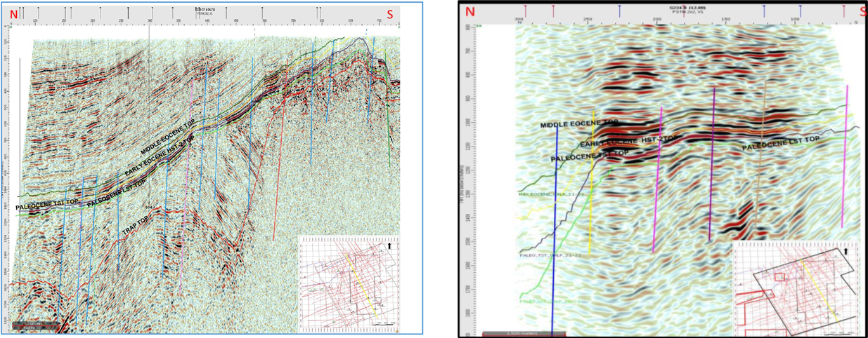
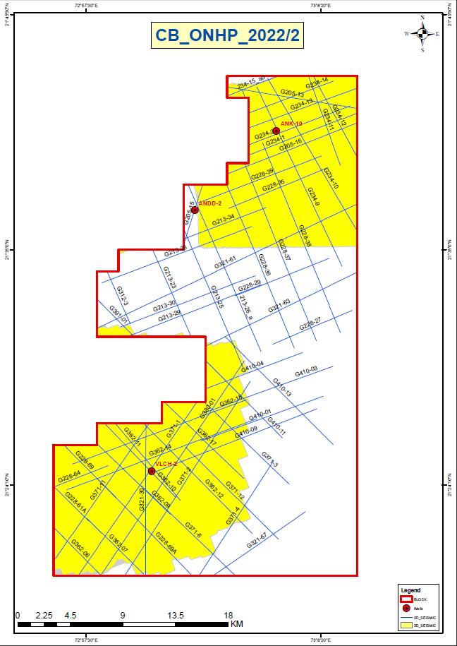

Cambay Basin
Block Name: CB-ONHP-2022/2
Block Area: 714 SQ KM
CB-ONHP-2022/2
Representative Seismic Section
Base Map
Petroleum System:
Source rock:- Cambay Shale, shale of the Ankleshwar/ Kalol Formation and Tarapur Shale
Reservoir:- Olpad Formation and Sandstone of Middle/Late Eocene
Entrapment mechanism:- Structural and Stratigraphic Traps
Envisaged Petroleum system: Paleocene, Early Eocene and Middle Eocene- Paleocene, Early Eocene and Middle Eocene
Data Availability
2D (LKM) | 3D (SKM) | Exp. Well
641 | 418 | 3
Target plays: Middle Eocene along with Paleocene LST and Early Eocene

Slide 10
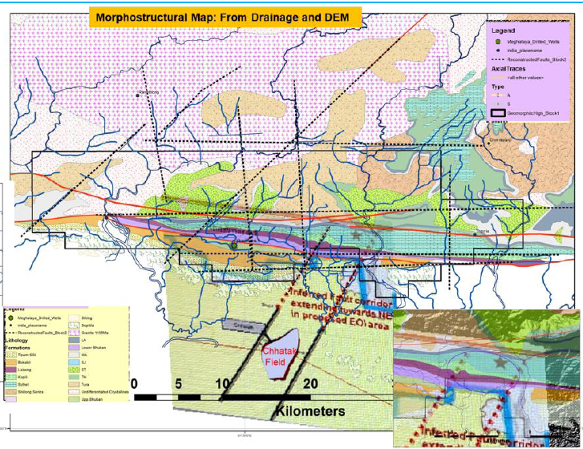
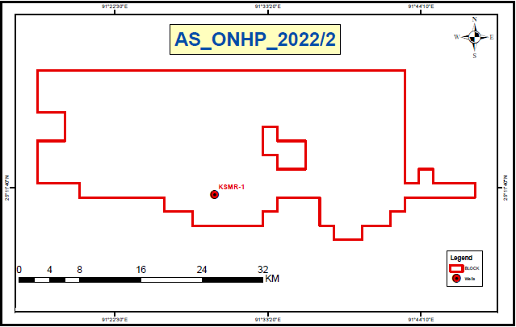
Assam Shelf Basin
Block Name: AS-ONHP-2022/2
Block Area: 784 SQ KM
AS-ONHP-2022/2
Base Map
Conceptual model for the area
Petroleum System:
Source rock:- Kopili, Sylhet and Tura formations
Reservoir:- The sandstone reservoirs within Tura, Sylhet, Kopili, Barail and Bhuban formations are probably sheet to discrete lenticular bodies
Entrapment mechanism:- Structural trap
Envisaged Petroleum system: Petroleum system envisaged are (i) Paleocene- Eocene: Tura- Sylhet- Kopili (ii) Oligo-Miocene Play: Barail-Bhuban play
Data Availability
2D (LKM) | 3D (SKM) | Exp. Well
0 | 0 | 1
Target plays: Paleocene & Oligo-Miocene sequences

Slide 11
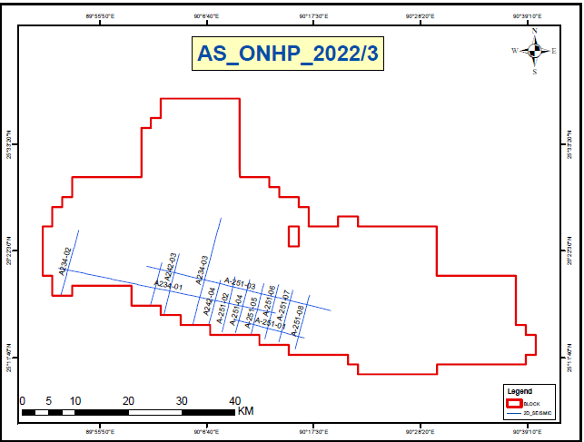
Assam Shelf Basin
Block Name: AS-ONHP-2022/3
Block Area: 2,168 SQ KM
AS-ONHP-2022/3
Base Map
Representative Seismic Section
Petroleum System:
Source rock:- Kopili, Sylhet and Tura formations
Reservoir:- The sandstone reservoirs within Tura, Sylhet, Kopili, Barail and Bhuban formationsare probably sheet to discrete lenticular bodies
Entrapment mechanism:- Structural trap
Envisaged Petroleum system: Petroleum system envisaged are (i) Paleocene- Eocene: Tura- Sylhet- Kopili (ii) Oligo-Mio Play: Barail-Bhuban play
Data Availability
2D (LKM) | 3D (SKM) | Exp. Well
206 | 0 | 0
Target plays: Paleocene & Oligo-Miocene sequences

Slide 12
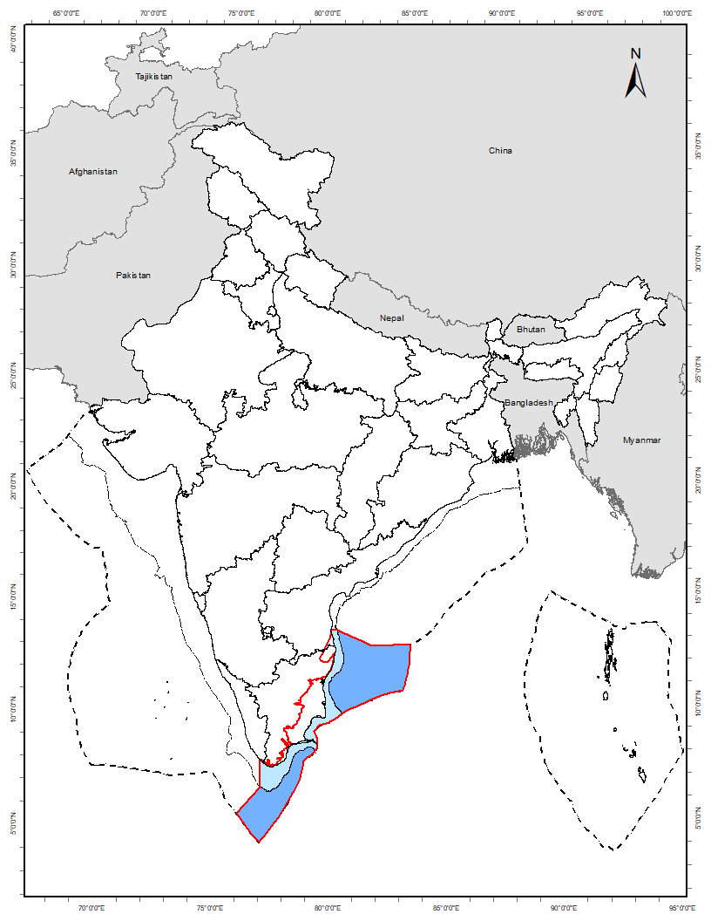
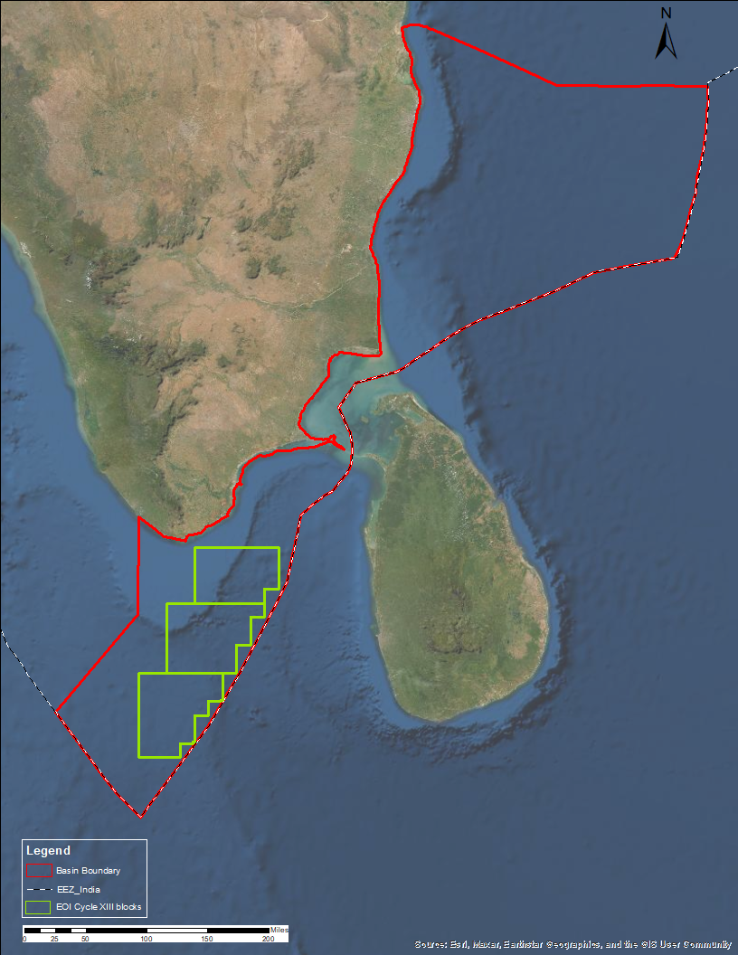
Cauvery Basin
Proven resources in Mesozoic and Basement
3 Blocks
3
CY-UDWHP-2022/3
Onland | Offshore
Deep | Shallow
Discovered|
Undiscovered
CY-UDWHP-2022/2
2
1
CY-UDWHP-2022/1
Basin's risked resource potential – 1,139 MMTOE
Area| 27,155 sq km
Known
01 MIOCENE
0
02 OLIGOCENE
Key characteristics
03 PALEOCENE-EOCENE
Basin with significant production from Mesozoic and Basement
Deep-to-Ultradeep water largely appraised but less explored
Opportunity to explore Ultradeep in the north-east and southern part towards Gulf of Mannar
04 CRETACEOUS_ LATE_CAMPANIAN-MAASTRICHTIAN
7
05 CRETACEOUS_LATE_SANTONIAN
Proven
06 CRETACEOUS_ LATE_CENOMANIAN-TURONIAN
07 CRETACEOUS_EARLY
08 JURASSIC
09 ARCHEAN_BASEMENT
Discovered_MMTOE
Undiscovered_MMTOE

Slide 13
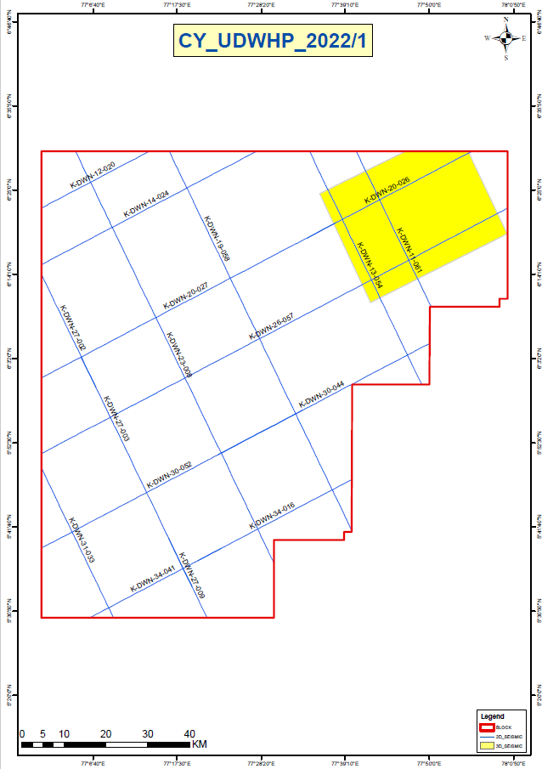
Cauvery Basin
Block Name: CY-UDWHP-2022/1
Block Area: 9,515 SQ KM
Petroleum System:
Source rock: Late Jurassic to Early Cretaceous sequences
Reservoir: Late synrift sequences, Lowstand sequences during Turonian, Late Coniacian-Santonian, Late Maastrichtian and Late Paleocene would result in the deposition of clastic reservoir facies in the Sub-Basin in the form of slope fans & basin floor fans.
Entrapment Mechanism: Fault closure , stratigraphic drape over structural highs, pinch-out traps and channel fills.
Envisaged plays: Basement, Cretaceous & Older and Tertiary play.
Thermogenic Petroleum System:
Middle Jurassic – Jurassic, Early Cretaceous, Late Cretaceous (?)
Early Cretaceous – Early Cretaceous, Late Cretaceous (?)
Late Cretaceous – Late Cretaceous (?)
Biogenic Petroleum System:
Oligocene – Oligocene (?)
CY-UDWHP-2022/1
Location Map
Representative Seismic Section
CY-UDWHP-2022/1
Data Availability
2D (LKM) | 3D (SKM) | Exp. Well
1002 | 988 | Nil
Proven
Target plays: Paleocene, Cretaceous & Basement/ Technical basement
Base Map

Slide 14
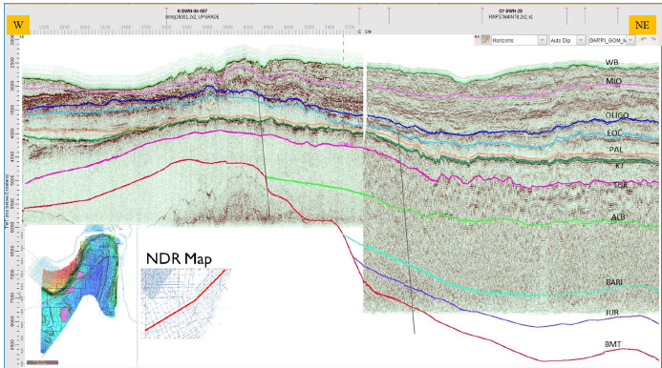
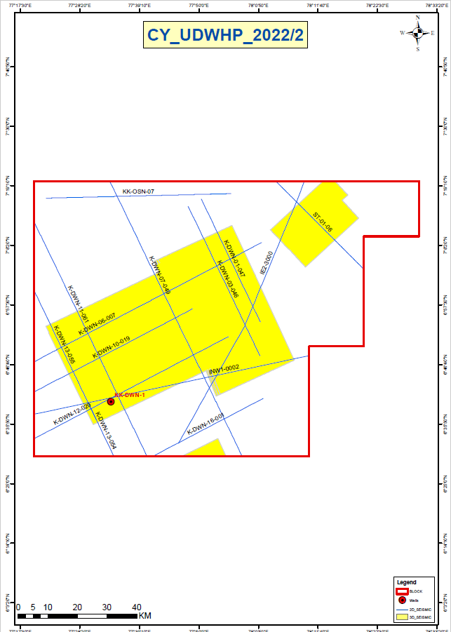
Cauvery Basin
Block Name: CY-UDWHP-2022/2
Block Area: 9,845 SQ KM
Petroleum System:
Source rock: Late Jurassic to Early Cretaceous sequences
Reservoir: Late synrift sequences, Lowstand sequences during Turonian, Late Coniacian-Santonian, Late Maastrichtian and Late Paleocene would result in the deposition of clastic reservoir facies in the Sub-Basin in the form of slope fans & basin floor fans.
Entrapment Mechanism: Fault closure , stratigraphic drape over structural highs, pinch-out traps and channel fills.
Envisaged plays: Basement, Cretaceous & Older and Tertiary play.
Thermogenic Petroleum System:
Middle Jurassic – Jurassic, Early Cretaceous, Late Cretaceous (?)
Early Cretaceous – Early Cretaceous, Late Cretaceous (?)
Late Cretaceous – Late Cretaceous (?)
Biogenic Petroleum System:
Oligocene – Oligocene (?)
CY-UDWHP-2022/2
Location Map
Representative Seismic Section
CY-UDWHP-2022/2
Data Availability
2D (LKM) | 3D (SKM) | Exp. Well
892 | 2811 | 1
Proven
Target plays: Paleocene, Cretaceous & Basement/ Technical basement
Base Map

Slide 15
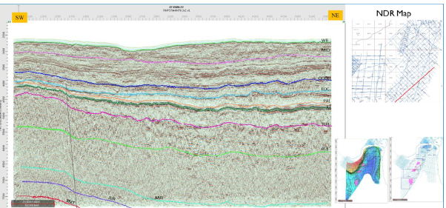
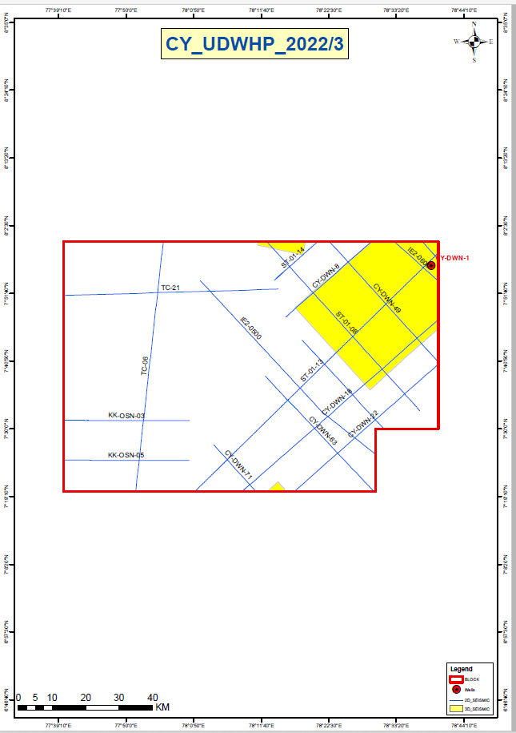
Cauvery Basin
Block Name: CY-UDWHP-2022/3
Block Area: 7,795 SQ KM
Petroleum System:
Source rock: Late Jurassic to Early Cretaceous sequences
Reservoir: Late synrift sequences, Lowstand sequences during Turonian, Late Coniacian-Santonian, Late Maastrichtian and Late Paleocene would result in the deposition of clastic reservoir facies in the Sub-Basin in the form of slope fans & basin floor fans.
Entrapment Mechanism: Fault closure , stratigraphic drape over structural highs, pinch-out traps and channel fills.
Envisaged plays: Basement, Cretaceous & Older and Tertiary play.
Thermogenic Petroleum System:
Middle Jurassic – Jurassic, Early Cretaceous, Late Cretaceous (?)
Early Cretaceous – Early Cretaceous, Late Cretaceous (?)
Late Cretaceous – Late Cretaceous (?)
Biogenic Petroleum System:
Oligocene – Oligocene (?)
CY-UDWHP-2022/3
Representative Seismic Section
Location Map
CY-UDWHP-2022/3
Data Availability
2D (LKM) | 3D (SKM) | Exp. Well
894 | 1444 | 1
Proven
Target plays: Eocene, Paleocene & Cretaceous
Base Map

Slide 16
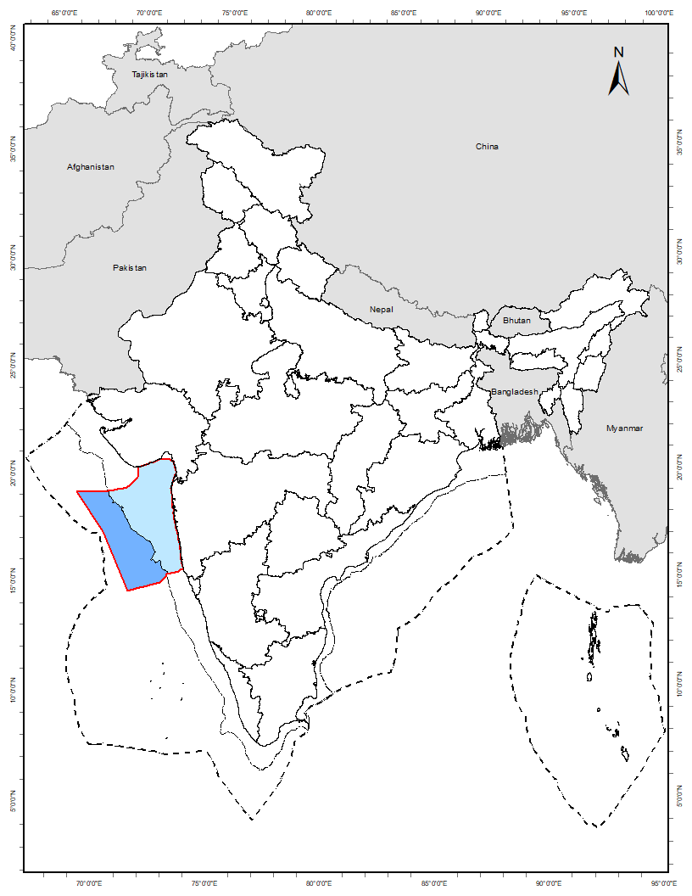
Mumbai Basin (Blocks under Finalization)
Mostly discovered, Mesozoic an opportunity
2
Onland | Offshore
Deep | Shallow
Discovered|
Undiscovered
1
Basin's risked resource potential – 2,377 MMTOE
Known
01 PLEISTOCENE-RECENT_BIOGENIC
Key characteristics
03 MIOCENE_LATE_BIOGENIC
02 PLIOCECE_BIOGENIC
1
The basin has discovered resources of 4.8 BTOE, producing half of country’s oil and gas
Opportunity to chase prospective plays (Paleocene and Eocene) towards deepwater
Opportunity to explore Sub-basalt Mesozoic Play at a deeper depth (3,000m+)
04 MIOCENE_MIDDLE
05 MIOCENE_EARLY
06 OLIGOCENE_LATE
Proven
07 OLIGOCENE_EARLY
08 EOCENE_MIDDLE_LATE
09 PALEOCENE-EOCENE_EARLY
10 CRETACEOUS_LATE_ BASEMENT-BASALCLASTIC

Slide 17
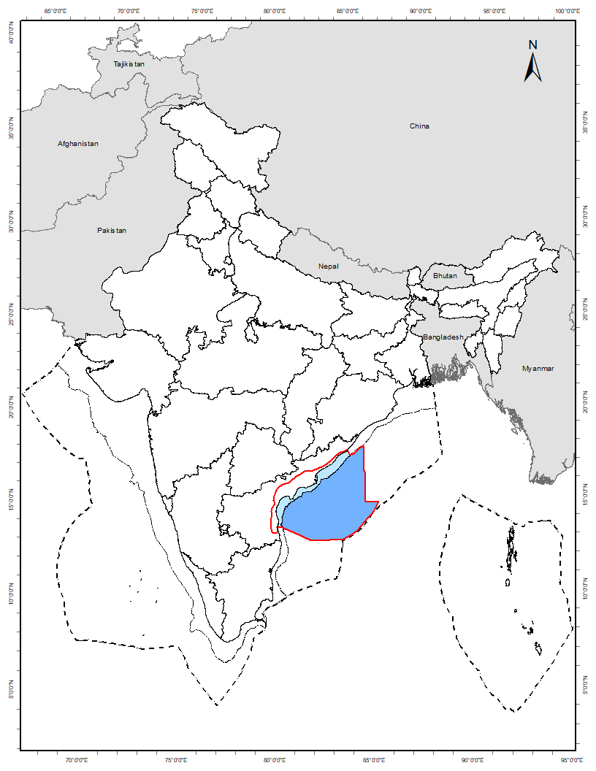
Krishna-Godavari Basin (Blocks under Finalization)
Most prospective, largely proven
1
Onland | Offshore
Deep | Shallow
Discovered|
Undiscovered
Basin's risked resource potential – 2,796 MMTOE
Known
12 ARCHEAN_BASEMENT
0
01 PLIOCENE_BIOGENIC
580
606
02 PLIOCENE_THERMOGENIC
284
732
03 MIOCENE_BIOGENIC
228
236
Key characteristics
04 MIOCENE_THERMOGENIC
168
163
Maximum resources, known for country’s largest deepwater biogenic gas field
With 2.0 BTOE resource established, proven plays have significant prospective resources
Deep/shallow water extensively appraised with large-scale datasets, an opportunity for intensive exploration of channelized deposits
05 EOCENE
Proven
06 PALEOCENE
07 CRETACEOUS_LATE
08 CRETACEOUS_EARLY
09 JURASSIC_LATE
502
505
10 TRIASSIC
11 PERMIAN
Discovered_MMTOE
Undiscovered_MMTOE

Slide 18
Blocks
in
Category – II Basins

Slide 19
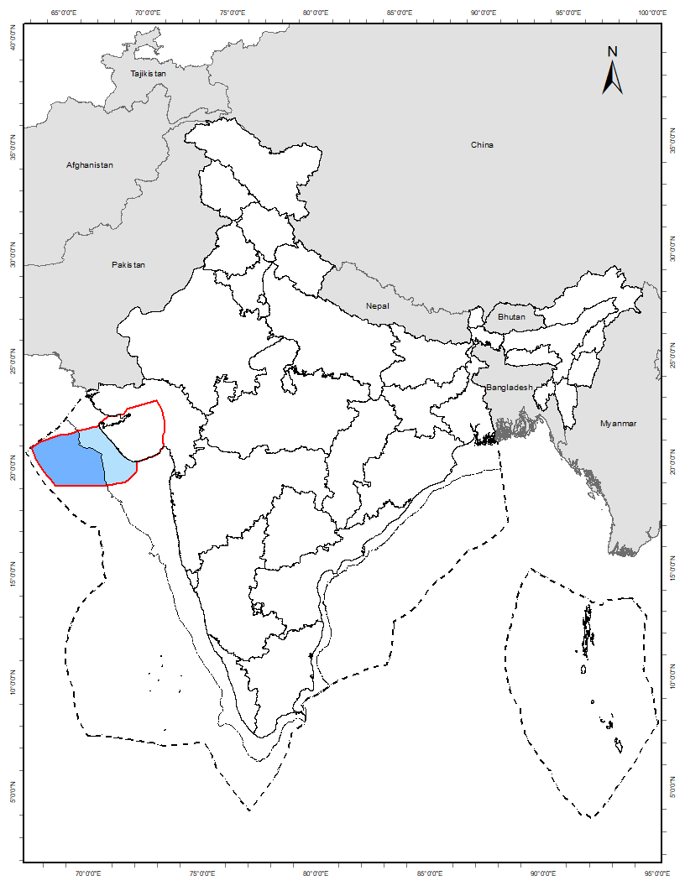
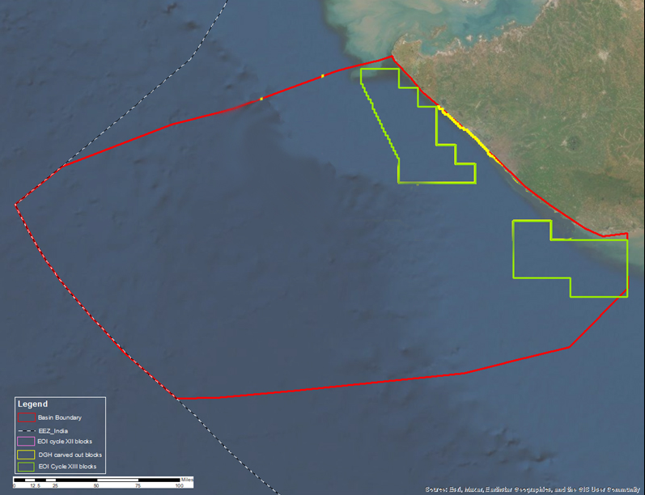
Saurashtra Basin
Significant sub-basalt Mesozoic discovery
2 Blocks
Gas Discovery
1
GS-OSHP-2022/1
2
GS-OSHP-2022/2
Onland | Offshore
Deep | Shallow
Discovered|
Undiscovered
Basin's risked resource potential - 198 MMTOE
Area| 11,039 sq km
Gas Discovery
Gas Discovery
01 MIOCENE_MIDDLE_CLASTIC
7
03 EOCENE_EARLY_CARBONATE
04 PALAEOCENE_CLASTIC
Key characteristics
Known
05 PALAEOCENE_CARBONATE
8
06 PALEOCENE_WEATHERED_BASALT
22
Presence of prospective plays of Middle Jurassic to Early Cretaceous
A significant gas discovery in Early Cretaceous reservoirs at 4,500m depth, below 2,500m thick weathered basalt
Extended proven Tertiary Plays of Kutch basin are potential target
07 CRETACEOUS_LATE_CLASTIC
5
08 CRETACEOUS_LATE_CARBONATE
3
11 JURASSIC_MIDDLE_UPPER
17
02 EOCENE_EARLY_CLASTIC
34
7
Proven
09 CRETACEOUS_EARLY
10 JURASSIC_LATE
36
16
12 JURASSIC_MIDDLE_LOWER
67
Discovered_MMTOE
Undiscovered_MMTOE

Slide 20
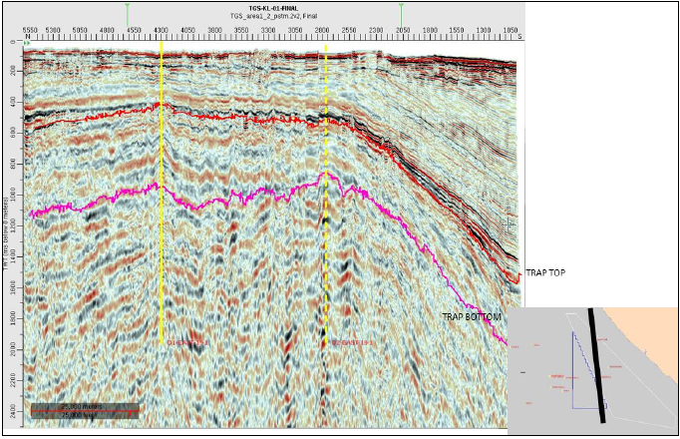
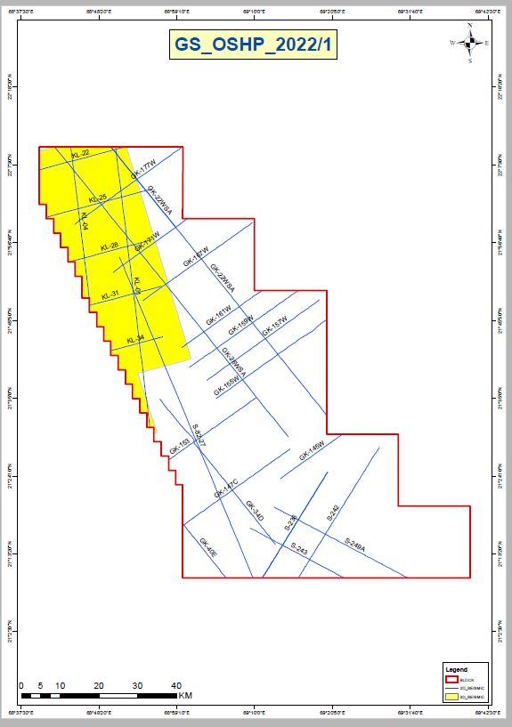
Saurashtra Basin
Block Name: GS-OSHP-2022/1
Block Area: 5,586 SQ KM
Petroleum System:
Source rock: Mesozoic
Reservoir: Late Jurassic, Cretaceous, Eocene-Early Miocene, Fractured Basalt
Seal: Basalt/Shale
Entrapment Mechanism: Strati-Structural & Structural
Envisaged plays: Jurassic, Cretaceous Plays dominantly strati-structural as wedge out against Trap bottom is present in drilled well.
Envisaged Petroleum system: Petroleum system envisaged is Jurassic-Jurassic, Jurassic-Cretaceous, Cretaceous-Cretaceous.
GS-OSHP-2022/1
Location Map
Representative Seismic Section
GS-OSHP-2022/1
Data Availability
Proven
2D (LKM) | 3D (SKM) | Exp. Well
1030 | 1369 | Nil
Target plays: Clastic Mesozoic sediments capped by Deccan basalt.
Base Map

Slide 21
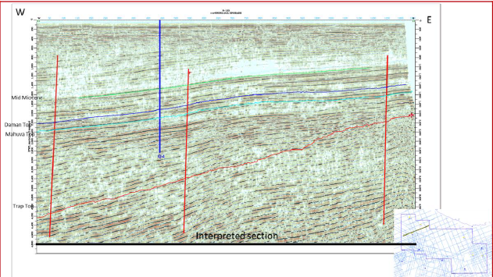
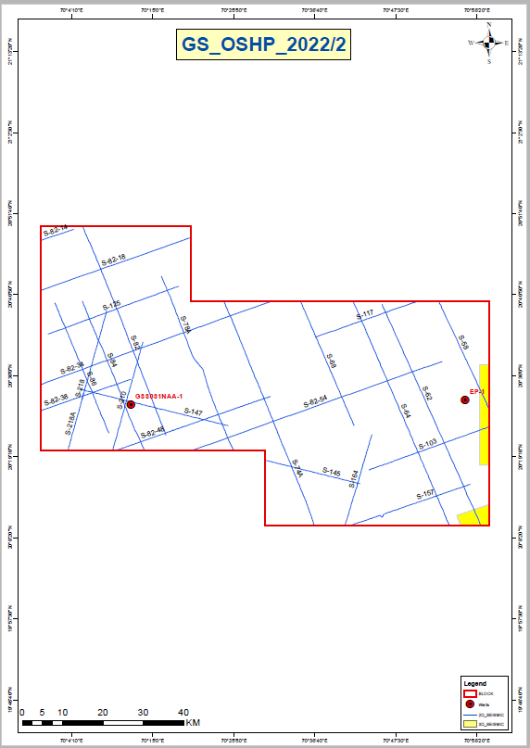
Saurashtra Basin
Block Name: GS-OSHP-2022/2
Block Area: 5,454 SQ KM
Petroleum System:
Source rock: Palaeogene shales of syn-rift stage deposited in the paleo-lows
Reservoir: Oligocene- Miocene section in form of limestones
Seal: Basalt/Shale
Entrapment Mechanism: Structural
Envisaged plays: Early Miocene carbonates, Late Oligocene carbonates
Envisaged Petroleum system: Eocene-Oligocene-Miocene carbonate Play
GS-OSHP-2022/2
Location Map
Representative Seismic Section
GS-OSHP-2022/2
Data Availability
Proven
2D (LKM) | 3D (SKM) | Exp. Well
912 | 56 | 2
Target plays: Early Miocene carbonates, Late Oligocene carbonates.
Base Map

Slide 22
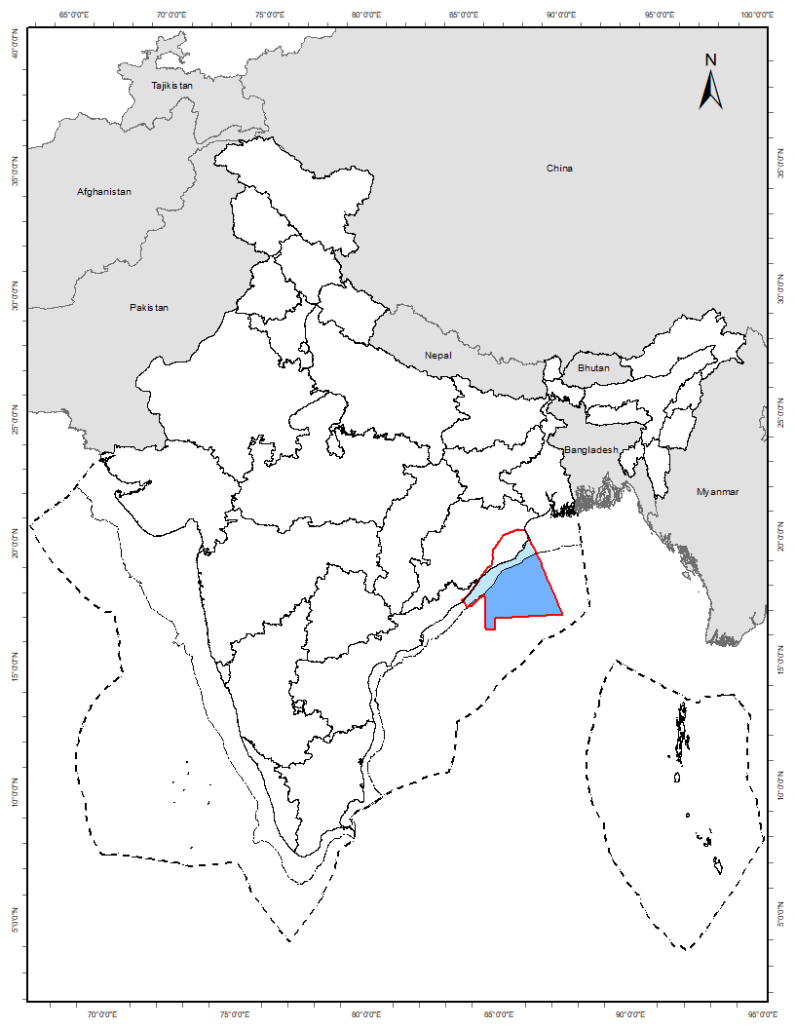
Mahanadi Basin (Blocks under Finalization)
Significant resource in Mio-Pliocene
Onland | Offshore
Deep | Shallow
Discovered|
Undiscovered
Basin's risked resource potential – 299 MMTOE
Known
08 CRETACEOUS
Key characteristics
01 PLIOCENE
02 MIOCENE
Strong analogy with easterly Bengal offshore that has numerous small-to-medium discoveries
Discovered Miocene play occurs as discrete and stacked reservoirs
Opportunity to explore significant prospective resource of Pliocene Play
03 MIOCENE_MIDDLE_BIOGENIC
Proven
04 MIOCENE_MIDDLE_THERMOGENIC
05 OLIGOCENE
06 EOCENE
07 PALEOCENE
3
Discovered_MMTOE
Undiscovered_MMTOE

Slide 23


Key Touch Points for Facilitation
Ministry of Petroleum and Natural Gas
Directorate General of Hydrocarbons
Website- http://petroleum.nic.in/
Contact us: https://mopng.gov.in/en/about-us/phone-directory
Website- https://dghindia.gov.in/
Contact us: http://dghindia.gov.in/contact_english.php
Get in touch at "investOnG@gov.in"
Hydrocarbon Exploration and Licensing Policy OALP Bid Rounds
National Data Repository
Website- http://online.dghindia.org/oalp/
Facilitation Desk Email: Facilitationoal@dghindia.gov.in
Website: https://www.ndrdgh.gov.in/NDR/
Email: indr@dghindia.gov.in

